Slide 1
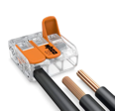
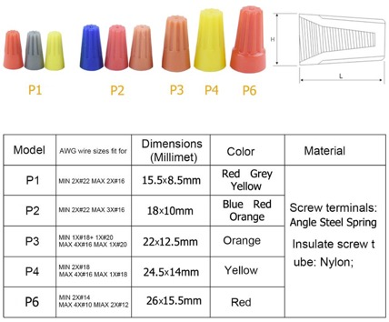
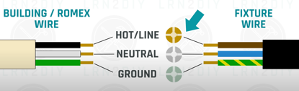


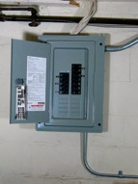
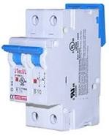




Electric Work
Maximum current in cables (in Amperes):
gauge\len 50ft 100ft 150ft
16 1-13 1-10
14 white 14-15 11-13 1-7
12 yellow 16-20 14-15 8-10
10 orange 16-20 16-20 11-15
8 black up to 40
6 up to 55
Cable types:
NM-cable = Non-metallic (a.k.a Romex cable):
AC-cable = Armored Cable (a.k.a. BX cable) – flexible metallic sheathing.
UF-cable = Underground Feeder Cable – outdoors, underground. Non-metalic, solid plastic sheathing, gray color.
Metal-Clad Cable - running through unfinished areas like basements.
Wires inside cables:
- one hot (black or red)
- one neutral (white)
- one bare ground
Twist Wire Connectors
(a.k.a. marettes, wing nuts, wire caps, wire twists)
WAGO Lever-Nuts
https://www.youtube.com/watch?v=9hlo87E_GdQ
https://www.thespruce.com/electrical-code-for-outlets-1821513
outlet
Toggle Light Switch
GFCI = Ground Fault Circuit Interrupter
screw colors:
brass – hot,
silver – neutral,
green - ground
circuit breaker
Knot wires together
electrical panel
Wire Strippers

Slide 2
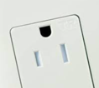
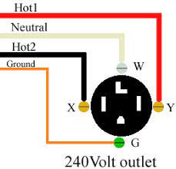
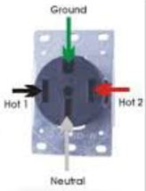
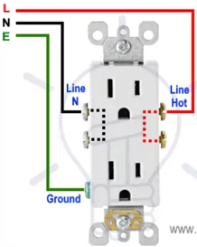


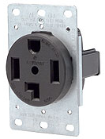
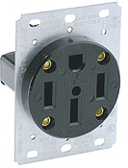


Outlets
Residential outlets – cheapest
Commercial / Industrical grade outlets - better
TR = Tamper-Resistant (plastic safety cover inside)
WR = Weather-resistant - corrosion-resistant materials
Good choice – buy commercial grade TR outlets
TR
Tamper-Resistant
10A
20A
Ground Fault Circuit Interrupters (GFCIs)
30A
50A

Slide 3
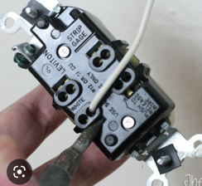
"Push-in" QuickWire terminals
Push-in wiring, sometimes branded "QuickWire", uses holes in the plastic casing, underneath which are sharp spring-loaded cleats that catch and hold the wire when you put it in. It compresses on the wire more when the side screw is tightened.
Most electrician I know uses the back connections on GFI's and side wires regular receptacles.
When inserting the wire, release the screw and tip the device so the grab plates would open.
To remove them, you take a jeweler's screwdriver or a small pick or probe and push into a square tab nearby, which pushes the cleat away allowing you to withdraw the wire.
Many people hate "push-in" because:
.. they are designed to work only with one gauge of wire (either 12 or 14AWG depending on the type of switch or outlet).
.. getting the wire out of the hole without damaging it is difficult
It is safer to use the side-clamping. Make sure to add isolation tape to prevent shorting on metal parts of bare ground.

Slide 4
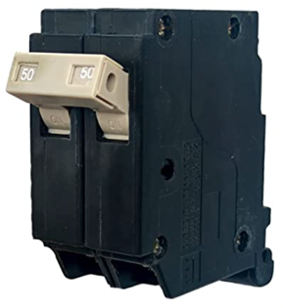
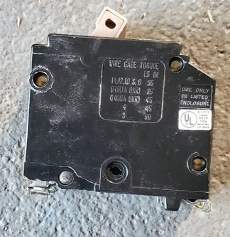
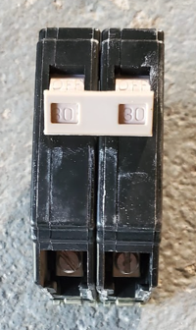
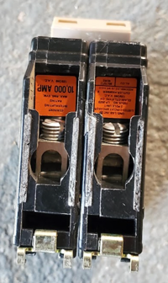
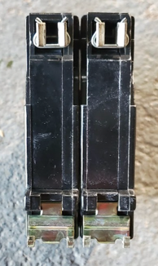
Electrical Breaker
August 2022 – bought on amazon:
CH250 2-Pole 50-Amp Circuit Breaker, Type CH 3/4-Inch Plug-On Molded Case Circuit Breaker, Thermal Magnetic Protection, 10 KAIC, 120/240V, Fit for Cutler Hammer Load Centers (3 Years Warranty)
Types of Circuit Breakers
https://www.homedepot.com/c/ab/types-of-circuit-breakers/9ba683603be9fa5395fab900f0d22b4
We need 50A 2-pole breaker
The Panel is compatible with Cutler Hammer standard

Slide 5
Electrical Breaker for dryer
August 2022 – bought on amazon:
CH250 2-Pole 50-Amp Circuit Breaker, Type CH 3/4-Inch Plug-On Molded Case Circuit Breaker, Thermal Magnetic Protection, 10 KAIC, 120/240V, Fit for Cutler Hammer Load Centers (3 Years Warranty)
It looks like we need a
2-Pole Eaton Interchangeable
Circuit Breaker (30A, 120/240V)
SKU: BR230
November 2023 – ordered
Cutler Hammer BR230 2 Pole 30Amp 120/240V Circuit Breaker

Slide 6
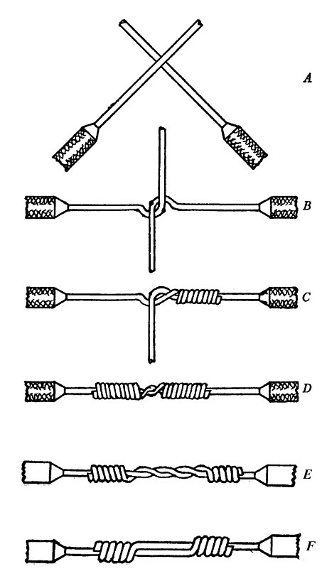
Splicing wires
https://en.wikipedia.org/wiki/Western_Union_splice
The Western Union splice or Lineman splice
is a method of joining electrical cable,
developed in the nineteenth century during the
introduction of the telegraph
and named for the Western Union telegraph company.
This method can be used where the cable
may be subject to loading stress.
The wrapping pattern design causes the join
to tighten as the conductors pull against each other.

