Slide 1

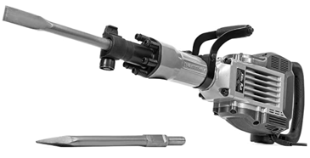
Electric Demolition Jack Hammer
XtremepowerUS 3600W Demolition Jack Hammer
1,900 bpm
.. https://www.amazon.com/dp/B07B4K1CNK
$250 , 4,300 reviews
VEVOR Demolition Jack Hammer 3600W 1,800 BPM (Beat Per Minute
.. https://www.amazon.com/dp/B0952MJ3XQ/
$220 , 278 ratings
Extension cord – 3 wire (grounded) 10-gauge

