Slide 1
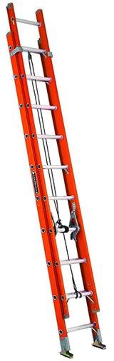
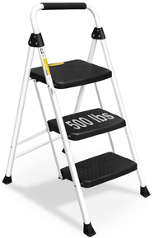
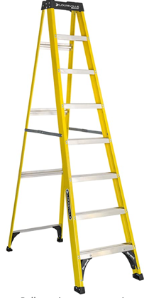
Ladders
3 Step Ladder, Folding, 500 lbs
https://www.amazon.com/gp/product/B09N6PZJ4F/
Louisville Ladder FE3232
32 Feet, 300 lbs, Fiberlass
https://www.amazon.com/gp/product/B000U0O6QO
Ladder 8' Fiberglass Step Ladder, 250 lbs
https://www.amazon.com/gp/product/B08CWSC2YX

