Slide 1
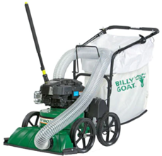
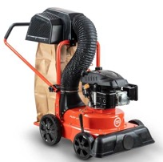
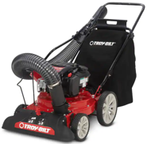
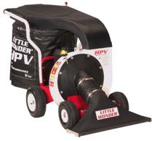
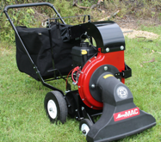
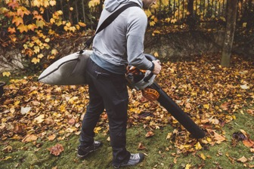
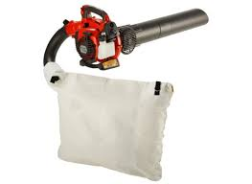
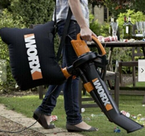
Leaf Vacuum / Mulcher / Blower
MerryMac Vacuum $1,500
DR Leaf and Lawn
Vacuum $950
Billy Goat 27" Self-Propelled Lawn/Litter Vacuum $1,700
Troy-Bilt 24" Leaf Vacuum $700
Little Wonder Pro Vac 6.5 HP Vacuum
$3,000
Husqvarna 125BVX leaf blower vacuum
$200
Worx corded
Leaf Mulcher / blower/ vacuum

