Slide 1
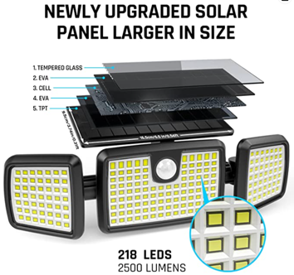
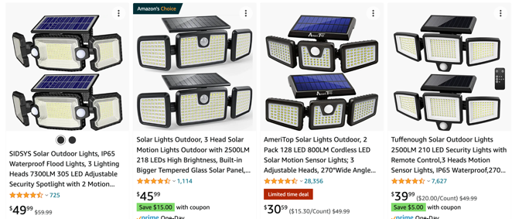
Outdoor Flood Lights
Search Amazon for:
solar motion sensor flood light outdoor
Solar Lights Outdoor,
3 Head Solar Motion Lights Outdoor
with 2500LM 218 LEDs High Brightness, Built-in Bigger Tempered Glass Solar Panel, Sensitive PIR Motion Inductor
(2-Pack) - $46
https://www.amazon.com/dp/B09YXPKGY2/

Slide 2
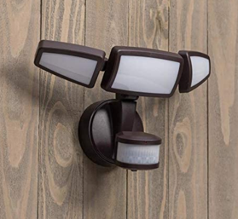
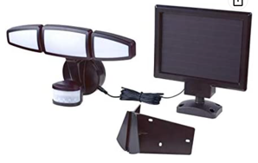
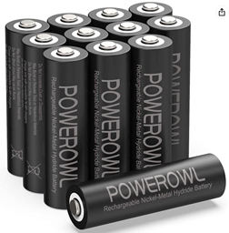
Our old Garage light
Utilitech 240-Degree 3-Head Bronze
Solar LED Motion-Activated Flood Light with Timer A911PB-T1200A-LBZ-PK
https://www.amazon.com/Utilitech-240-Degree-3-Head-Motion-Activated-A911PB-T1200A-LBZ-PK/dp/B07N6N9YTD
==================================
Solar Panel:
Jiawei Renewable Energy Co, Ltd.
Model: A911Pb-T1200A-LBZ
3.7V, 10.5W
Made in China
Intertek 5013747
==================================
Main Unit:
Use only rechargeable battery
customer service: 1-866-994-4148
Caution: replace battery with
Woo-Power Technology Co., Ltd
Type AA 2000mAh only
==================================
POWEROWL Solar Rechargeable AA Batteries 2800mAh, Wide Temperature Range
https://www.amazon.com/dp/B0839C7C4P

