Slide 1
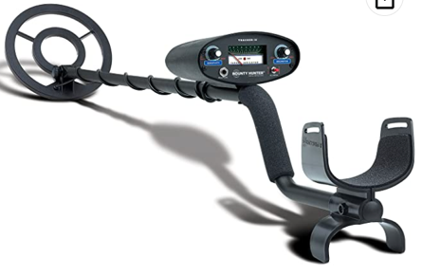
Metal Detector
Bounty Hunter TK4 Tracker IV Metal Detector, 8-inch Waterproof Coil Detects
$106
https://www.amazon.com/dp/B00005A3L1

