Slide 1
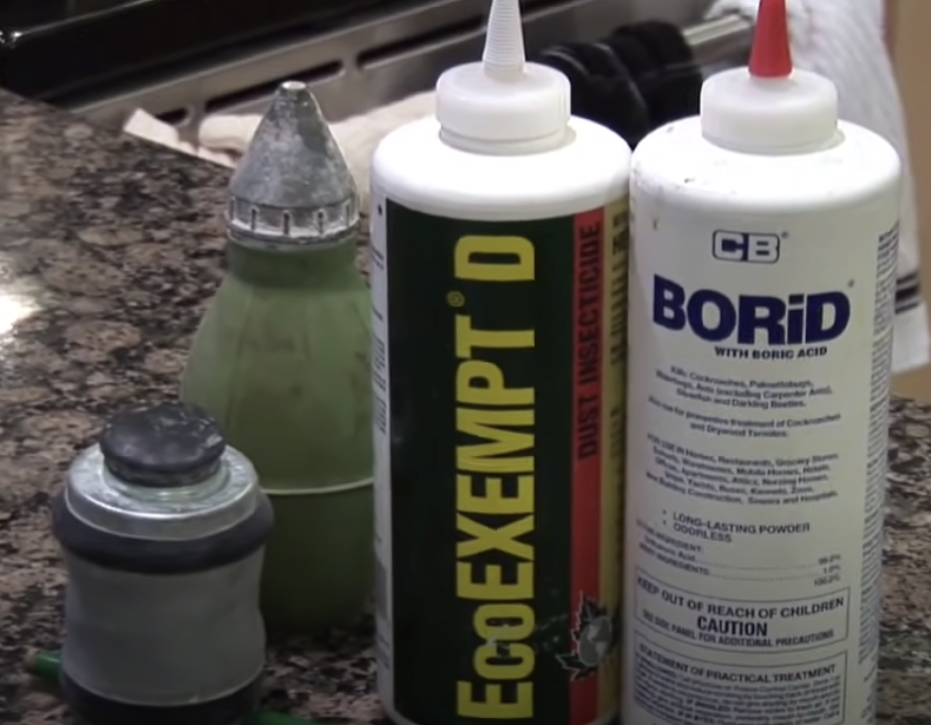
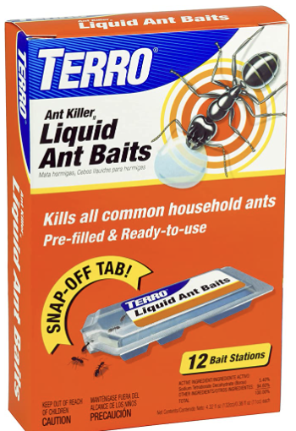
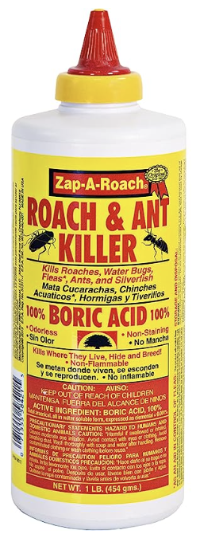
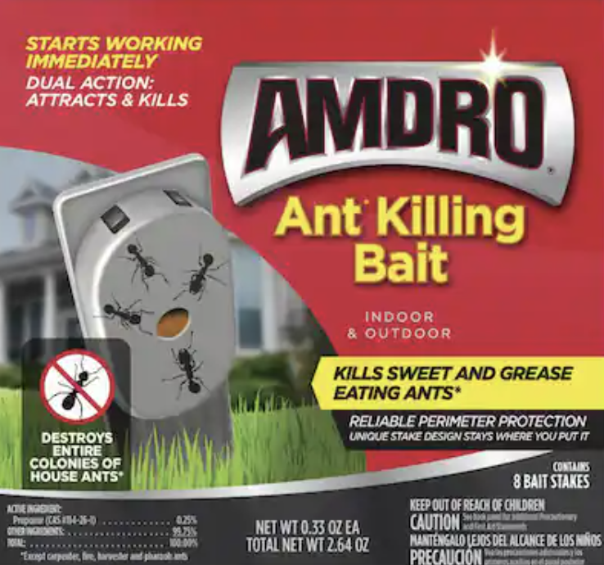
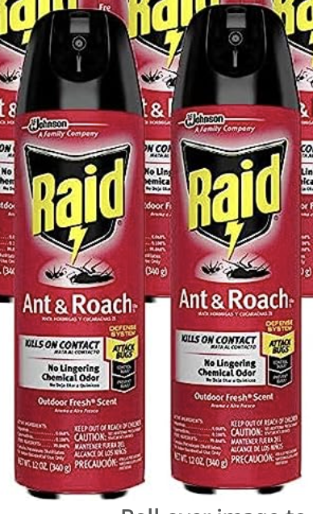
How to Kill House Ants
https://www.youtube.com/watch?v=gSLtPlK52eY
house ants eat sugar & protein
Find what they eat (give them samples).
Then give them what they eat as a bait (with poison).
The workers bring it to the colony. They feed it to the larva; the larva digest it and, and then, the by-product from the larva is what the queen and the workers eat. So, you're going to kill off all the stages of the colony. It is very effective – but slow.
You can also use different types of pesticides (dust, spray) on areas where you notice ants (especially on their trails, around the edges of the counters, under them, along the baseboard).
Use something safe (in the house).
Do not use repellent, because the ants will just go around it.
Ant Killer baits:
TERRO T300B - https://www.amazon.com/dp/B00E4GACB8
in 2020:
1. Syngenta Advion Fire Ant Bait https://www.amazon.com/dp/B00407FUTA - outside
2. RAID Ant & Roach Killer https://www.amazon.com/dp/B003AOA35K – indoor contact killer (up to 4 weeks)
3. TERRO Liquid Ant Bait https://www.amazon.com/dp/B00E4GACB8 - bait stations
4. Orange Guard 101 Home Pest Control https://www.amazon.com/dp/B002OTWTYK – kills on contact
5. AMDRO Ant Block https://www.amazon.com/dp/B001H1JKSY – outside barrier, 3 months
6. Aunt Fannie's Ant Remedy https://www.amazon.com/dp/B07B8X9N8P – safe spray
7. Amdro Kills Ants Liquid Ant Bait https://www.amazon.com/dp/B0096Q0EG4 – bait stations.
1) Max Double Control ● Buy on Amazon: https://amzn.to/3ErxJvb
2) Indoor and Outdoor ● Buy on Amazon: https://amzn.to/3xEPgOV
3) Ant Killer Liquid Baits ● Buy on Amazon: https://amzn.to/3EBYw83
4) Ant, Roach and Spider ● Buy on Amazon: https://amzn.to/36xFLGk
5) Ant Killer & Crawling ● Buy on Amazon: https://amzn.to/3vo0G76
6) Home Defense Insect ● Buy on Amazon: https://amzn.to/387Yk44
7) Insect Killer for Lawns ● Buy on Amazon: https://amzn.to/36t2ZNI
10.Terro Outdoor Liquid Ant Killer Bait Stakes ► .https://amzn.to/42MB5nw ✅
9.Raid Ant and Roach Killer Fragrance Free ► .https://amzn.to/42S0CM7 ✅
8.Diatomaceous Earth ► .https://amzn.to/41ryyhj ✅
7.Aunt Fannie’s Ant Spray ► .https://amzn.to/41vLRgE ✅
6. TERRO T300B Liquid Ant Killer ► . https://amzn.to/41zyGvg ✅
5.Advance 375a Select Granular Ant Bait - 8 oz. ant Killer ► . https://amzn.to/44LAfsO ✅
4.Amdro 100099307 Block Home Perimeter Ant Bait Granules ► .https://amzn.to/455rZEm ✅
3.Combat Indoor and Outdoor Ant Killing Gel ► .https://amzn.to/3O3wWXX ✅
2.Syngenta Advion Ant Gel 4 Tubes 30 Grams Each ► https://amzn.to/44R5d2P ✅
1.Orange Guard 101 Home Pest Control Gallon ► .https://amzn.to/455rY3g
1. TERRO T300B Liquid Ant Bait Ant Killer - https://amzn.to/3qPjomz
2. Amdro Liquid Ant Bait Stations - https://amzn.to/3iKsblx
3. Amdro Ant Block Home Perimeter Ant Bait Granules - https://amzn.to/3wJF1bP
4. Syngenta - A20380A - Advion Fire Ant Bait - https://amzn.to/36JiMrI
5. Raid Ant & Roach Killer Spray for Listed Bugs - https://amzn.to/3qMAPUU
zap-a-roach, Boric Acid spray, since 1946
https://www.amazon.com/dp/B00LLQ4AU8

