Slide 1
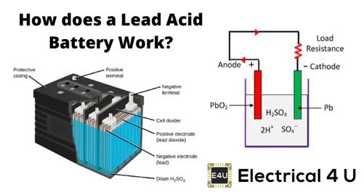
Automotive Battery
a lead storage battery
wet cell (flooded) battery, with six cells
each cell is filled with sulfuric acid solution
each cell has alternate plates: .. (-) cathode - lead .. (+) anode - lead dioxide
Amp hours (Ah) - energy storage capacity (typically 40-100 Ah)
Example: 100 Ah battery should be able to continuously provide 5 amps for 20 hours while maintaining a voltage of at least 10.5 volts.
Note: the relationship between the Ah capacity and the discharge rate is not linear; as the discharge rate is increased, the capacity decreases. A battery with a 100 Ah rating generally will not be able to maintain a voltage above 10.5 volts for 10 hours while being discharged at constant rate of 10 amps.
Note: Capacity also decreases with temperature.
CCA , CA, MCA, HCA = Cranking amperes for 12V battery: for 30 sec, while maintaining a voltage of at least 7.2 volts .. CCA = Cold cranking amperes: at 0 °F (−18 °C) .. CA = Cranking amperes = like CCA, but at 32 °F (0 °C) .. MCA = Marine cranking amperes = like CA .. HCA = Hot cranking amperes: at 80 °F (27 °C)
SoH = State-of-Health (%)
SoC = State-of-Charge (%)
Battery Types:
STD - Standard flooded (wet cell) = liquid electrolyte
AGM = Absorbed Glass Mat = electrolyte in glass mat, spill-proof, maintenance free, faster charging, safer, do not need ventilation, more durable, can deliver more current, a bit more expensive
Gel Cell - similar to AGM, sealed, use a silica-type gel, maintenance-free, leak-proof, and very safe, but they are more sensitive to charging
Calcium-Calcium Batteries - has calcium alloy on both + & - plates to reduce the fluid loss, and therefore, decrease the rate of self-discharge
Deep Cycle Batteries - designed to be discharged down as much as 80% time after time, Have much thicker plates
Lithium-Ion Batteries – popular in electric vehicles and hybrids. They're lighter and more efficient, but also more expensive.
Nickel-Metal Hydride (NiMH) Batteries - often used in hybrid vehicles. They have a high energy density and a long cycle life, but they also suffer from the 'memory effect'

Slide 2
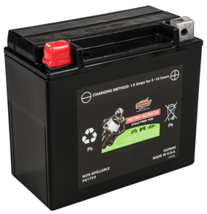
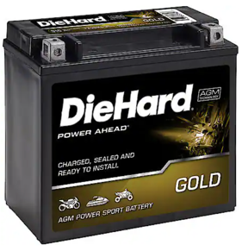
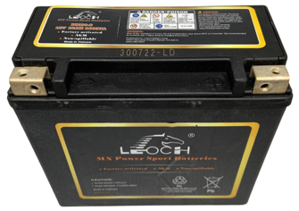
12V AGM ATV Batteries
FAYTX20HL
12 V
310 CCA
18 Amp Hour
TX20HL
12 V
310 CCA
18 Amp Hour
MX20-3
12V
310 CCA
18 Amp Hour

