Slide 1
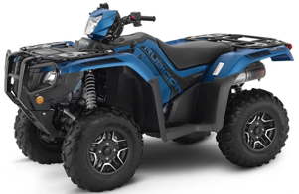
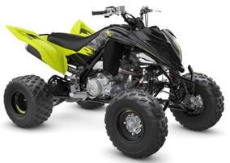
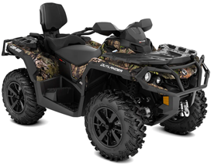
All Terrain Vehicle (ATV). ( $8-$9K )
Honda Fourtrax Foreman Rubicon 520 DCT Deluxe
Polaris Sportsman XP 1000 Ride Command
Yamaha Raptor 700R
Can-Am Outlander MAX XT
CFMoto CForce 1000 Overland
One Response
Honda Fourtrax Foreman Rubicon 520 DCT Deluxe
Yamaha Raptor 700R
Can-Am Outlander MAX XT

Slide 2
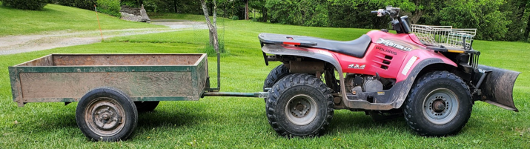
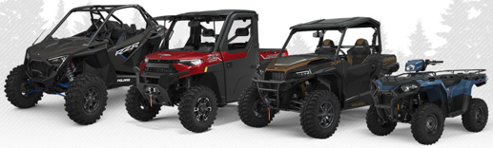
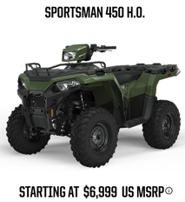
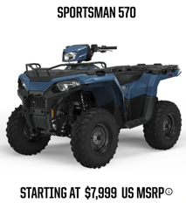
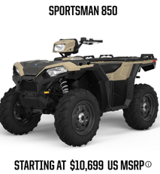
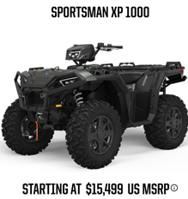
Previous owner had 20-y.old Polaris
Polaris Xpedition 425 (years 2000-2002)
price new - $6K+, price today - $1.4K
27 HP
modern off-road Polaris
https://offroad.polaris.com/en-us/
with trailer and plow
33 HP
90 HP

Slide 3
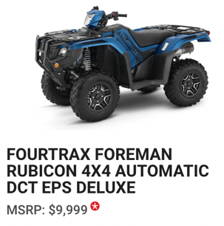
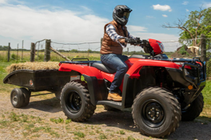
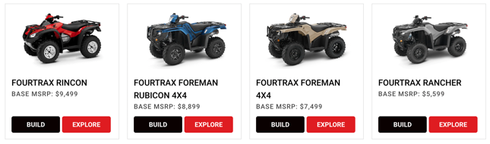

Honda is the most reliable ATV
Which ATV Is Most Reliable? Brand Comparison .. https://atvhelper.com/which-atv-is-most-reliable-brand-comparison/#
Honda ATVs since 1970, reputation for performance and reliability.
Bomb-proof transmission, metal gears, very durable, can take lots of abuse.
Multiple models (utility):
Rancher – smallest, doesn't lock 4 wheels (not good for snow pushing).
Foreman - good
Foreman Rubicon – has DCT (auto-transmission)
DCT (Dual-Clutch Transmission == Automatic transmission)
ES (Electric-shift transmission)
EPS (Electrical Power Steering)
Build your Honda ATV:
.. https://powersports.honda.com/atv/recutility/fourtrax-foreman-4x4/build
Honda FourTrax Foreman 4x4 TRX520FM1LN (2022) MSRPrice - $7.5K
Engine - 4-stroke liquid cooled 518cc
.. https://www.youtube.com/watch?v=Bd_8UyRdxuY
Honda TRX450R (2022) – a race ATV
Engine - 39 HP, Weight – 350 lbs,
Top speed – 74 mph, MSRPrice - $6.7K

Slide 4
Dealers for zip code 12741:
===========================
RUSTY PALMER, INC.
19.5 miles away
1175 Texas Palmyra Hwy, Honesdale, PA 18431
http://rustypalmer.net/honda/
(570) 253-4507
===========================
NORTH AMERICAN WARHORSE, INC.
38.2 miles away
1000 Dunham Dr., Dunmore, PA 18512-2666
https://www.nawarhorse.com/
(570) 346-2453
===========================
MAVRIX MOTORSPORTS
44.4 miles away
21 Dunning Rd., Middletown, NY 10940-2212
https://www.mavrixmotorsports.com/
(845) 344-2453
===========================
BINGHAMTON Honda
47.5 miles away
120 E Service Hwy, Binghamton, NY 13901
https://binghamtonhonda.net/
(607) 722-7433
===========================

