Slide 1
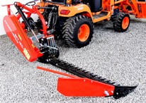
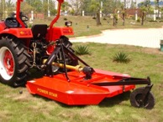
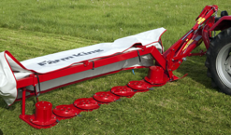
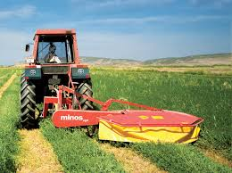
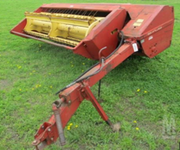
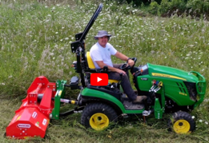
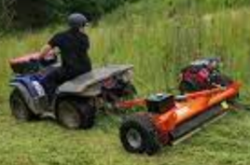
Hay Mowers - Cutting Grass on Big Fields
(typically using using tractor with PTO and 3-point hitch)
Sickle Bar Mower - reciprocating blade
Rotary cutters - brush hog, one big horizontal cutter
Disk mowers – use many small 18" disks
Drum cutters - two 36" disks = drums
PTO
Tow Behind
Haybine Mower (Mower-Conditioner) – uses reel, disk or sickle cutter, and crimper rolls
Flail cutters (horizontal cylinder with attached "flails"), can be PTO-driven or tow-behind (used with ATV/UTV)

Slide 2
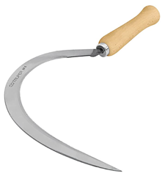
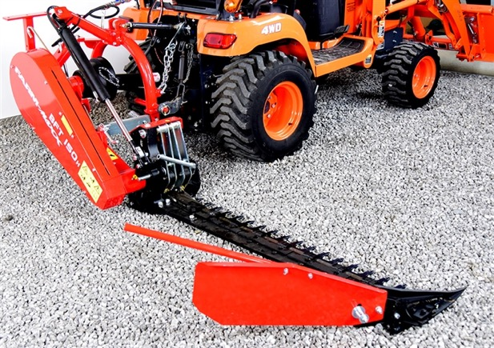
Sickle Bar Mower
Sickle

Slide 3
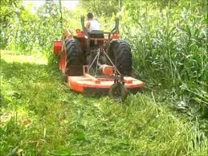

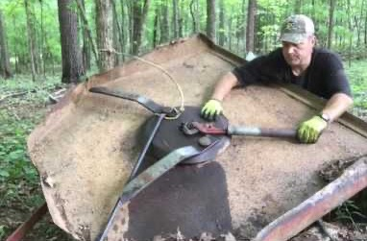
Brush Hog (single spindle rotary cutter)
brush = scrub vegetation = low woody plants (between grass or heath and high forest).
Bush hogging, a.k.a. brush hogging - clearing lands of tall grass, small trees and brush.
A bush hog is a rotary cutter usually attached to the back of a farm tractor using the three-point hitch and are driven via the power take-off (PTO). No belts !!
you need 5 horse power on PTO for each 1 ft of width of brush hog. So for a 6 ft width you need 30 HP on PTO, so probably 50HP total, because power on PTO is usually ~70% of total engine power.
A bush hog has blades that are not rigidly attached to the drive like a lawnmower blade but are on hinges. This way, if the blade hits a rock or a stump, then it can bounce backward or inward. The centrifugal force will then make it go outwards again.
A tractor need to have a hydraulic system and a PTO shaft

Slide 4

Disk Mower – multiple small disks

Slide 5
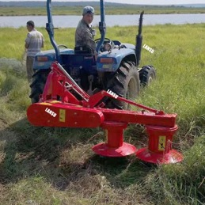
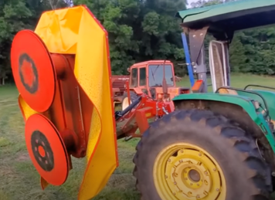
Drum Mower
A drum mower (a.k.a. disc mower) - uses one or more drum-like structures that house a set of rapidly rotating cutting blades.

Slide 6

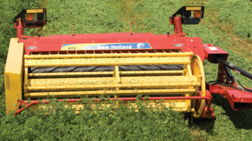
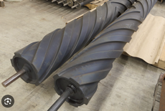

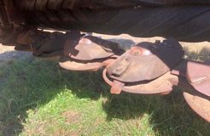
Haybine Mower-Conditioner
A haybine mower (a.k.a. mower-conditioner) – cuts hay and conditions them to accelerate the drying process. Very reliable "work horse".
Reel - spins to guide the grass into the cutting mechanism
Cutting - uses a sickle bar cutter (old models) or rotary disc cutter (new models)
Conditioning – passing the cut hay between two rolls with patterns which crimp or crack the stems of the hay as it passes between them
Windrowing - the hay is typically laid out in a thin, wide row known as a windrow.
Drying and Baling - the cut and conditioned hay is left in the field to dry for a few days. After that it is collected and baled for storage.
For cutting,
old models use sickle bars
new models use disks
crimper rolls

Slide 7
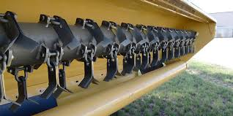

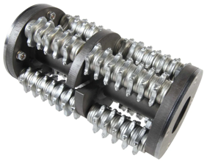
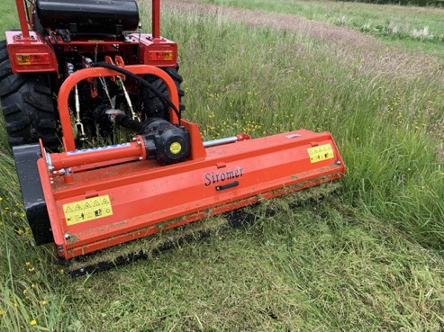
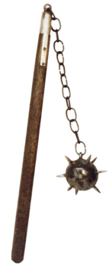
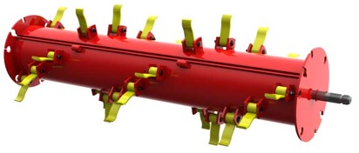
Flail Mower
flail - a deadly medieval age weapon - a wooden staff with a short heavy stick or ball swinging from it.
https://www.youtube.com/watch?v=NVFKhcY_6DQ

Slide 8
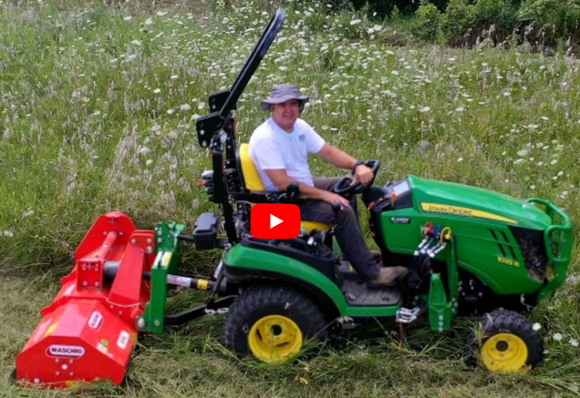
Flail Mower with sub-compact tractor
61" Maschio flail mower - $4K .. https://www.agfolks.com/store?q=flail
John Deere 1025R sub compact tractor – 18K
.. https://www.deere.com/en/tractors/compact-tractors/1-series-sub-compact-tractors/1025r/

Slide 9

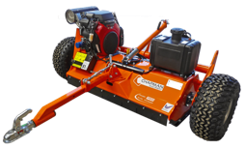
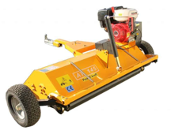
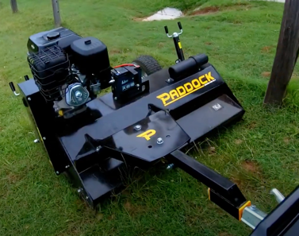
Tow Behind Flail Mower with UTV / ATV
Usually 4-5 ft wide (up to 60". =152 cm)
Chapman Machinery – UK & US, $7.24K new https://www.youtube.com/watch?v=Nywy8u_rU8c https://chapmanmachinery.com/agricultural-machinery/atv-flail-mower-pro/
Bestco 59" - in US, $3,260 https://betstco.com/product/pk-at145e/
Old Bush Hog Flail mower (discontinued) https://www.youtube.com/watch?v=J0GkhTS5nus
Other countries:
Paddock – Australia, $6-10K https://www.youtube.com/watch?v=_kov_z-XbnE https://www.paddockmachinery.com/products/atv-slasher-mower
Wessex - in UK https://www.youtube.com/watch?v=h3kInXmBJIQ https://www.wessexintl.com/machines/atv-equipment/flail-mowers/atv-flail-mower/
Sinolink – in China https://www.youtube.com/watch?v=siYmHS_gK0Q.

