Slide 1
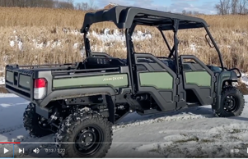
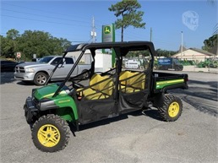
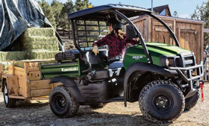
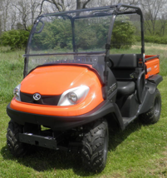
Utility Vehicle ($8-20K)
https://en.wikipedia.org/wiki/Side-by-side_(vehicle)
The side-by-side (SxS or SSV),
also called a utility task vehicle (UTV)
or recreational off-highway vehicle (ROV),
a small, 1- to 6-person four-wheel drive off-road vehicle.
Such vehicles have powertrains similar to those of ATVs (all-terrain vehicles)
John Deere XUV 825M S4 Full-Size Four Seat Gator
(30K new, 15K used)
Kawasaki MULE SX
( $8,000 )
Types of Gators - https://www.youtube.com/watch?v=cR7hSR6n83A
XUV = CUV = Crossover Utility Vehicle
Kubota RTV 520
( $10,000 )
https://www.youtube.com/watch?v=n9OXKI1Q5Xw

Slide 2
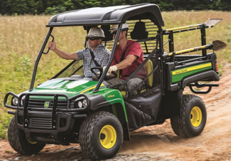
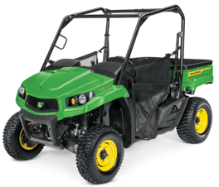
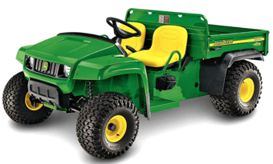
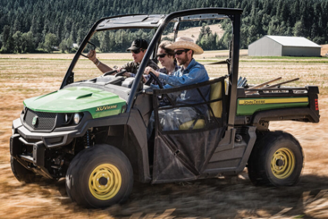
John Deere Gator Utility Vehicles
https://www.deere.com/en/gator-utility-vehicles-product-list/
HPX615E 13.7K work, traditional
cargo: 45"x52"x11",
1000 lbs cargo
590 towing capacity
XUV590M
$15K, 4wd,
Power Steering, ...
cargo: 32.3"x56.5"x11.7"
Crossover UV, fast,
mid-size, instant 4WD, ...
500 lb cargo
towing 680 kg
TS 4x2 10.3K work, traditional
cargo 45"x12"x52"
Other models:
XUV590M s4 17K, 4wd
XUV560E s4 - 12K-14K, excellent ride, 4wd
XUV825M s4 - 20K (4 people, 4WD, PowerSteering)
HPX815E 15k3, work, diesel
XUV590E 14.4K, 32-hp, 4wd, fast (E = Economy, same as 590M, but without Power Steering)
TH 6x4 12k6 - Traditional , 6 wheels
XUV835M. 20K
(3-seat, 4WD, 4,000 tow),
cargo 45 x 12 x 52 in.

Slide 3
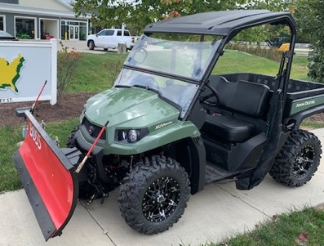
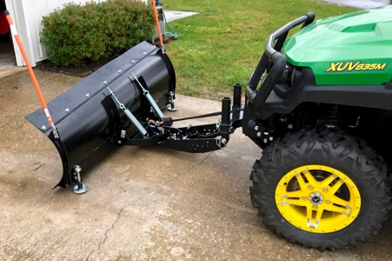
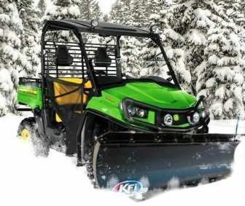
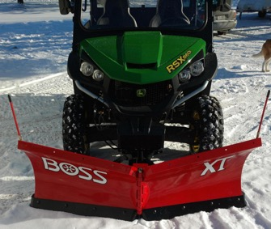
Snow Plow

