Slide 1
Garbage Solutions
Jeff Sanitation Inc – garbage pickup service
(845) 482-0926, dhughson8@gmail.com
5239 NY-52, Jeffersonville, NY 12748
Lake Huntington - in the Town of Cochecton in Sullivan County, NY, along Route 52, zip code 12752
Sullivan County Division of Solid Waste
(845) 807-0290
email: recycling@co.sullivan.ny.us
https://sullivanny.us/Departments/SolidWasteRecycling
chttps://sullivanny.us/Departments/SolidWasteRecycling/CountyLandfill
Thompson Sanitation
845-796-1032
47 Katrina Falls Rd, Rock Hill, NY 12775 (rt.17 near exit 109)
Hancock Transfer Station
Garbage dump in Delaware County, New York
1488 Green Flats Rd, Hancock, NY 13783
7:30-3:30 except Sunday
(607) 637-3522
25 miles, 32 min drive
Sullivan County Landfill
164 Dump Rd, Wurtsboro, NY 12790
Wed, Sun 7:45AM–2:45PM
(845) 888-0256
40 miles, 53 min drive (rt.17 after exit 110)

Slide 2
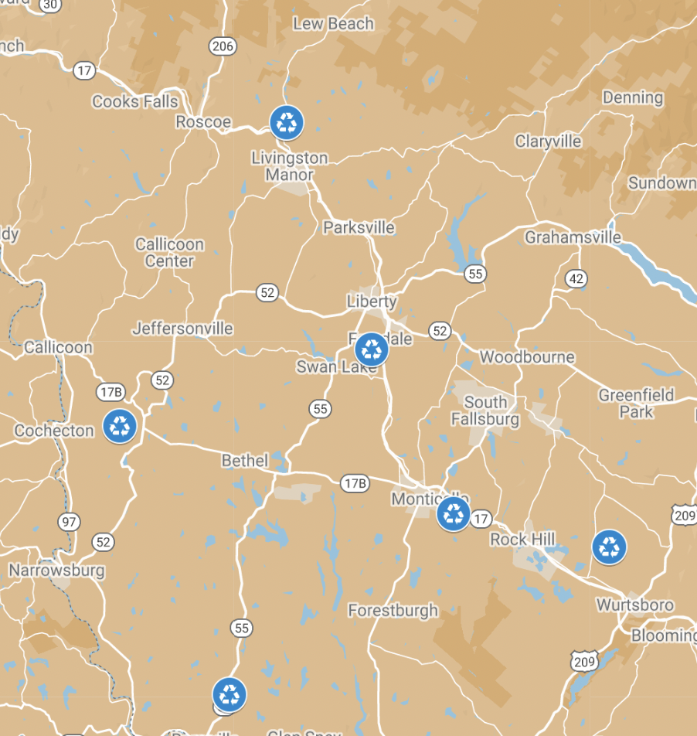
Sullivan County Division of Solid Waste
(845) 807-0290
email: recycling@co.sullivan.ny.us
.. https://sullivanny.us/Departments/SolidWasteRecycling
.. https://sullivanny.us/Departments/SolidWasteRecycling/CountyLandfill
Rockland Transfer Station
(between Livingston Manor and Beaverkill Campground)
131 Overlook Drive, off County Route 151, Livingston Manor, NY
Tue, Thu, Sat 7:45-2:45
Western Sullivan Transfer Station
433 Mitchell Pond East Road, Cochecton, NY 12726
(845) 932-8845
Wed & Sat 7:45am – 2:45pm
(14 miles, 22 min)
Ferndale Transfer Station (near Monticello)
78 Lt J G Brender Hwy, Ferndale, NY 12734
(845) 292-3670
Tue, Thu, Sun 7:45-2:45

