Slide 1
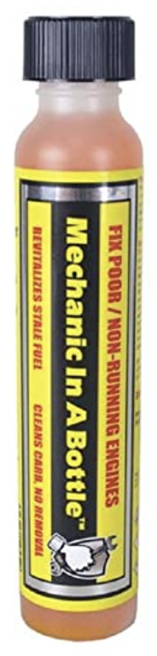
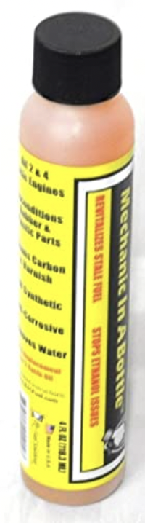
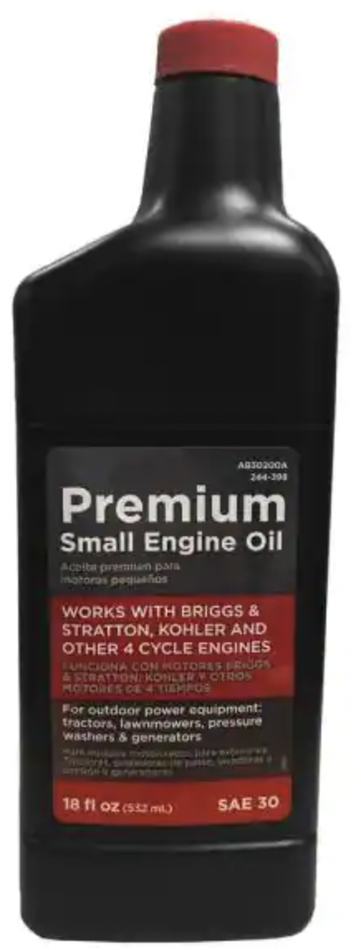
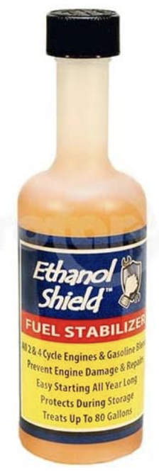
Ethanol Shield Fuel Stabilizer
.. https://www.amazon.com/Fuel-Solutions-Ethanol-Shield-Bottle/dp/B008GHYCQ2/
18 oz. SAE-30 Small-Engine Oil
.. https://www.homedepot.com/p/Homelite-18-oz-SAE-30-Small-Engine-Oil-AB30200A/202564512
Ethanol Shield Fuel Stabilizer
.. https://www.amazon.com/Fuel-Solutions-Ethanol-Shield-Bottle/dp/B008GHYCQ2/

