Slide 1
JACKS for Lawn Mowers and Tractors

Slide 2
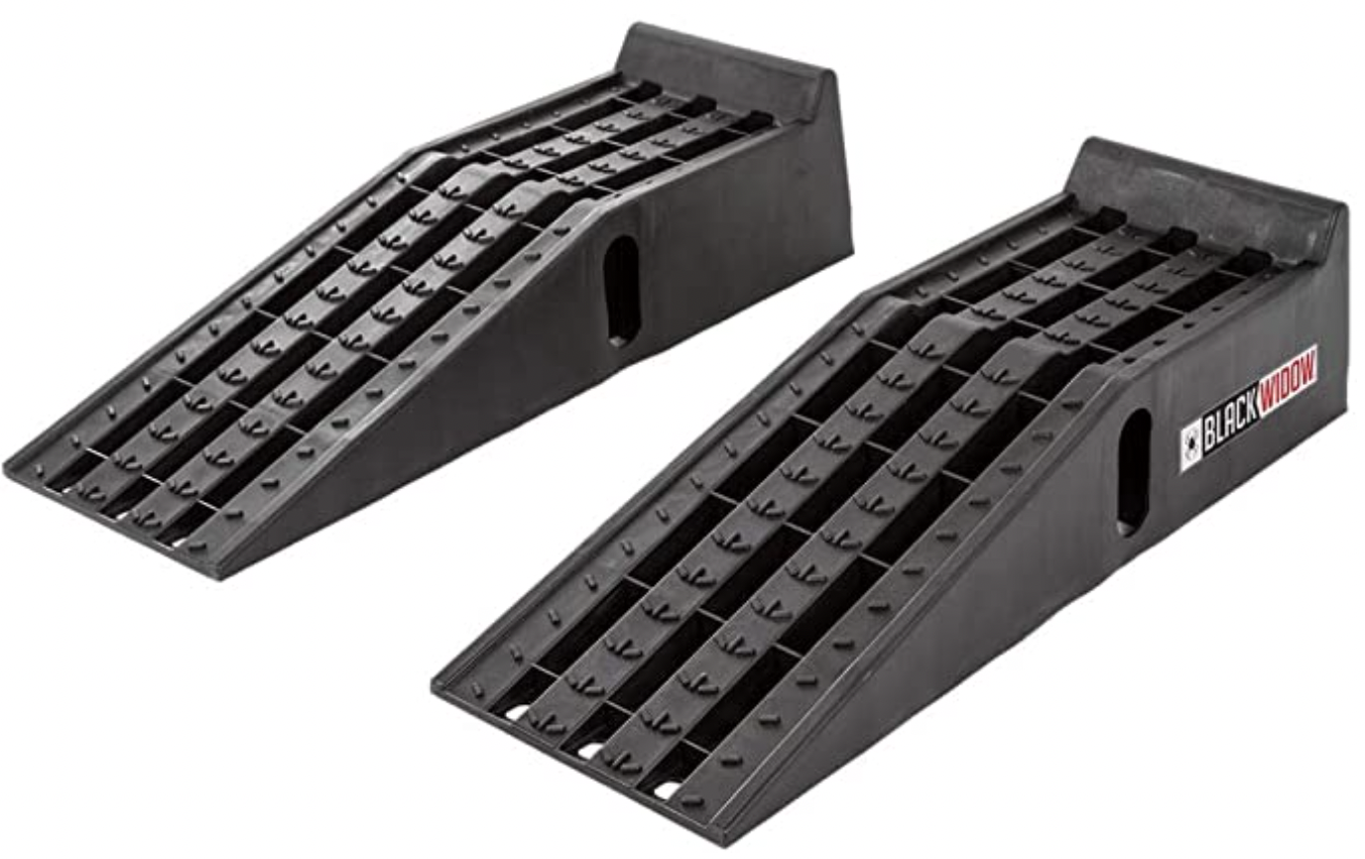
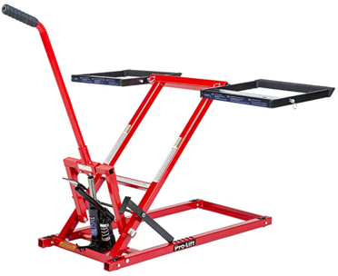
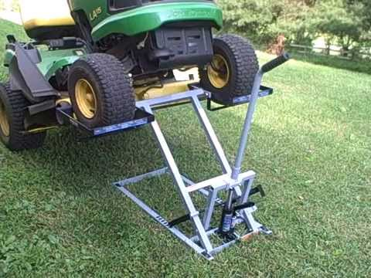
Pro-LifT T-5355A Lawn Mower Lift 550 Lbs Capacity
for Tractors and Zero Turn Lawn Mowers
$141, amazon, 3,300+ positive ratings
We also bought Black Widow PSR295 Plastic Car Service Ramps
$68
https://www.amazon.com/dp/B01N308YYO
We bought this in August 2022
https://www.amazon.com/gp/product/B06XTT9YY2/

Slide 3
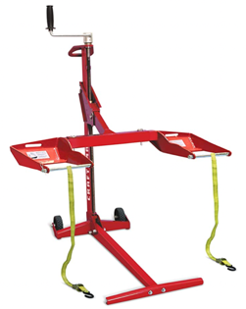
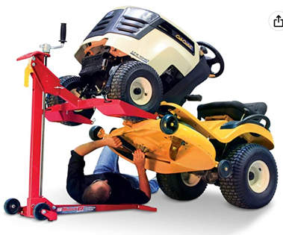
MoJack Craftsman 45099 Lift-500lb Lifting Capacity
$334.00
MoJack EZ Max - Residential Riding Lawn Mower Lift, 450lb Lifting Capacity
$300.00
https://www.amazon.com/45099-MoJack-Lift-500lb-Residential-Maintenance/dp/B0855CH72P/
https://www.amazon.com/MoJack-EZ-MAX-Residential-Maintenance/dp/B00IKCLGVW/

Slide 4
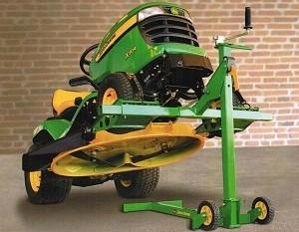
John Deere XD Mower Lift
$300+ ??

Slide 5
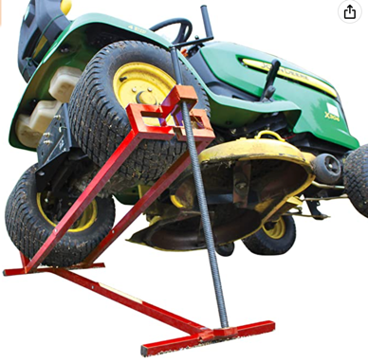
VOUNOT Ride on Mower Jack Lift
Weight Capacity 400kg
$107.11
https://www.amazon.com/VOUNOT-Telescopic-Maintenance-Tractors-Capacity/dp/B07BHFNTRG/

Slide 6
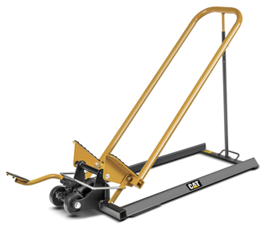
600 LB. MOWER JACK
SKU: 980220 | UPC: 028907525044
Regular price$299.99
https://www.catpremiumproducts.com/products/600-lb-mower-jack

Slide 7
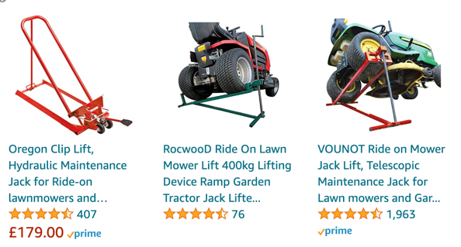
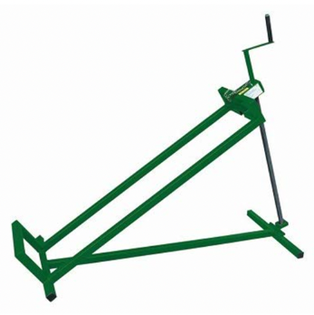
Toolland QT200 lift for lawn tractor
https://www.amazon.co.uk/Velleman-175359-Tractor-Mower-Hoist/dp/B00H83I3B0

Slide 8
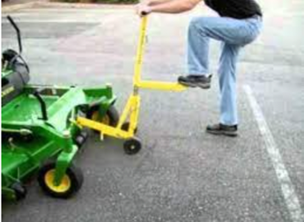
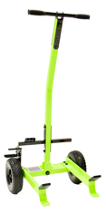
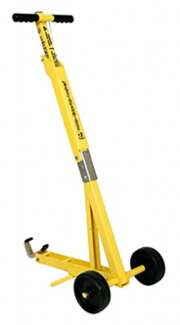
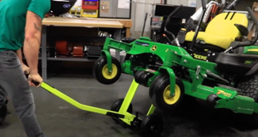
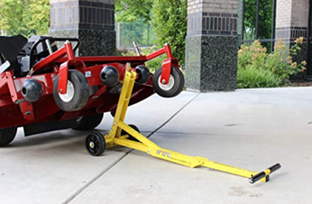
Jungle Jim's Mower Lift Jack
up to 800 pound Capacity!
$260.00
Ballard Inc - SUPER JACK V2
$290.00
Must have 24” between front caster wheels to work properly
Not designed for lawn tractors
Does NOT work on units with front mounted weight kits
Does NOT work on ZTR’s with the rear bagger mounted on
Does NOT work on the Country Clipper decks
https://www.ballard-inc.com/product/super-jack-v2/
https://www.youtube.com/watch?v=5X4WH3cSUc8
https://www.amazon.com/Jungle-Jims-Commercial-Push-Mower/dp/B00V5HMK14/

