Slide 1
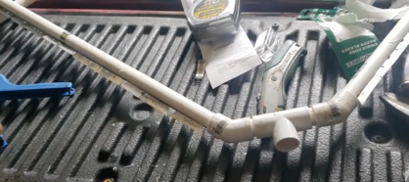
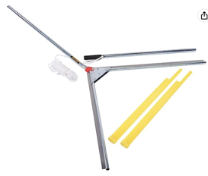
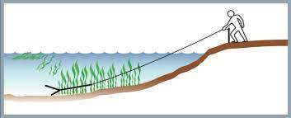
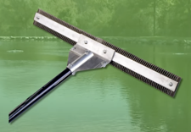
Weed Razer
DIY Razer using PVC pipes and single-edge razor blades
Jenlis The Original Weed Razer, Lake Weed Cutter, Large Pond Aquatic Plant Cutting Tool, Long and Sharp Razor Blades
Shear Cattail, Reed, Lilly & Chara Algae,
48 Inch Cut Width,
25 Foot Throw Rope
https://www.amazon.com/dp/B002AMMNWO/
$170

Slide 2
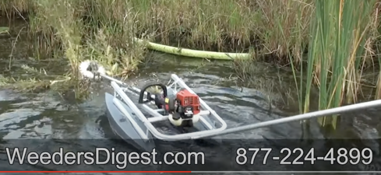
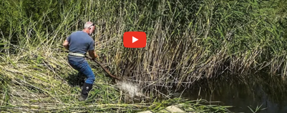
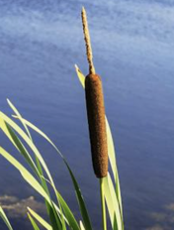
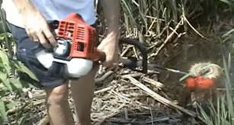
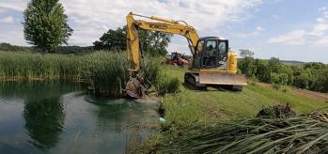
Cut Pond Grass
Pond Grasses (cattail, etc.) can be cut using a Scythe
Using floaters for longer reach
Cattail cutter: https://cattailcutter.com
excavating cattails
cattail

Slide 3
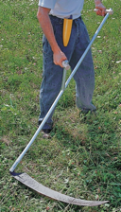

Manual Cutting Tools
Silky Professional BIGBOY 2000 Folding Saw 360mm XL Teeth
https://www.amazon.com/dp/B0014CA3JQ
$77 on amazon
Scythe

Slide 4
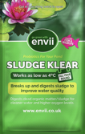


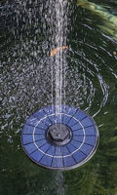
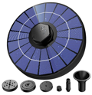
Pond Sludge (at the bottom)
Can be removed using "Envii Sludge Klear"
How to Remove Algae, Muck and Sludge from a Pond:
https://www.youtube.com/watch?v=kb6cqlkSFzU
API POND ALGAEFIX Algae control - https://amzn.to/3jjeWbd
APPLIED BIOCHEMISTS Bacti-Klear Aquatic Microbial Blend - https://amzn.to/37fsXB4
ZATK 3.5W Solar Fountain - https://amzn.to/3jdEoPk

Slide 5
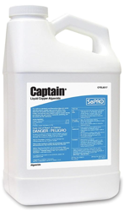
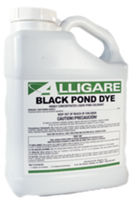
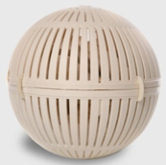
Kill Algae
Captain Liquid Algaecide
Alligare Black Pond Dye
BioSphere Pro Beneficial Bacteria
https://www.pondalgaesolutions.com/biosphere-pro-beneficial-bacteria.aspx

Slide 6
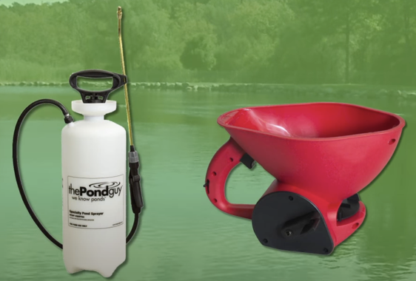
Pond Sprayer
Granular Spreader

Slide 7
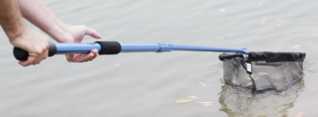
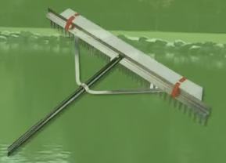
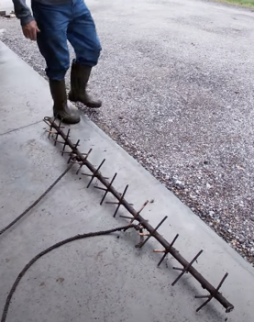
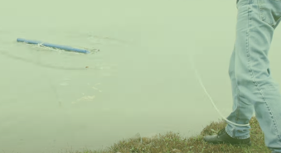
Pond Net
Pond Rake
Floating debris skimmer
6 feet metal tube
with 13 metal crosses welded to it.
It sinks to the bottom, and pulled using a tractor
https://www.youtube.com/watch?v=VWKlpMeRY5g

Slide 8
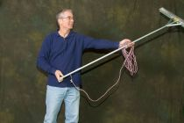
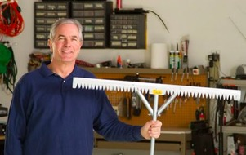
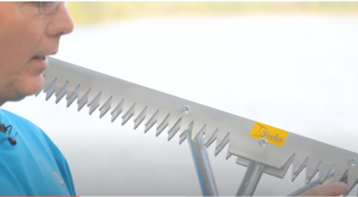
T-weeder tool
$180
Note:
it is not good for pulling cattail.
It is only good for "soft" weeds which don't have strong roots and are easy to pull
https://tweedertool.com
https://tweedertool.com/order-here
https://www.youtube.com/@TWeederTool

Slide 9
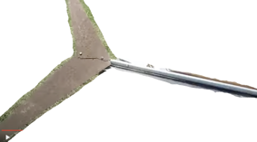
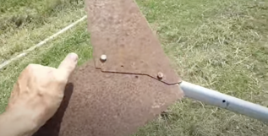
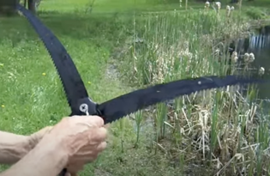
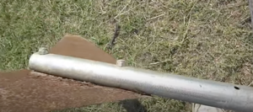
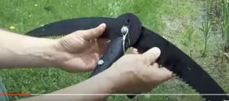
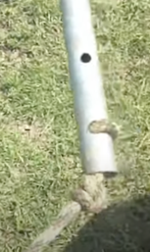
Simple Cheap DIY Pond Weed Cutter
One Piece of 1-inch electrical conduit
Two old saw blades
Two bolts with nuts
Rope at the other end
https://www.youtube.com/watch?v=BMOlMe4nRYs
"The Pond Shark" - similar.
.. https://www.youtube.com/watch?v=tM8yIJUpMp4

Slide 10
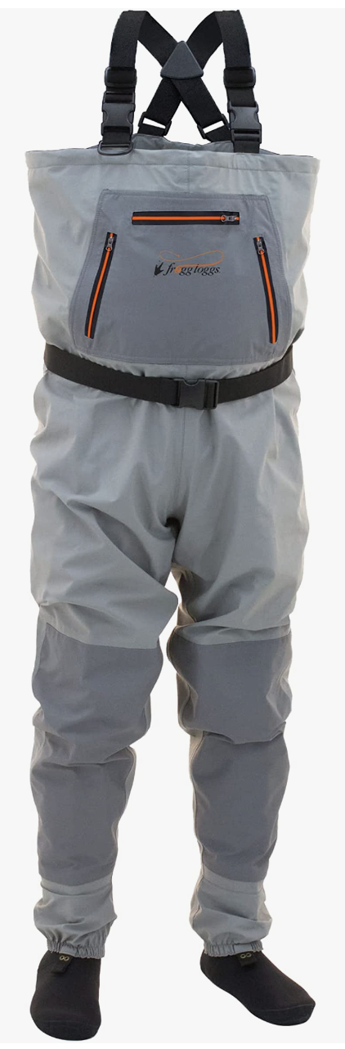
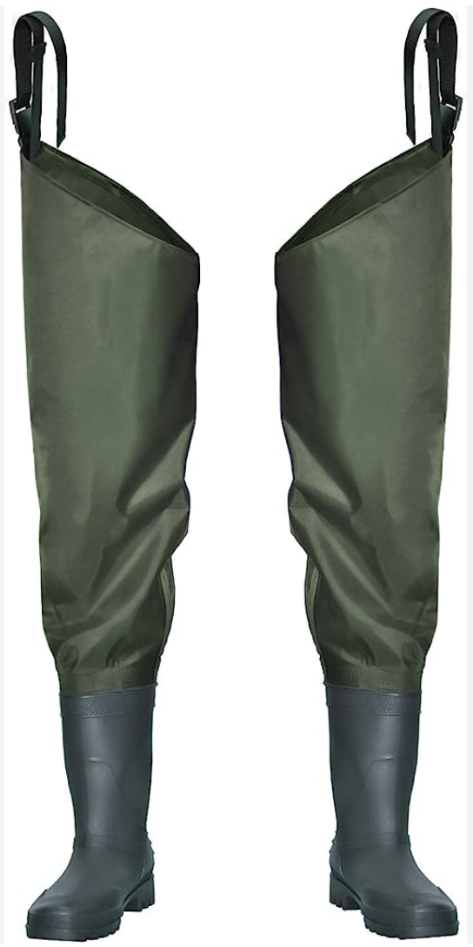
Fishing waders
https://www.youtube.com/watch?v=DqlBbPC1pCc
Examples:
https://www.amazon.com/gp/product/B077PMTDLL - $75
https://www.amazon.com/dp/B0BP2WG284 - $380
"wade" = walk through water
"angler" = person who fishes with a rod and line
Fishing waders = waterproof boot that extends from the foot to the chest (chest waders, use shoulder straps) or to hips (hip waders, secured by the belt)
materials - rubber, PVC, neoprene, and Gore-Tex varieties
an angler wearing waders can wade into rivers, streams, ponds, etc. without getting their clothes wet
chest waders are more common because they allow for deeper wading.
The boots attached to fishing waders can be either "stockingfoot" (require to wear an external boot), or "bootfoot" (boot is integrated with the wader).
chest waders
hip waders

