Slide 1
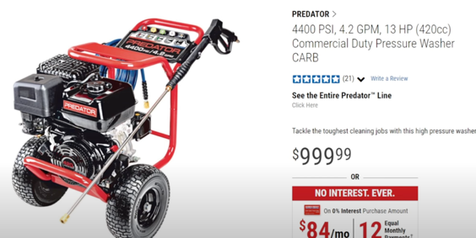
Pressure Washer
Harbor Freight
https://www.youtube.com/watch?v=b5Kw_IJ0QNc
PSI – pressure (1-2K, 2-3K, 3-4K, 4K+)
1-2K – car washer, ... electric (Portland PW, Yard Force, XTremePowerUS ~$100-$130)
2-3K – fences, garage doors, etc. (electric or gas) (Bouer, Champion, Simpson ... – has a dolly with wheels, $200 - $350)
3-4K – paint prep, etc. ~$400
4K – oil and graffite paint
Example: Simpson Pressure Washer provides 4000 PSI / 3.5 GPM with a reliable Honda GX270 Engine
Example: Predator 4400 PSI 4.2 GPM
1. SIMPSON Cleaning ALH4240 ► US Prices: https://amzn.to/2QhpVDE
2. Briggs & Stratton 20505 ► US Prices: https://amzn.to/2Sqa5JB
3. NorthStar 4.000 PSI ► US Prices: https://amzn.to/2MtmMzi
4. Generac 6565 ► US Prices: https://amzn.to/39azBID
5. Simpsons Cleaning PS3835 ► US Prices: https://amzn.to/37ceCn5
GPM (Gallons Per Minute)
angle (cone) = 15 degrees
turbo nozzle

