Slide 1
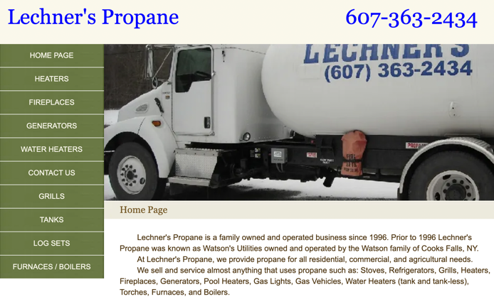
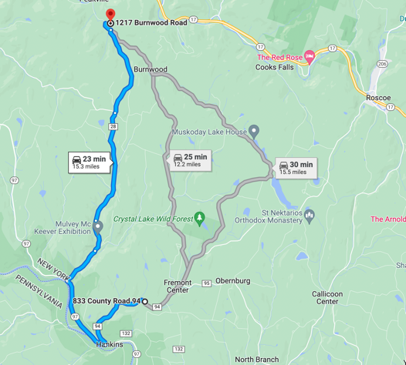
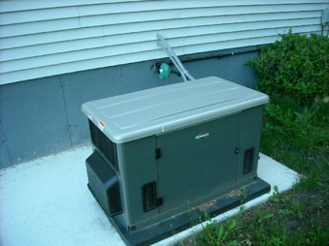
Propane
Leecher's Propane family business - George & Kevin Leecher George@LechnersPropane.com Kevin@LechnersPropane.com +1(607) 363-2434 • Work
1217 Burnwood Rd, East Branch, NY 13756-2109
https://www.lechnerspropane.com
Price (June 2022): 4.65/gallon
Expect $60 refill every 2 months
Backup Generator
min 12KW
better 20-26KW

