Slide 1
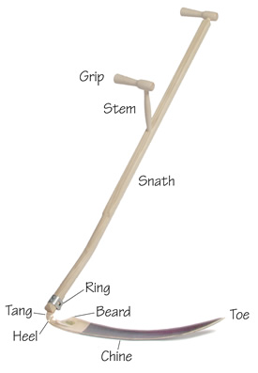
Scythe
A scythe is a hand tool used for mowing grass or reaping crops.
It has a long, curved blade attached at an angle to a long handle.
This traditional agricultural tool has been in use across the world for centuries, but it's less common today due to the advent of mechanized farming equipment.
Despite its lesser usage in agriculture today, the scythe is still used in some regions and contexts where small-scale, sustainable farming practices are valued.
https://scythesupply.com
https://byxco.com/collections/scythes-accessories
ebay
Good video: https://www.youtube.com/watch?v=VVn1kiZnldQ

Slide 2
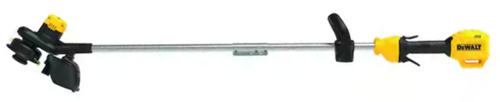
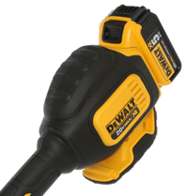
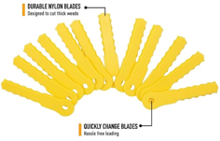
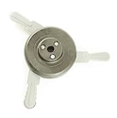
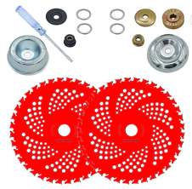
DEWALT Cordless String Trimmer
20V MAX Battery
Motor
$140
can use string, nylon or metal blades https://www.amazon.com/gp/product/B0045PS4RW
Weed Warrior Brush Cutter
Weed Trimmer Blade Head
NeJesZoe 9" x 36Teeth
Carbide Tip Blades Trimmer Cutter
Brush Weed Eater
https://www.amazon.com/dp/B0BK6RRMZX

