Slide 1
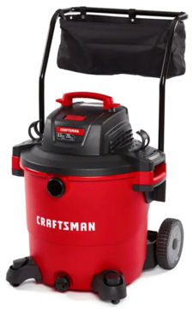
Vacuum
CRAFTSMAN CMXE-VBE-17-656
S/N 23079R210183
20 Gallon Wet/Dry Vac with Cart, amazon May 7
Parts: Emerson Tool Co 8-5 EST M-F, tel: 800-325-1184
Other: 888-331-4569, 855-805-9124

