Slide 1
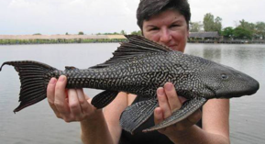
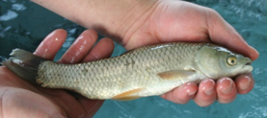
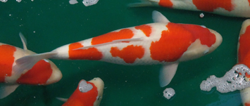

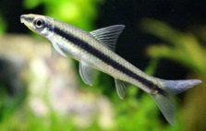
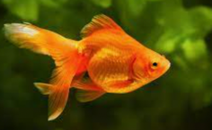
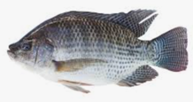
Fish to Clean the Pond
Fish that clean ponds by eating algae and other debris include:
common pleco
mosquitofish
Siamese algae eater
grass carp. Be careful with carp, koi and other bottom feeders – they can make your pond look dirty
What Types of Fish Eat Duckweed?
Duckweed is a thick, green weed that grows on tops of water (similar to algae but is much thicker and denser).
Grass Carp
Koi fish
Goldfish
Tilapia
Grass Carp
Plecos (Plecostomus Catfish)
Mosquitofish
Koi fish
Tilapia
Siamese algae eater
Gold fish

Slide 2
Google for:
fish store near fremont ny
.. https://www.yelp.com/search?find_desc=fish+stores&find_loc=Rockland+County%2C+NY

Slide 3
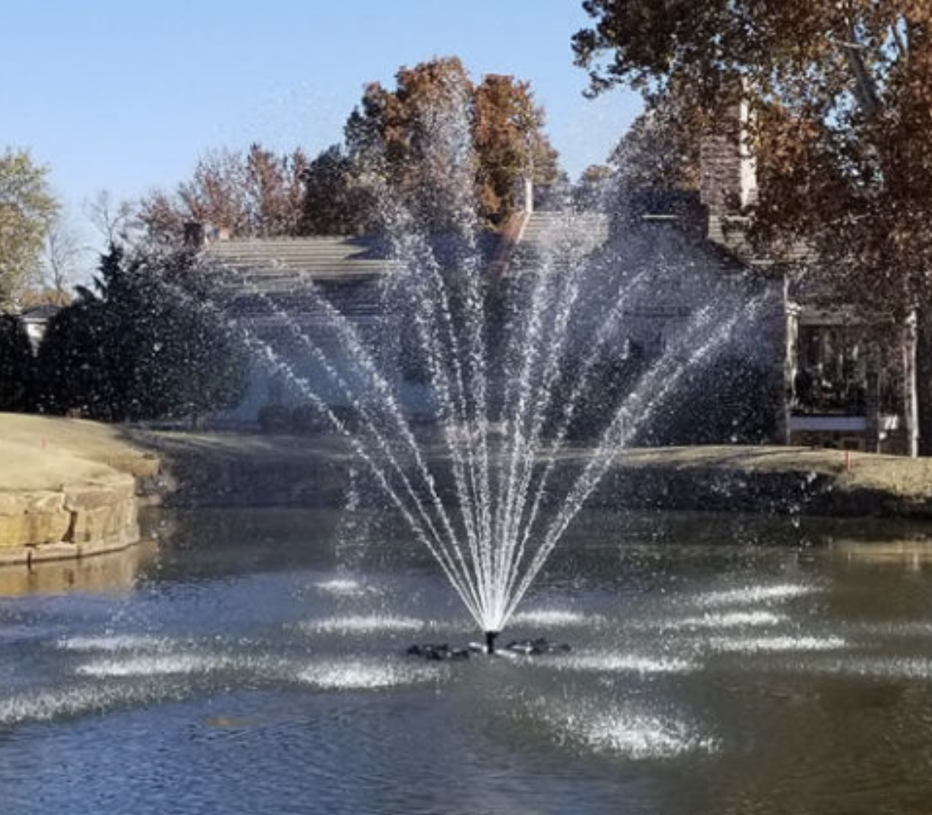
Solar Powered Aerator
https://www.scottaerator.com/bubble-pro-mini-sub-surface-aerator
Solar Powered Pond fountain
https://outdoorwatersolutions.com/products/solar-powered-fountains/elite-solar-pond-fountains/

