Slide 1
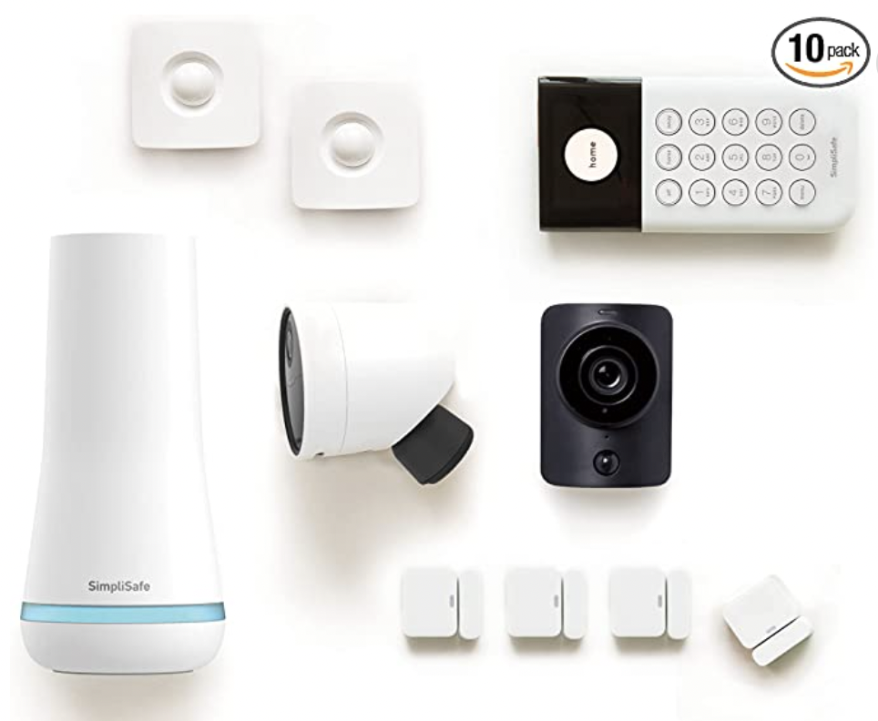
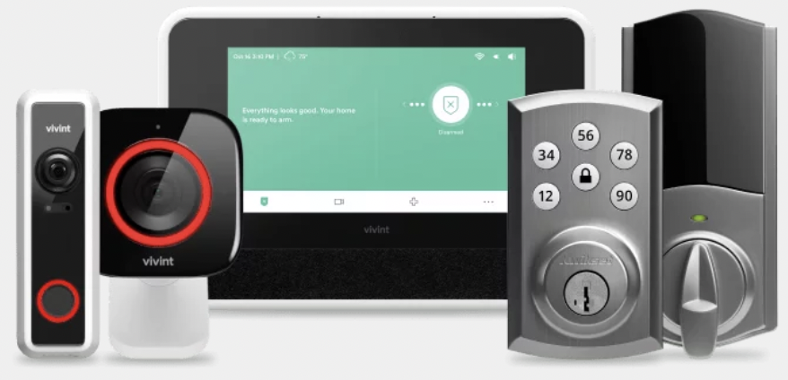
Security System
Best home security systems of 2022 .. https://www.safewise.com/best-home-security-system/ab/
Mostly require monthly contract $17-$35/mo
Vivint: Best overall
SimpliSafe: Budget pick
ADT: Trusted brand name
Cove: Best customer experience
Frontpoint: High-end DIY pick
Abode: Best DIY automation security system
Ring Alarm: Best outdoor cameras
Blue by ADT: Best optional monitoring system
Wyze: Most gadgets
Brinks: Most safety sensor options
Best No Monthly Fee Home Security Systems
https://www.security.org/home-security-systems/best/no-monthly-fee/
Top pick: SimpliSafe
https://simplisafe.com/value
https://www.amazon.com/SimpliSafe-Wireless-Security-System-Outdoor/dp/B09C9VDVHF/
$251 - SimpliSafe 10 Piece Wireless Home Security System with Outdoor Camera, no contract, compatible with Alexa and Google Assistant

