Slide 1
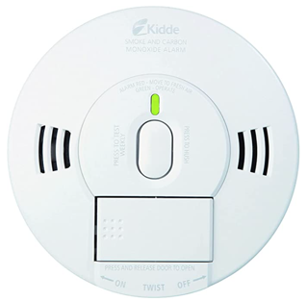
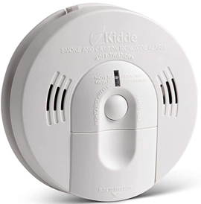
Smoke & Carbon Monoxide Alarm
Kidde Smoke & Carbon Monoxide Detector, Hardwired Interconnect, Combination Smoke & CO Alarm with Battery Backup, Voice Alerts
https://www.amazon.com/dp/B086S4CHCR/
Kidde Smoke & Carbon Monoxide Detector, Battery Powered, Combination Smoke & CO Alarm, Voice Alert
https://www.amazon.com/dp/B00PC5S0PA

Slide 2
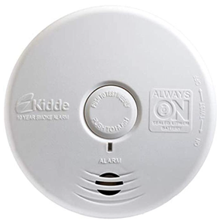
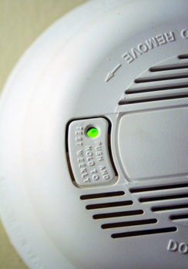
Our old alarms
Kidde Smoke Detector
https://www.amazon.com/dp/B086S5HQZX
Old Carbon Monoxide detectors

