Slide 1
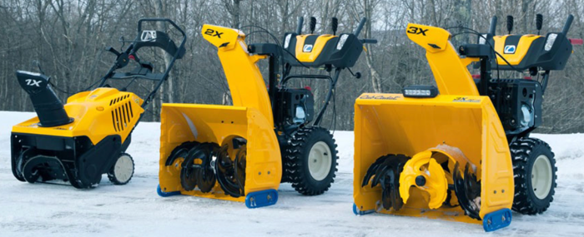



Single-Stage Models: The auger both pulls up and discharges the snow.
The snow discharge distance is usually limited to about 3".
Because the auger touches the ground, it is covered in rubber
to protect the surface.
Works only on paved surfaces.
Two-Stage Models:
The auger only pulls up the snow from the ground.
A separate component within the snow blower, the impeller,
discharges the snow from the chute.
This allows the snow blower to send the snow up to 60"
Because the auger does not touch the ground, it is all metal
(not rubber-tipped, as with the single-stage models).
Works on any surface (paved, gravel, dirt).
Three-stage Models:
same stages as the two-stage snow blower, but the addition
of a third stage, the accelerator.
Accelerator allows snow to be driven through the impeller
quickly – more power, speed, heavy snow removal
auger
impeller (throws snow through the tube)
accelerator (pushes snow to impeller)
24" width is good.
gas engine (at least 6 hp)
should be 2-stage or 3-stage
Electrical start
can have Fuel Injection, but not required

Slide 2
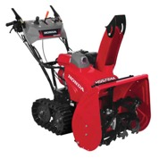
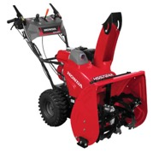
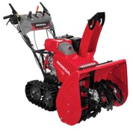
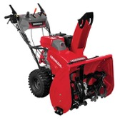
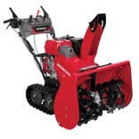
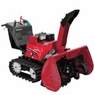
Honda – best snowblowers
https://powerequipment.honda.com/snowblowers
$3,300
$3,100
$3,700
$3,500
$4,100
$9,300
HSS724AT / HSS724ATD
Two stage 24"
Track drive (better)
adjustable auger height
24" wide
1500 lb./min
Throws snow 49 feet
Self propelled
hydrostatic drive
Electric start (ATD only)
HSS724AW / HSS724AWD
Same, but with Wheel drive
HSS928AT / HSS928ATD
Two stage 28"
Track drive (better)
adjustable auger height
28" wide
1900 lb./min
Throws snow 52 feet
Self propelled
hydrostatic drive
Electric start (ATD only)
HSS928AW / HSS928AWD
Same, but with Wheel drive
HSS1332AT / HSS1332ATD
Two stage 32"
Track drive
adjustable auger height
32" wide
2750 lb./min
Throws snow 56 feet
Self propelled
hydrostatic drive
Electric start (ATD only)
HSM1336i
Two stage 36"
Hybrid:
two electrical motors: drive
gas motor: auger+impeller
Mode:
Auto,
Semi-Auto
Manual
36" width
up to 3000 lb./min
Track drive
Electric start
Best Choice

Slide 3
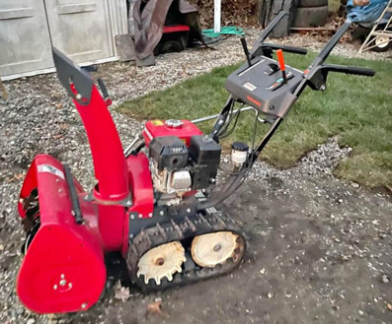
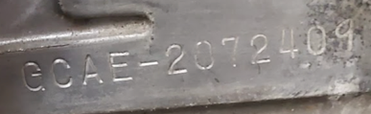
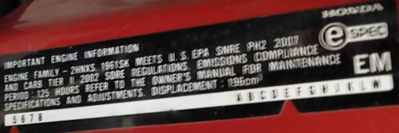
I bought used Honda HS724 in December 2022
Missing lamp/light.
The manual shows copyright year 2001.
Honda Engine Serial # GCAE-2072409
The label on the frame says that
it meets the US "EPA SNRE PH2 2007",
Does "2007" mean the year?
https://www.jackssmallengines.com/jacks-parts-lookup/manufacturer/honda/snow-blower

