Slide 1
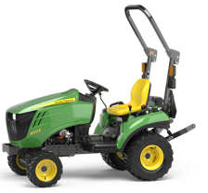
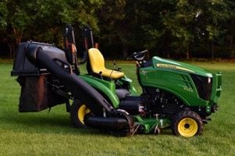
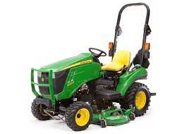
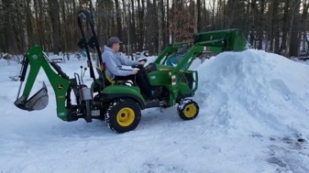
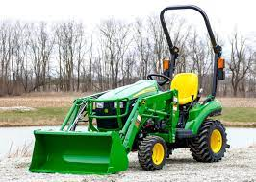
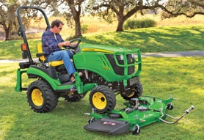
John Deere Sub-Compact Tractor
1023E - $15,600
1025R - $18,400
https://www.deere.com/en/tractors/compact-tractors/1-series-sub-compact-tractors/1023e/
https://www.deere.com/en/tractors/compact-tractors/1-series-sub-compact-tractors/2023-1025r/
https://www.youtube.com/watch?v=TeHIpRNJ3LU
Engine - diesel , 21.5 or 24 hp
PTO – 14.5 or 17.2 hp
mower deck, 120R loader, ...
1025R is better – more PTO power, can use 3-point hitch implement, PTO precision handling, better seat, better steering
Front loader
Quick attach
back counter-weight
mower platform + bagger
tires, dual-tires
additional hydraulics
Auto-connect mower platform

Slide 2
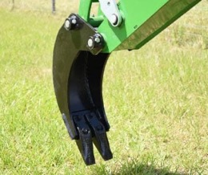
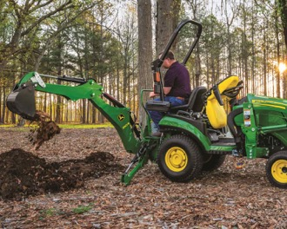
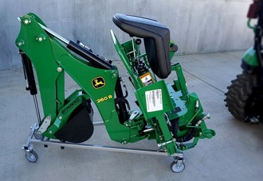
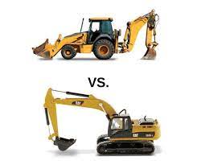
Backhoe 260b – use with 1025R
$6K
has its own seat
regular bucket, trenching bucket
trenching bucket
Wheeled Backhoe – smaller, lighter, more agile
Tracked Excavator - heavier duty, can dig more, father and deeper

Slide 3
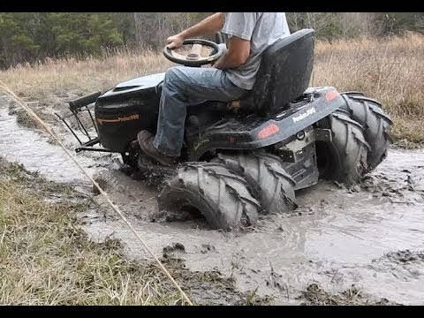
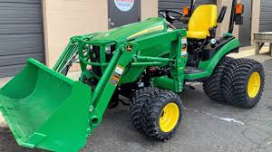
Dual Tires (Dualies)
https://www.youtube.com/watch?v=oDdR-KLIF-Q
Can potentially help in muddy conditions
Distribute the weight over a larger surface area, which can reduce ground pressure, thus preventing the tractor from sinking into soft or muddy ground
Increase traction since there are now twice the number of lugs (the raised patterns on a tire) making contact with the ground.
Downsides:
Added Weight
Turning Resistance
Cost and Installation
Wider Profile (harder to navigate)
Soil Compaction
Other solutions to consider:
tire chains
wider single tires

Slide 4
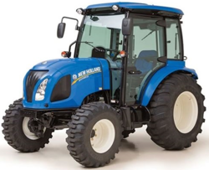
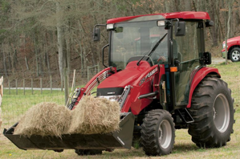
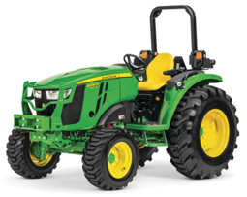
Tractor $30-$50K
https://www.tractor.com/news/5-of-the-best-compact-tractor-choices/
Power Take-Off (PTO)
The tractor's stub shaft, often called the PTO,
rotates at 540 or 1000 rpm (9..17 times/sec)
and used to transfer power to external attachments.

Slide 5
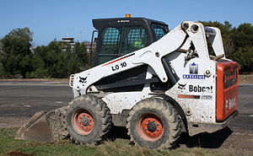
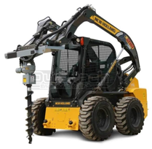
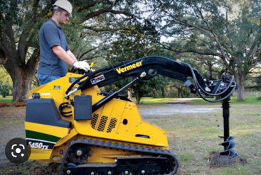
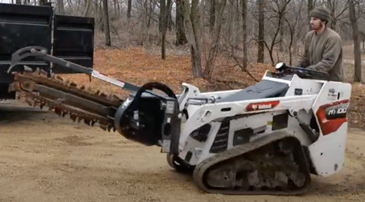
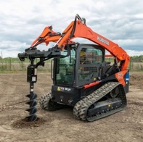
Skid Steer
https://en.wikipedia.org/wiki/Skid-steer_loader
A skid loader, skid-steer loader, SSL, or skidsteer:
compact vehicle with lift arms
typically four-wheeled or tracked
extremely maneuverable , can turn in place ("zero-turn")
right and left wheels are independent (have separate transmissions)
wheels don't turn
turning accomplished by different speed of left and right sides
Post Hole Auger Drive
Mini Skidsteer with Post Hole Digger
Bobcat LT-113 Trencher and MT100

Slide 6
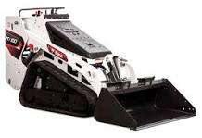

Bobcat MT100 Skid Steer
https://www.youtube.com/watch?v=rG7cya22ksI – good video review
$26K - $35K used, $42K new
Bobcat LT-113 Trencher and MT100

