Slide 1
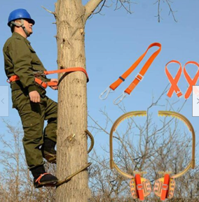
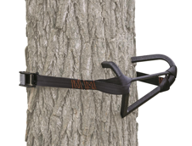
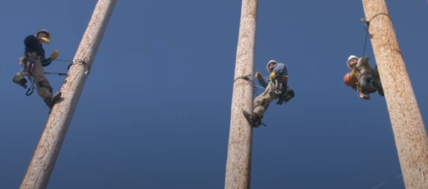

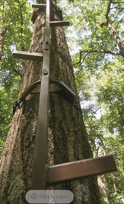
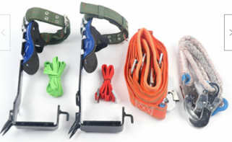
Tree Climbing
Primal Tree Stands Strap On V-Treestep
https://www.youtube.com/watch?v=Kb1pyjAStMk
2 Gears Tree Climbing Spike Set
Pole Climbing Spike with Adjustable Safety Belt: $47 on ebay
Climbing Poles
Linemen – men maintaining power lines
https://www.youtube.com/watch?v=0C_8TfmA5UA
https://www.youtube.com/watch?v=GiGlypZJ9yI
Professional Tree Climbing Spike
Pole Climbing Spurs
Climber Tool+Safety Belt
$52 on ebay
Guide Gear 20' Rapid Climbing Sticks – 20 feet, $60

