Slide 1
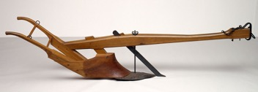
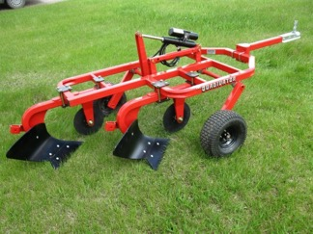
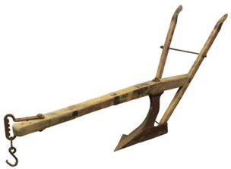
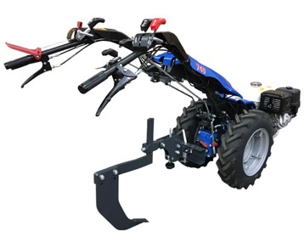
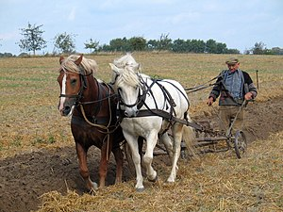
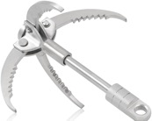
Make a Trench
A moldboard is the curved part of a plow that cuts into the soil, lifts it, and turns it over. It's a fundamental component in traditional plows.
Plow (Plough)
Subsoiler
Middlebuster
Tiller
Tow behind plow
bottom plow
Large Grappling Hook

Slide 2
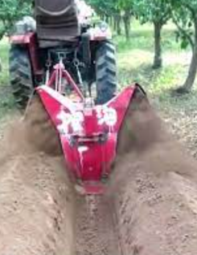
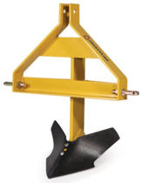
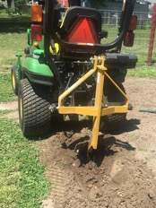
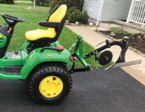
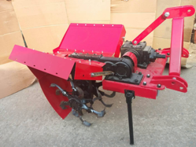
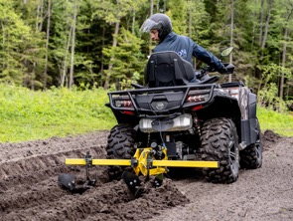
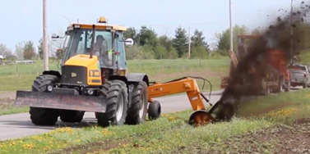
CountyLine Middle Buster
$300.00
Middle Buster (shallow) tow behind
Taizhou Harctor Machinery CO.,LTD
ATV garden plow
Hurricane Ditcher

Slide 3
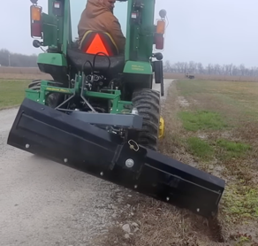
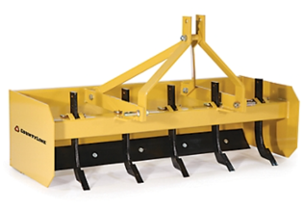
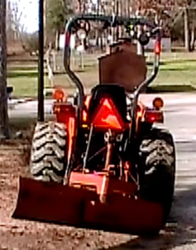
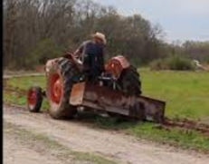
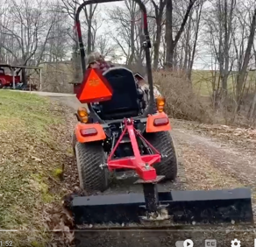
Making trench using tractor box blade at an angle
box blade
rear angle box blade
making a trench

Slide 4
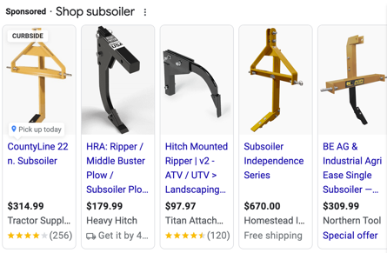
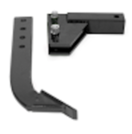
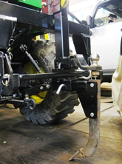
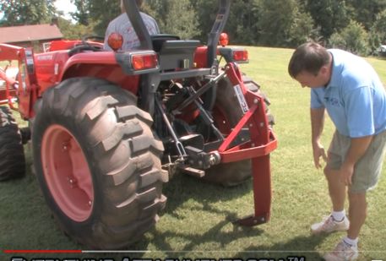
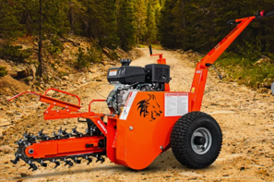
Subsoiler (tractor-mounted or walk behind)
https://en.wikipedia.org/wiki/Subsoiler
A subsoiler or flat lifter is a tractor-mounted farm implement used for deep tillage, loosening and breaking up soil at depths below the levels worked by moldboard ploughs, disc harrows, or rototillers.
Subsoiling is a slow operation and requires high power input: 60 to 100 horsepower (45 to 75 kW) to pull a single subsoil point through a hard soil.
Typically, a subsoiler mounted on a compact utility tractor will reach depths of about 30 cm (12 in) and have only one thin blade with a sharpened tip.
The subsoilers are raised and lowered hydraulically.
Some models feature power-take-off (PTO)-driven vibrating devices.
Ripper/Middle Buster Plow
Subsoiler Plow, Potato Plow
https://www.amazon.com/Ripper-Sub-Soiler-Potato-Middle-Standard/dp/B078QW39ZC/

Slide 5
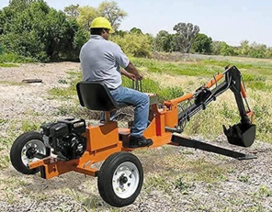
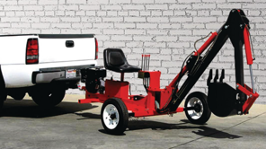
Towable Backhoe (Sit-On Trencher)
Central Machinery Towable Backhoe (Sit-On Trencher) with 9 HP Engine
Harbor Freight 62365 Trencher
$4,400.00

Slide 6
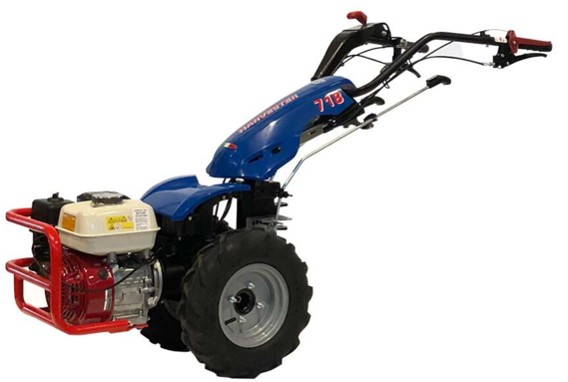
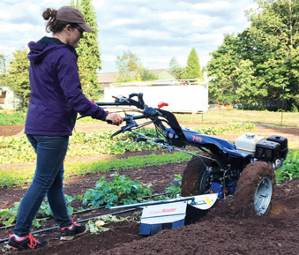
BCS America
Walk-behind tractors, various attachments
(tiler, roller, plow, spreader, ridger, rotary plow, subsoiler, cultivator, brush mower, etc.
https://www.bcsamerica.com/products/tractors

Slide 7
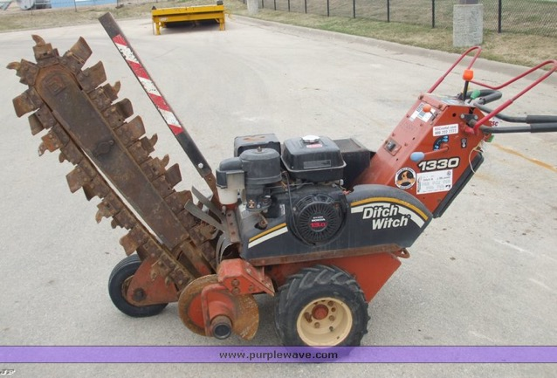
Ditch Witch
https://www.ditchwitch.com

