Slide 1
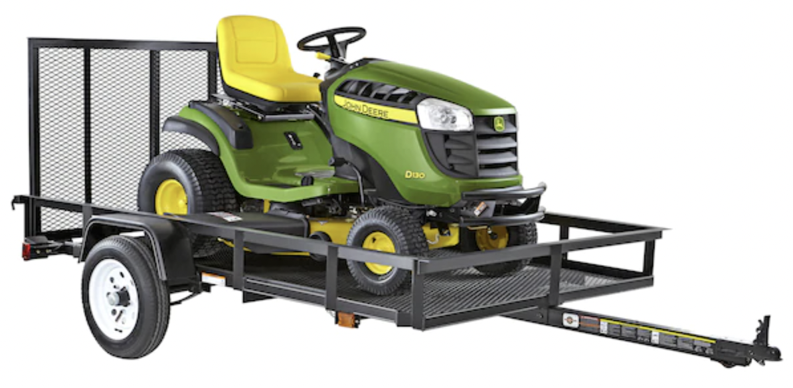
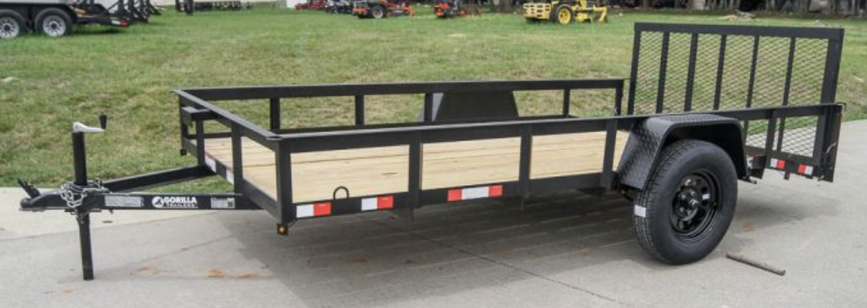
Towing Capacity
Toyota Sienna Towing capacity is 3,500 lbs
Towing capacity is the most weight your car can pull both legally, and safely.
Towing too much weight can lead to your trailer swinging, and pulling your vehicle out of control.
It can also create difficulty stopping, and wear out your brakes quickly.
It is against the law to tow more than the towing capacity of your vehicle, your towbar, or towball.
Carry-On Trailer 5-ft x 8-ft Wire Mesh with with Ramp Gate,
1625 lbs load + 375 lbs weight = 2,000 lbs total max
$1,150.00
https://www.lowes.com/pd/Carry-On-Trailer-5-ft-x-8-ft-Wire-Mesh-Utility-Trailer-with-Ramp-Gate/3005264
Weight of the trailer itself ?
Get light aluminum trailer?
Does trailer has its own breaks ?
John Deere 425 weight is 900 lbs
UXV590M weighs 1,435 lbs (650 kg)
For a UXV590M weighs 1435 lbs. We will need a bigger 6' x 12' single-axle trailer,
for example this 6.4x12 Dovetail Utility Trailer – 3500 lb Axle
$1,825.00
https://sleequipment.com/6x12-utility-gor-utility-trailer.html

Slide 2


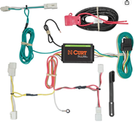



ATV UTV Trailer
2021 ATV UTV Trailer Buying Guide for 4-Wheelers and Side by Sides .. https://www.youtube.com/watch?v=CIA2vd6cUCY
PJ Channel Utility UTV ATV Landscape Trailer Comparisons .. https://www.youtube.com/watch?v=XCP5LlA0LWg
Sure-Trac Tandem Axle Utility Trailers .. https://www.youtube.com/watch?v=2GQmRGrmeKE
Trailer Hitch➔ https://amzn.to/3eHPBo8
Ball Mount➔ https://amzn.to/2xExf75
Hitch Ball➔ https://amzn.to/2RXAEVe
Wiring Harness➔ https://amzn.to/2RWvDw5
Hitch
$150
Hitch Ball Mount
$20
Ball
$10
Wiring Harness
$55

Slide 3
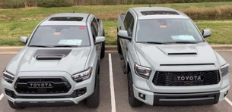


Truck – $20-50K
Toyota Tacoma Truck https://www.toyota.com/tacoma/
Toyota Tundra Hybrid Truck https://www.toyota.com/tundra/
Toyota All Electric Truck https://www.youtube.com/watch?v=ETwjPUKzGEw
Tacoma vs Tundra
Car - $50K
All Electric (2023 ?)
Toyota Sienna Minivan AWD (All Wheels Drive) 7-seater https://www.toyota.com
Toyota Sienna AWD
towing capacity 3,500 lbs
Trailer Hitch installation:
https://www.youtube.com/watch?v=GTk8iqXha7Q
Another good video: https://www.youtube.com/watch?v=Ujg61Ync2Mc

