Slide 1
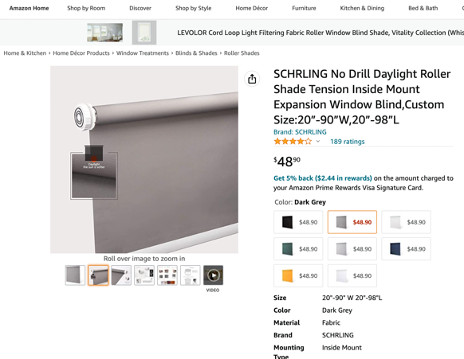
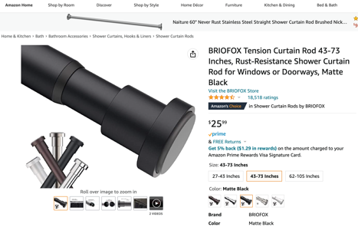
Tension Blinds for Windows
Drill-free installation options:
Tension Rods for Curtains (like bathroom curtain rod, only for light curtains)
Twist and Fit Curtain Rods Example: BRIOFOX Tension Curtain Rod 43-73" https://www.amazon.com/BRIOFOX-Tension-Curtain-Rust-Resistance-Doorways/dp/B07V354X63/
Compression Systems
Temporary hooks using adhesive pads
SCHRLING No Drill Daylight Roller Shade Tension Inside Mount Expansion Window Blind,Custom Size:20”-90”W,20”-98”L

