Slide 1
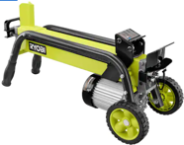
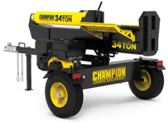
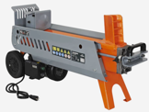
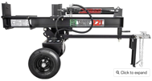
Wood Log Splitter
22 tons,
electric
$2,850 new
34 tons,
gas engine, $1,900 new
5 tons, electric, $45 on facebook marketplace
9 tons,
electric
$550 new

Slide 2
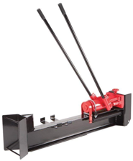
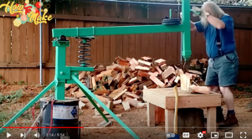
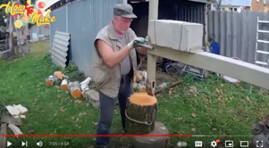
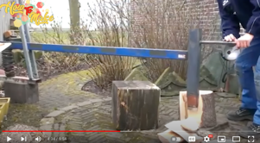
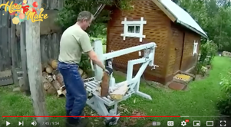

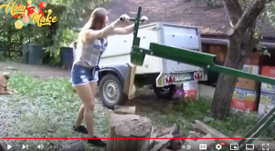
Maunual Firewood Splitter
https://www.youtube.com/watch?v=7txUWFFHkBc
https://www.youtube.com/watch?v=wd_E9VhSfSg
10 Ton Horizontal Log Splitter Wood Cutter Manual Hydraulic 2 Speed
.. https://www.amazon.com/dp/B006ZBCB3M

Slide 3
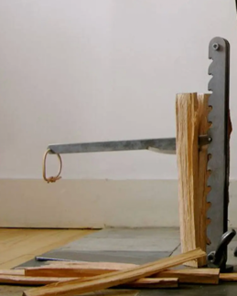
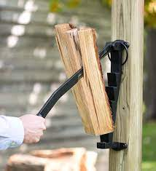
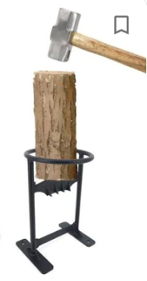

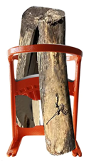
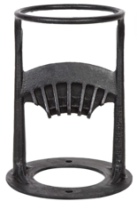
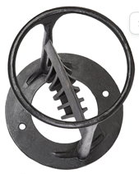
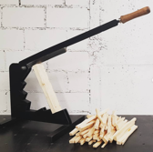
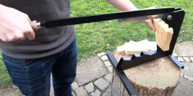
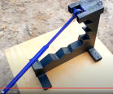
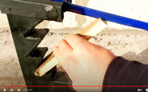
Firewood Kindling Splitter
The Beaver Lever Kindling Cutter
Stikkan Softwood Kindling Splitter
Kindling Cracker Wood Splitter for Firewood
https://www.youtube.com/watch?v=HGLJjR5frtc
https://www.youtube.com/watch?v=HGLJjR5frtc
https://www.youtube.com/watch?v=ZI6cwHRAu8U
Firewood Kindling Splitter

Slide 4
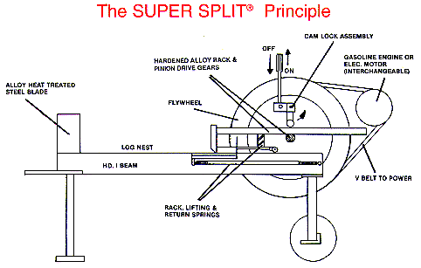
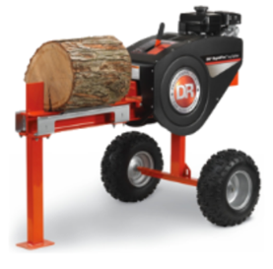
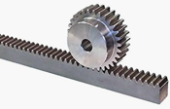
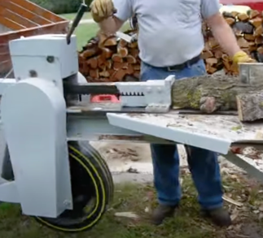
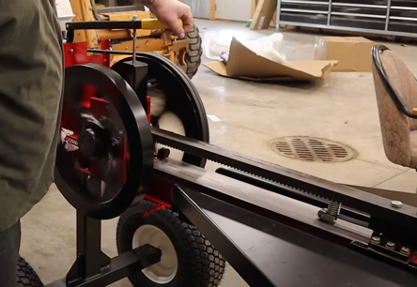
Fly Wheel Log Splitter = kinetic log splitter
Google for vintage fly wheel log splitter
https://www.youtube.com/watch?v=hlAerawLdYU
rack and pinion gear
Motor (gas or electric) rotates massive flywheel(s)
The shaft (axle) of this wheel has a (pinion) gear
A moveable rack also has gear.
It is pressed to the shaft gear using a cam lock
The rotating gear pushes the rack in a short burst, then disenges
Several burst may be needed to split the wood

