Slide 1
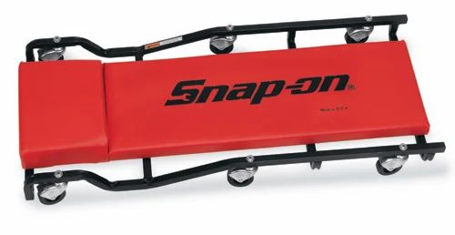
Best Mechanic's Creeper
https://www.youtube.com/watch?v=4QSQ9Qz202M – video review
Big Red Plastic: https://amzn.to/3H1jWxC
Big Red Metal: https://amzn.to/47bbVAN
Pro-Lift Plastic: https://amzn.to/3NEDEmb
DNA Motoring: https://amzn.to/3tD6NHN
JEGS plastic: https://amzn.to/48dQJLL
Vevor: https://amzn.to/48w8DZS
JEGS Metal: https://amzn.to/47bbGFT
K Tool: https://amzn.to/48xKX7w
Performance Tool: https://amzn.to/3NIVt3R
Traxion: https://amzn.to/41GC1u3
Omega: https://amzn.to/41GIi9g
Pittsburgh and Daytona are sold at Harbor Freight
Snap On available at the online Snap On store
$300+

