Slide 1
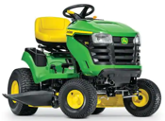
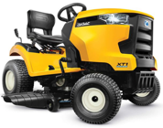
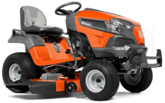
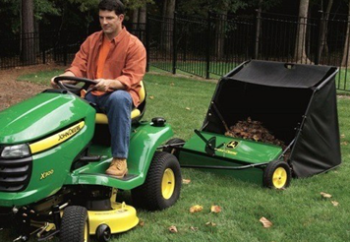
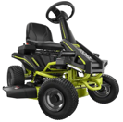
Riding Lawn Mower ($3-$4K)
https://www.familyhandyman.com/list/best-riding-lawnmowers/
John Deere S100
Gas Hydrostatic Lawn Tractor
42 in. 17.5 HP
$2,300 at Home Depot
Husqvarna TS 248XD Lawn Tractor
$3,600
cub cadet lawn mower
Husqvarna YTA24V48 and the Cub Cadet XT1 LT42
Ryobi RY48111
Electric Engine 38 inches 100 Ah Battery
$2,700 at Home Depot
John Deere Lawn Tractor
with sweeper

Slide 2
John Deere Lawn Mowers - comparison
Mullally Tractor Sales
16 miles, deliver
M-F, Sat 8-5, Sun 8-12
4510 NY-52, Jeffersonville, NY 12748
Phone: (845) 482-5222
Lindsey Equipment
27.4 miles
M-F 8-5, Sat 8-12, Sun closed
237 Sunrise Avenue, Honesdale, PA 18431
(570) 253-3334
in-store pickup only
Delaware Sport Center LLC
27.8 miles
M-F 8-5, Sat 8-2pm, Sun closed
30104 State Highway 10, Walton, NY 13856
(607) 865-8888
in-store pickup only
 | S240 | S330 | S350
Price | 3.3K | 3.8K | 4.0K
Engine | 18.5HP, v-twin cylindrical | 22HP, v-twin cylindrical | 21.5HP iTorque 2-cyl gasoline
Cutting | 42" | 42", cuts evenly | 42", cuts evenly
Frame strength and protection | average | strong | strong
Steering | 18" turning radius | 16" turning radius, very low-effort | 16" turning radius, very low-effort
Fuel tank | 9.1 liter | 12.5 liter | 12.5 liter
Main differences | Cheaper | Better for bigger area, bigger tank, better protection | Better for bigger area, bigger tank, better protection

Slide 3
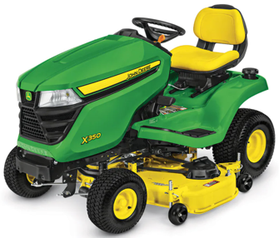
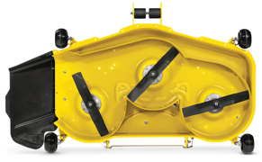
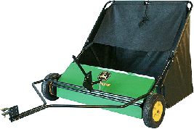
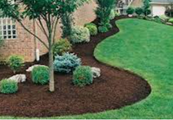
John Deere X350 Lawn Tractor with 48-inch Deck
$4,500.00
21.5-hp (16.0-kW)* iTorque™ Power System
48-in. (122 cm) Accel™ Deep Deck, MulchControl™ kit (close side door to cut grass and mulch it instead of throwing it to the side)
Twin Touch™ forward and reverse foot pedals
4 year/300 hour bumper-to-bumper warranty
X350: .. https://www.deere.com/en/mowers/lawn-tractors/x300-series/x350-lawn-tractor-48-in/
MulchControl™ Kit:
.. https://www.deere.com/en/campaigns/ag-turf/mower-decks/mulching-mower-decks/
Attachments:
.. https://www.deere.com/en/attachments-accessories-and-implements/riding-mower-attachments/
Lawn Sweeper 42" $580:
.. https://www.deere.com/en/attachments-accessories-and-implements/attachments-search-tool/#/detail/LPSTS42JD.
X350 cuts tall grass (video):
.. https://www.youtube.com/watch?v=j5_tsp1cQeI
$580.00
Mulch = a layer of (organic) material
applied to the surface of soil
Mulching = spreading a layer of (cut)
material on the ground around plants
sweeper
Accel Deep™ Mower Deck (included)
Deep draw and flat-top design
better quality of cut
at faster ground speeds

Slide 4
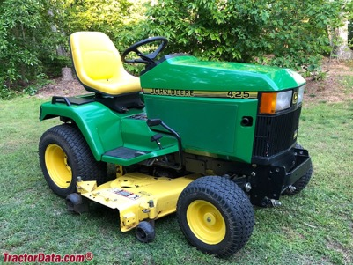
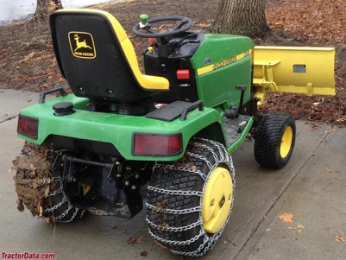
John Deere 425 (and 445)
1992 - 2001
Built in Horicon, Wisconsin, USA
Original price was $8,995 in 1995
Engine: 20HP Kawasaki 617cc 2-cyl gasoline
carburetor
(model 445 has 22 hp and fuel injection)
Fuel tank: 6.5 gal
Transmission: hydrostatic
Two-wheel drive, differential lock (mechanical rear)
Power Steering
425 Serial Numbers
https://www.tractordata.com/lawn-tractors/000/0/4/43-john-deere-425.html
Year. First tractor
1993 010001
1994 020001
1995 030001 M00425A-036065
1996 040001
1997 050001
1998 060001
1999 070001
2000 080001
2001 090001

Slide 5
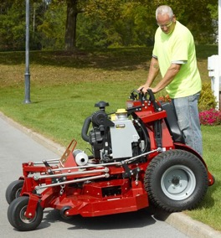
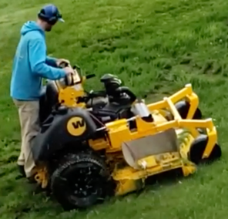
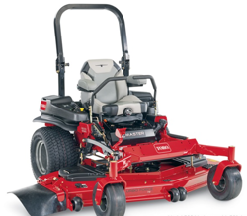
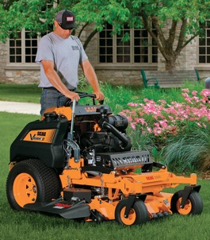
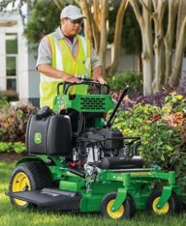
Pro Mowers
Top 3 Stand On Mowers: 1. Ferris Z3X
2. Wright ZK
3. Scag V-Ride II
TORO Z-MASTER (38 hp) – $17K
https://www.toro.com/en/professional-contractor/commercial-mowers/6000-series-60-38-hp-999cc-horizon-technology-72946
https://www.youtube.com/watch?v=eQMdzvXnxpg
Ferris Z3X (37hp, 61") - $12K
Wright ZK (37hp, 61") - $16K price
model WSZK61S61E8E-49S
https://www.wrightmfg.com/download/sales/pricing/Wright_Power_MSRP_2023_Rev02_2022_06_22a.pdf
Top brands for "Stand On" mowers:
1. (best) Wright ZK
2, 3, 4 – Exmark Staris, Scag Vride 2, Feris Z3X.
5. Cub Cadet Pro X600
John Deere 648R Quiktrak (22hp) – $10K
Scag V-Ride II (37hp, 61") - $11K

Slide 6
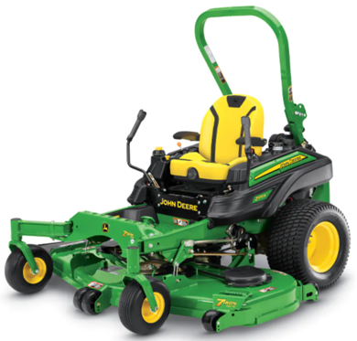
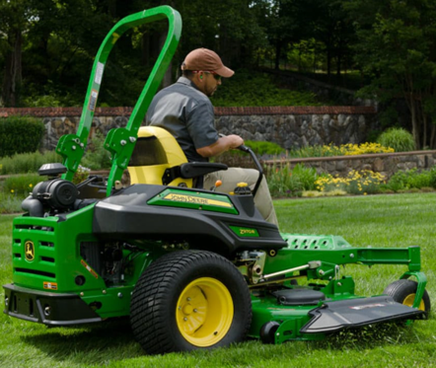
John Deere Z970R Zero-Turn Mower (35hp)
https://www.deere.com/en/mowers/commercial-mowers/commercial-zero-turn-ztrak-mowers/z970r-mower/
Base Price - $19K

Slide 7
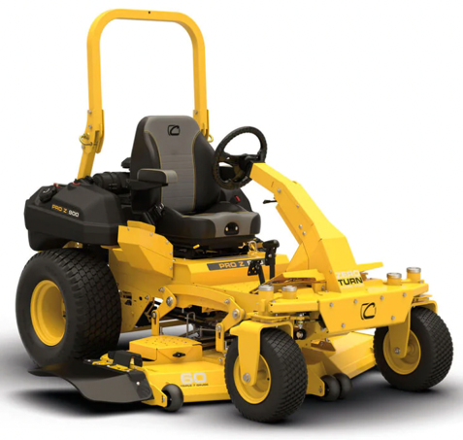
Steering Wheel Zero Turn
CUB CADET PRO Z 960 S KW Steering Wheel Commercial Zero Turn
.. https://www.arcolawn.com/products/pro-z-960-s-kw-steering-wheel-commercial-zero-turn

Slide 8
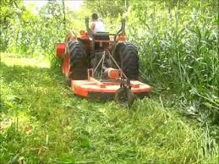
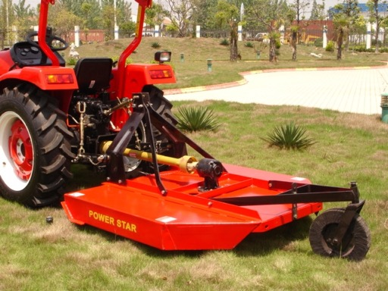
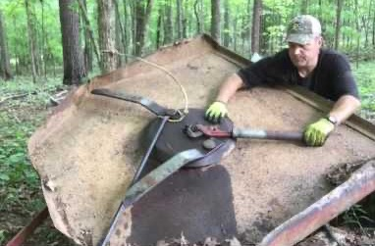
Brush Hog
brush = scrub vegetation = low woody plants (between grass or heath and high forest).
Bush hogging, a.k.a. brush hogging - clearing lands of tall grass, small trees and brush.
A bush hog is a rotary cutter usually attached to the back of a farm tractor using the three-point hitch and are driven via the power take-off (PTO). No belts !!
A bush hog has blades that are not rigidly attached to the drive like a lawnmower blade but are on hinges. This way, if the blade hits a rock or a stump, then it can bounce backward or inward. The centrifugal force will then make it go outwards again.
A tractor need to have a hydraulic system and a PTO shaft

Slide 9
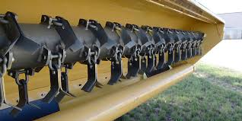

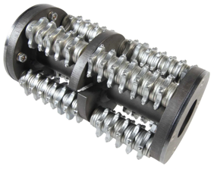
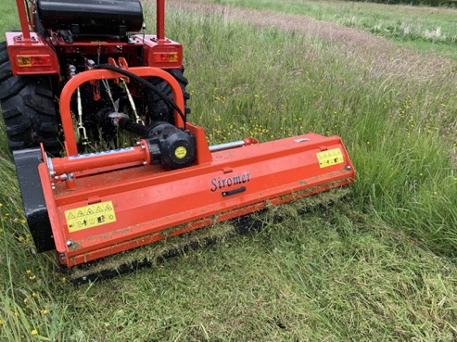
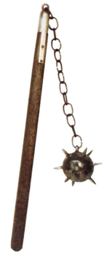
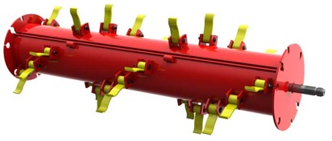
Flail Mower
flail - a deadly medieval age weapon - a wooden staff with a short heavy stick or ball swinging from it.

Slide 10
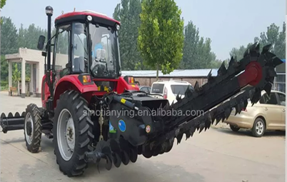
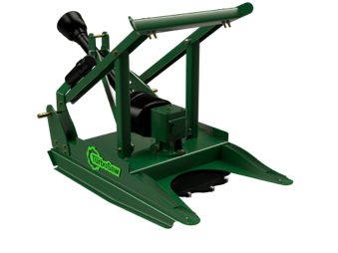
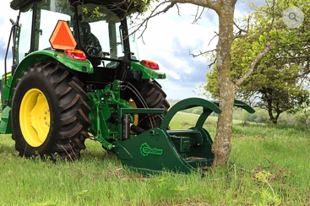
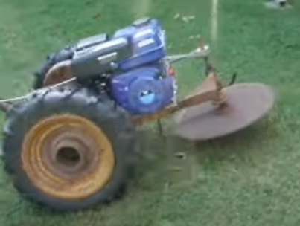
Tractor Saw

Slide 11
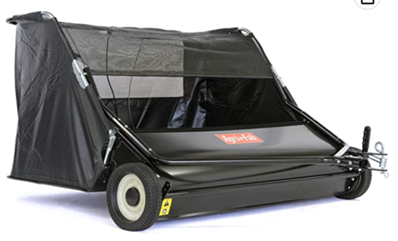
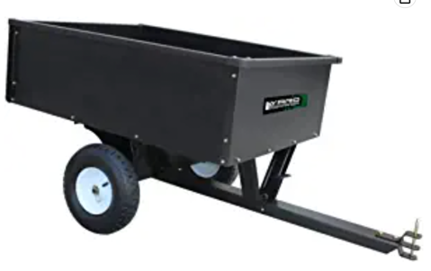
Sweeper
Dump Cart
Agri-Fab Inc 45-0546 52" Lawn Sweeper, Black
https://www.amazon.com/gp/product/B07KMX858N/
10 Cubic Feet Steel Dump Cart
https://www.amazon.com/dp/B08R95SSTJ

Slide 12
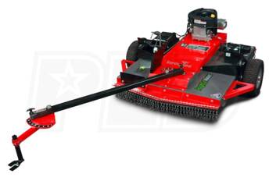
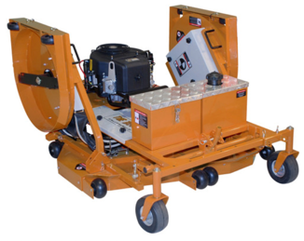
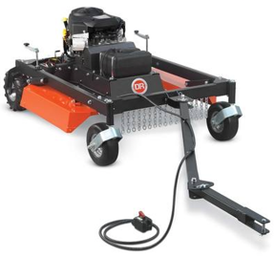
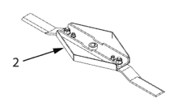
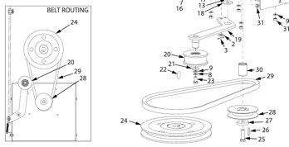
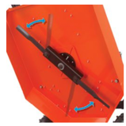
Pull-Behind Mower
Pivoting Blades
Beast 22 HP 100 in. Tow-Behind Mower, Convertible into a 52 in. Finish Cut or Brush Mower, Powered by a 22 HP Subaru Engine, RECONDITIONED
$2,090.00
Earthquake (44") 17.5HP Briggs Tow-Behind Rough Cut Mower w/ Electric Start
$2,500.00
Acreage™, Division of Ardisam, Inc.
1160 8th Avenue, PO Box 666, Cumberland, WI 54829
800-345-6007 | Fax 715-822-2223
acreageimplements.com = https://www.getearthquake.com/
DR Field and Brush Mower PRO XL44T (20HP) $3,800.00
https://www.gxioutdoorpower.com/beast-22-hp-100-in-tow-behind-mower-convertible-into-a-52-in-finish-cut-or-brush-mower-powered-by-a-22-hp-subaru-engine-not-sold-in-california-reconditioned/
https://www.drpower.com/Power-Equipment/Field-%26-Brush-Mowers-/Tow-Behind/DR-Field-and-Brush-Mower/p/TB23044BEN
https://www.mowersdirect.com/Earthquake-RC4432/p70906.html

Slide 13
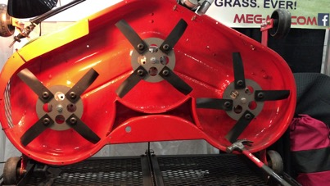
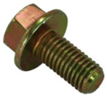
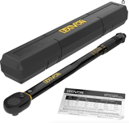
Meg-Mo blades
To order I need to provide this info:
Center hole - round
Current Blade OEM Part # M115495
https://meg-mo.com
The MEG-MO™ Rotary Mulching Blade System
John Deere Standard Mower Blade for 48" deck
Part Number: M115495
Hole in the center – round, 13/16 inch
Length of the blade (rotating diameter) 16 5/8 inch
Nut M18
Searching John Deere Parts:
.. https://partscatalog.deere.com/jdrc/navigation/equipment/73515
Then go to mower deck attachment:
.. https://partscatalog.deere.com/jdrc/navigation/equipment/78976
Then select "20 Mid-Mount Mower Decks 48-Inch and 54-Inch (For 425, 445 and 455 LGT)"
Then select "Belt Drive, Blades, Idlers and Spindles - ST561860"
.. https://partscatalog.deere.com/jdrc/sidebyside/equipment/78976/referrer/navigation/pgId/2341197
The John Deere Blade Bolt - 19M7788 (requires M18 nut driver (18mm)):
.. https://www.greenpartstore.com/John-Deere-Blade-Bolt-19M7788.html
E-Mail: sales@meg-mo.com Call (877) 625-0125
Received call from 815-625-0125
Riding mower blades should be installed between
70 and 90 foot pounds of torque
LEXIVON 1/2-Inch Drive LX-183 (10-150 Ft-lb)
https://www.amazon.com/LEXIVON-2-Inch-Torque-13-6-203-5-LX-183/dp/B07MP1Q3W8/

Slide 14
Self-made rotary cutter
https://www.youtube.com/watch?v=WIVh1qrUUAY
ATV Mower With three Harbor Freight Predator 173cc engines!
2017

