Slide 1
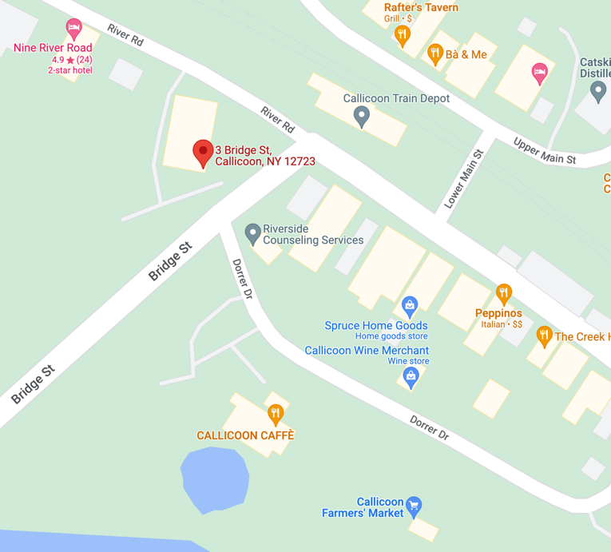
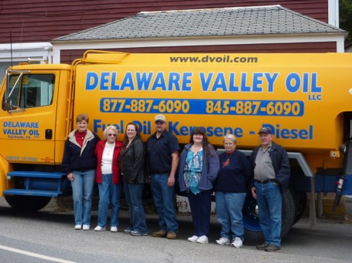
Oil - 550 Gallon Tank
Service?
Cleaning?
Delaware Valley Oil
http://dvoil.com
Phone (845)-887-6090
Office: M-F 8am-4pm
3 Bridge Street, Callicoon, NY 12723
P.O. Box 838 Callicoon NY 12723
Email delawarevalleyoilllc@yahoo.com
Email: LeanaStanton@aol.com
Owner: Casey Milk
Truck driver: Larry
Brian
845-645-9403
Plumber
(Boiler/Filter mainenance)
2022-07-06: 150 gal ($5.79/gal)

Slide 2
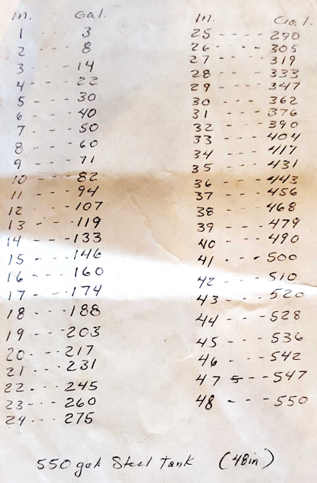
550 gal Steel Tank
Diameter: 48" (depth)

