Slide 1
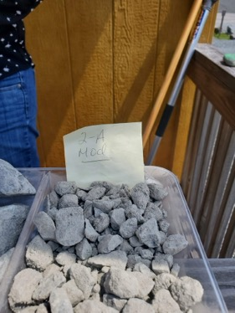
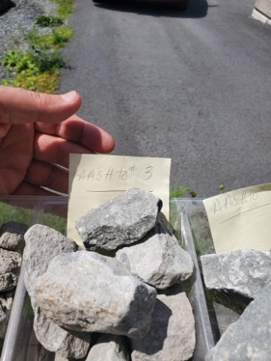
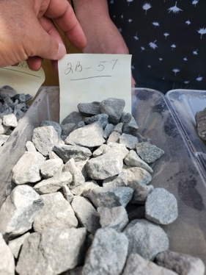
Gravel
Rutledge Excavating Gravel
570-224-4720•Jen_load_area – main phone
570-224-8042•Main_Office
570-224-4002•Driver_Toby_Johannes
2434 Hancock Hwy, Equinunk, PA 18417
2496 Hancock Hwy, Equinunk, PA 18469
https://www.facebook.com/RutledgeExcavating/
email: info@rutledgeexcavating.com
Brian Hillriegel. (d.b.a. B P Construction)
845-807-8592 - mobile
Co Rd 131, Callicoon, NY 12723
66 Hillriegel Dr, Callicoon, NY 12723-5338
2-A Mod
AASHTO # 3
2B - 57

Slide 2
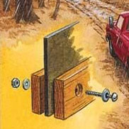
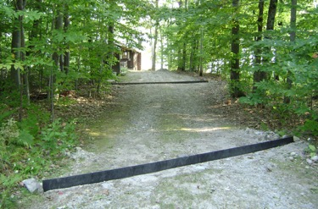
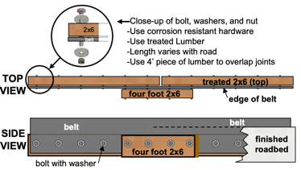
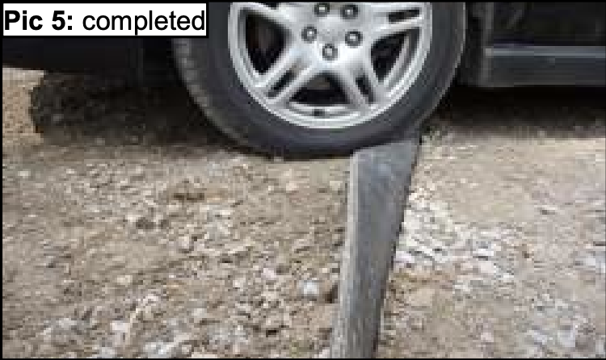
Water Divert Bar, Rubber Razors
DIY Rubber Razors, Waterbars: erosion prevention for roads, paths and trails
https://awwatersheds.org/rubber-razors-do-it-yourself-conservation-practices/
https://www.atlasbelt.com/waterbars.php
https://www.atlasbelt.com/conveyor-belt-water-diversions-instructions.php
Instructions:
https://www.atlasbelt.com/TB_Conveyor_Belt_Diversion.pdf
Recycled conveyor belt (0.5" x ~15" x road width+30%)
2x6" treated lumber.
corrosion resistant bolts, washers, and nuts
12 Bolts 3/8" diam ( 8 short (4"), 4 long (6"))
24 wide washers
12 nuts
You then dig a trench diagonally across the road deep enough to leave approximately 4" of the rubber belt exposed above your gravel road.
Once installed, trucks and other machinery can easily drive over the rubber and will spring back to its original position once they have passed.
Google for "buy recycled conveyor belt"
https://www.google.com/search?q=buy+recycled+conveyor+belt
https://www.miprcorp.com/conveyor-belts/used-belts/
https://www.repurposedmaterialsinc.com/conveyor-belt/
https://www.repurposedmaterialsinc.com/conveyor-belt/ohio-conveyor-inventory/

Slide 3
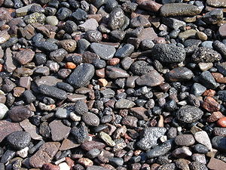
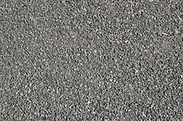
Gravel
https://en.wikipedia.org/wiki/Gravel
gravel is categorized into :
granular gravel (2–4 mm or 0.079–0.157 in)
pebble gravel (4–64 mm or 0.2–2.5 in)
ISO 14688 grades gravels as
fine - 2–6.3 mm (0.079–0.248 in)
medium - 6.3 – 20mm (0.248 – 0.79 in)
coarse - 20–63 mm (0.79–2.48 in)
One cubic meter of gravel ~ 1,800 kg = 4,000 lb
one cubic yard ~ 1,400 kg = 3,000 lb
Gravel
Crushed Stone
1/2 inch pebble gravel:
$15-75 per cubic yard
$25-53 per ton
$5-20 per bag
2" Lava Rock (red/brown)
$75-165 per cubic yard
$115-220 per ton
$5-22 per bag
2" River Rock
$45-140 per cubic yard
$60-170 per ton
$5-17 per bag
For 2 inches depth:
1/4 to 1/2 inch gravel (medium size): 100 square feet per ton
1/2 to 1 inch gravel (more coarse): 90 square feet per ton
1.5-2 inch gravel (coarse): 80 square feet per ton

Slide 4
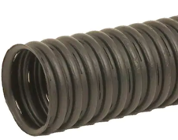
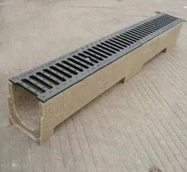
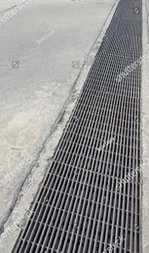
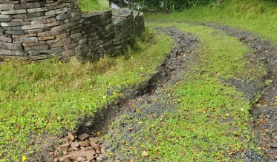
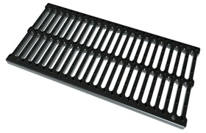
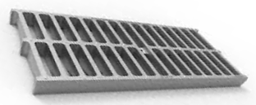
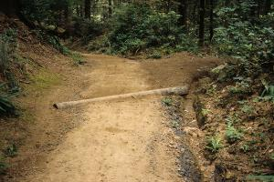
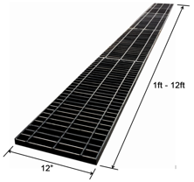
How to Drain or Divert Water
Perforated Drain Pipe
Advance Drainage Systems
Polymer Concrete Drain
Drainage Groove Water Drain Ditch
Water running down the road makes deep grooves in it.
drain grate
trench grate
Sewer Cover
Rainwater Grate
Trench Cover
Resin Manhole Cover
50cm x 30 cm x 2 cm
$44 at Walmart & Amazon
Steel Trench Grating "Sold by the Foot" 1" Thick x 12" Wide https://www.metalsdepot.com/product/3266
Water bars and drainage dips every ~10 meters diagonally to divert water to the side. You can use soil+gravel, or a log
https://roadsforwater.org/guideline/water-harvesting-and-drainage-from-unpaved-roads/use-basic-road-surface-drainage/

Slide 5
To stabilize your steep gravel road and prevent erosion,
focus on creating a reinforced foundation
with proper drainage and anchoring.
Here's a solution combining gravel stabilization techniques
with cement plate preparation:
Foundation and Stabilization Approach
1. Excavate 12-18" depth across the road width (minimum 8' for single lane); Install geotextile fabric over compacted subgrade to prevent soil mixing. Add 8-12" base layer of angular crushed gravel (¾" clean stone) compacted in 4" lifts.
2. Slope Anchoring System
| Method | Implementation | Benefit |
|----------------------|----------------------------------------------|---------------------------------|
| Ground anchors | Install 2.5' rebar anchors every 6' | Secures foundation perimeter |
| Retaining structures | Build concrete curb/block wall on lower edge | Prevents downhill slippage |
| Soil nails | 1/2" steel rebars grouted into slope | Adds shear resistance |
3. Gravel Locking Layer - Install geocell panels (BaseCore HD or TRUEGRID) over base gravel. Fill cells with 20mm angular gravel, compacting to create interlocked surface; Cap with 4" layer of finer crushed stone (5-10mm) for smooth finish.
4. Cement Plate Installation - Pour 6" reinforced concrete slabs (4000psi mix) with: 6×6 W2.9 welded wire mesh at mid-depth; ½" rebar dowels extending 18" into slope every 4'; Expansion joints every 10' with sealant; Texture surface with broom finish for water runoff
Critical Drainage Features
• Crowned surface: 2% cross-slope minimum for water runoff
• French drains: Perforated PVC pipes in gravel trenches along edges
• Check dams: Concrete barriers every 15m on steeper sections

