Slide 1
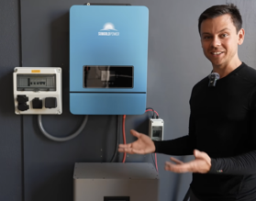
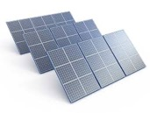
Solar
All-in-one
Put together 10KW 48V battery solar system in just one hour https://www.youtube.com/watch?v=rRqV8BHE8lY
"all-in-one" inverter unit - combines inverter, battery charger, and solar charge controller
Connect a 48V 16kWh battery to the inverter (using thick cables)
Install a solar PV disconnect switch (to disconnect the solar array)
AC Outlet Box - pre-wired box with breakers and AC outlets
Use flexible conduit (hoses) to protect the wiring
outlets
disconnect
To combine solar battery power with grid power automatically, you need a hybrid inverter with the Automatic Transfer Switch (ATS) to switch loads from solar battery to grid power when the battery level becomes low
Popular DIY-friendly options include EG4, Growatt, MPP Solar, and the premium Victron MultiPlus
These units can also blend both sources simultaneously, pulling partial power from each when needed.
Battery
PV panels = photovoltaic panels
convert sunlight directly into electricity using the photovoltaic effect
A PV panel is made up of many individual PV cells (usually silicon) that release electrons when photons from sunlight strike them
This electron movement creates a direct current (DC)

Slide 2
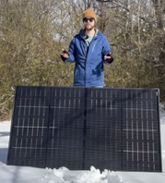

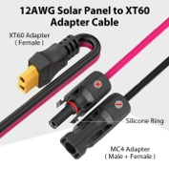
Recommendations from "What's Next"
https://www.youtube.com/@WattsNextSolar25/videos
FOSSiBOT F1800 (1,024 Wh, 1,800 W) – power station (battery+inverter+charge controller). Eco mode (solar first, grid backup)
Aferiy P310 (3,840 Wh, expandable to 11,520 Wh) - very good deal
Oupes Guardian 6000 (4,608 Wh, 3.6KW @ 120 V / 6KW @ 240 V) ~$1,600 (using self-installed Reliance generator transfer switch)
EcoFlow - not recommended (expensive, bad customer service)
Even bigger DIY hybrid: WattCycle all-in-one 12KW split-phase hybrid inverter with matched LiFePO4, into the same transfer switch
Recommended solar panels:
Colsun 215 W bifacial (56"x30") efficient, bifacial, anti-shading
ZioUpw 450 W folding (portable)
FOSSiBOT 200 W (storage-friendly)
Solar to XT60i Cable with XT60 connector
Harbor Freight cheap > EcoFlow mid-tier > Oupes/WattCycle whole-home
Cables: MC4 for panels, XT60 for power station.
Wall charging cable: Included for grid-tied "eco mode" or UPS functionality
FOSSiBOT F1800 + SP420 1.8 kW 1.0 kWh ~$750 ~$417/kW
Aferiy P310 (base) 3.6 kW 3.8 kWh ~$1,100 ~$306/kW
OUPES Guardian 6000 + switch 6 kW 4.6 kWh ~$1,909 ~$318/kW
WattCycle 12K DIY + 16kWh + panels 12 kW 16 kWh ~$8,500 ~$708/kW
The FOSSiBOT F1800 accepts up to 500W of solar input via its XT60 port, with a voltage range of 12V–60V and a max current of 15A
Panel: FOSSiBOT SP420 (420W, 32V) - charges the station in 2.5 hrs
2 panels: FOSSiBOT SP200 panels (200W each) wired in series. Important - never mix different panel models
Third-party panels are also supported, as long as they stay within the 12–60V / 500W limits and use MC4 connectors
Cable - MC4-to-XT60 type

Slide 3
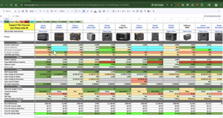
Solar
Solar Panels (portable folding 400W panel)
Battery - store electricity - A Watt Cycle 280Ah LiFePO4 "smart" battery (features Bluetooth connectivity for app-based monitoring)
Charge Controller - regulates the variable electricity coming from the panels, converting it into a constant, safe voltage to prevent damage to the battery
Use extension cables with MC4 connectors to link the solar panels to the charge controller
A terminal fuse for the battery connection
Crimping Tool - for attaching ring terminals to wires
https://www.youtube.com/watch?v=tXHKtBk9IE0
Oupes Mega 2 Pro, a portable solar generator
2.5KW inverter, 140W USB-C ports, and a long-lasting lithium iron phosphate battery
But the original Oupes Mega 2 outperforms the "Pro" version in several key categories, including solar input capacity and overall value - https://www.youtube.com/watch?v=Fw3Ixuu8Ook
Ultimately, while the Mega 2 Pro is a decent unit, it is not recommended over the original Mega 2
DC to 120V AC using Inverter
panels > Charge Controller > battery bank (48V) > DC breakers/fuses > bus bars to cleanly join multiple wire connections
Shunt - part of a meter system used to monitor energy flow
Switches: Used to safely isolate different parts of the system (e.g., between panels and charge controller)
https://www.youtube.com/watch?v=w4s-oE-VQwg

Slide 4
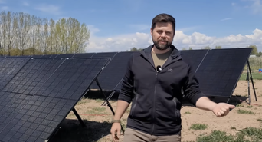
Solar
DIY Solar system from scratch. Modular. Connected through a generator interlock kit - https://www.youtube.com/watch?v=KUciR-Qwgtk
Power their entire home, charge an EV, and run a small bitcoin mining operation for approximately $25K
The core strategy involves using a high-capacity solar generator (inverter/battery unit) that can be integrated into a home’s electrical panel via an interlock kit
Run off-grid while maintaining the flexibility to revert to grid power if needed
This system requires fewer permits than a permanent roof-mounted installation, as the panels are mounted on temporary, non-permanent stands
Central Unit: EcoFlow Delta Pro Ultra X (inverter battery management system).
Battery Storage - 6 expansion batteries (totaling ~37 kWh capacity)
Solar Panels – 23-24 panels (450W each), connecting 12 panels in series
Mounting - Minute Man Solar portable panel stands
Grid Connection - 50-amp cable (1450p to ss250r)
Be aware of the inverter's maximum output (e.g., 12KWatts)

Slide 5
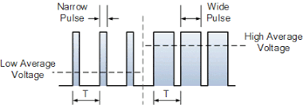
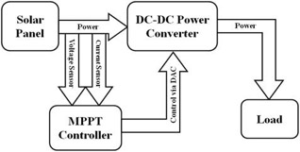
Solar Charge Controller
A solar charge controller regulates the unstable voltage from solar panels into a safe, steady voltage for battery charging
Panels can output 16–20V or higher depending on sunlight and temperature, while a 12V battery needs only ~14–14.5V. Too much voltage damages it
There are two main types of controllers – both using switching:
PWM (Pulse Width Modulation) controller - rapidly switch the connection on/off to reduce voltage (simple, ~75% efficient)
MPPT (Max Power Point Tracking) controller is also a switchingDC-DC converter, but it uses feedback to find the optimal power point on the panel's output curve (~95% efficient, recovering 20–30% more energy)
Both manage a three-stage charge cycle — bulk, absorption, and float — and block reverse current flow at night to prevent battery drain.

Slide 6
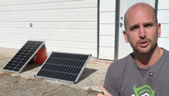
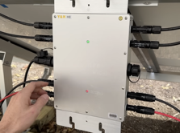
Solar
100W Harbor Freight Thunderbolt vs Rich Solar panels
Harbor Freight panel consistently outperformed the Rich Solar panel, yielding 17% more energy overall
The Harbor Freight panel is physically larger and features soldered connections, while the Rich Solar panel uses a standard MC4 connector and includes clear specification labeling
Ultimately, the Harbor Freight panel proved to be the more efficient performer in this test.
https://www.youtube.com/watch?v=gZuk3TEtjuc
The creator tested a plug-and-play solar setup using four 360W panels and a 1200W micro-inverter https://www.amazon.com/dp/B09N8X1Z71
The system failed on day two due to overheating, leading to the conclusion that this specific unit is unreliable and lacks the necessary safety certifications for utility net metering
Over one week, the impaired system generated only 7.7 kWh, highlighting that such setups are merely supplemental rather than effective replacements for full-scale, permitted solar systems
Ultimately, the creator advises against this specific product due to its poor durability and lack of compliance
https://www.youtube.com/watch?v=zZ8Dq207Szk

Slide 7
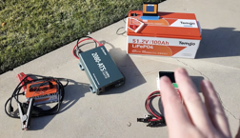
Solar
In 2020, seven major solar manufacturers agreed to a standardized wafer size (the M10 standard, 182 mm)
Five major brands use the same "Topcon" cell architecture and silicon:
Canadian Solar (TOP Hiku 6)
JA Solar (Deep Blue 4.0)
Trina Solar (Vertex S)
Jinko Solar (Tiger Neo)
Qcells (Q.tron)
REC Group - the exception, it is genuinely different. They use Heterojunction (HJT) cell technology - more efficient in high-heat environments like Phoenix or Houston - but 5-15% higher price
Don't Overpay for Brands - most panels on the market are interchangeable commodity products. Negotiate
https://www.youtube.com/watch?v=tAIMdtmmcWY
DIY 48V solar power system
48V battery, 48V inverter , Solar Charging (panels + charge controller)
You can charge the battery using solar panels, a gas generator, or a standard AC wall outlet, allowing for dual-source charging
Benefits: flexibility to scale, higher battery capacity, modular components
Battery - a "golf cart" style battery - Temgo brand as an example, 48V, 100Ah (5KWatt) - with a built-in monitor and bluetooth capabilities
Inverter - Juna 2800W model - can work with 24V and 48V
Solar Panels - "Colon" brand, 200W units
Solar Charge Controller - MPPT charge controller
https://www.youtube.com/watch?v=bcXmFFIzG0M

Slide 8
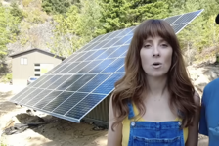
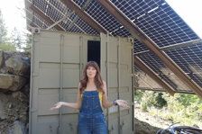
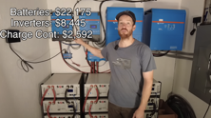
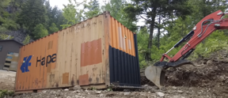

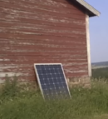
Solar
$50K off-grid system:
60 kWh of lithium battery storage ($22K)
10 kW of solar panels
20 kW of inverter output ($8.5K)
They buried a shipping container under the panels to house the equipment.
https://www.youtube.com/watch?v=ccBM0iSvqIc
Amish low-cost 4-components solar:
solar panel 100W, 2'x4', $100
charge controller between panel and battery $30
battery 100Ah lithium iron phosphate (LiFePO4) battery — $150 to $250
small inverter 400W (DC-to-AC) $40
He also notes the necessity of a fuse between the battery and the rest of the system for safety.
https://www.youtube.com/watch?v=seU-9byk2sM

Slide 9
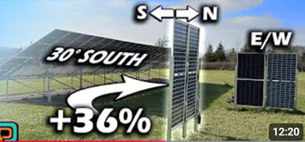
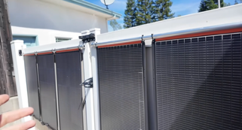
Solar Panels Orientation matters
Solar Panels Orientation matters https://www.youtube.com/watch?v=I-Fz5T5c0OQ
Compared Canadian solar bifacial panels in north-south vertical, east-west vertical, and south-facing 30° tilted configurations
The 30° south-facing bifacial setup is the highest overall producer annually
The north-south vertical panels offer a distinct advantage by providing highly consistent, year-round energy production
This makes them particularly effective for users in northern climates looking to avoid heavy winter snow accumulation
Conversely, for summer-heavy energy needs like air conditioning, east-west configurations may be more beneficial
The analysis highlights that optimal installation strategy ultimately depends on specific regional sunlight patterns, weather conditions, and seasonal energy requirements
Vertical solar panel can outperform traditional horizontal arrays
The core advantage lies in temperature management: vertical panels exhibit heat transfer coefficients nearly double those of horizontal counterparts
They maintain significantly lower operating temperatures, so vertical systems avoid the voltage drops typically caused by heat-induced efficiency losses in high-irradiance conditions
By reducing the temperature difference between the panels and the ambient environment, these vertical systems achieve more balanced voltage performance
Consequently, researchers observed a 2.5% increase in annual energy yield
This suggests that vertical configurations, such as solar fences, could be an unexpectedly effective and efficient solution for future solar energy generation
https://www.youtube.com/watch?v=g7pfBidv7ug
https://www.youtube.com/watch?v=sAwFOIXBAnE – turn any fence into solar

Slide 10
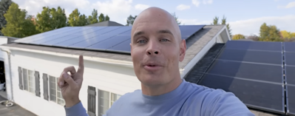

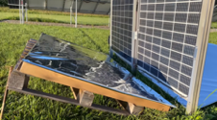
Solar
JerryRigEverything reflects on his home solar panel system six years after its initial installation.
He discusses the long-term performance and reliability of his setup while highlighting the evolution of residential energy technology.
The video serves as a transition to promote the EcoFlow DELTA Pro Ultra X, a modern whole-home backup system
Ease of installation and power capacity
https://www.youtube.com/watch?v=w3QlyvY600Q
Some solar panels can track position of the sun. Compare 3 types of solar panel installations: static, single-axis trackers, dual-axis trackers
Trackers harvest more energy than static (especially in early morning and late afternoon).
But if you have ample space, simple static mounts may be cheaper and more reliable
https://www.youtube.com/watch?v=r7HwQdssbas
Vertical vs. South-Facing Panels,
Adding reflectors
Bifacial panels
https://www.youtube.com/watch?v=xD1MT-ek05w

Slide 11
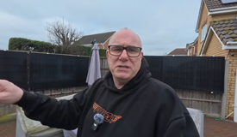
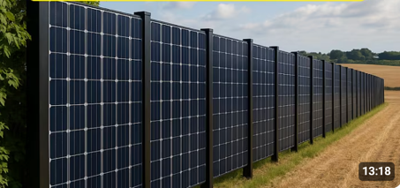
Solar Panels on Garden Fences
solar panels mounted on garden fences
https://www.youtube.com/watch?v=8-FtZZwq758
https://www.youtube.com/watch?v=L-GqZ2Z90aM

Slide 12

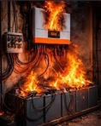
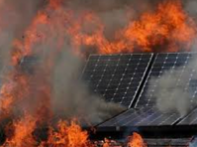
Solar Inverters - Reliability
Solar inverters are the most failure-prone component of home solar systems, often requiring costly replacements after 10–15 years
The Solar Exposed video recommends three reliable options:
The SMA Sunny Boy for simple, unshaded roofs;
The Enphase IQ8 microinverter system for shaded roofs, complex layouts, or future expansions;
SolarEdge as a budget-conscious alternative that requires an extended warranty due to the company's financial instability
Avoid installers who refuse to discuss your inverter choice, as they may be prioritizing their profit margins over your system's longevity
Ultimately, choosing the right equipment—and securing a long-term warranty—is critical to ensuring your solar investment pays for itself rather than resulting in unexpected future bills
https://www.youtube.com/watch?v=cG9MwK4-8C0
Safety measures:
Rapid Shutdown - reducing system voltage to safe levels within seconds during emergencies - required by the National Electrical Code
Arc Fault Circuit Interrupters (AFCIs) automatically detect and shut down dangerous electrical arcs
Ground Fault Protection Devices (GFPDs) detect leakage currents and disconnect the system
Anti-islanding protection shuts down grid-tied inverters immediately if the utility grid goes offline
Overcurrent breakers isolate strings when voltage or current anomalies are detected
Microinverter architectures eliminate high-voltage DC runs, significantly reducing fire risk
Physical requirements - ventilation and clearance around inverters, UL 1741/1703 certified equipment, pest screens to prevent wiring damage, and clearly labeled manual disconnect switches
Routine inspections every one to two years catch loose connections and corrosion before they escalate.

Slide 13
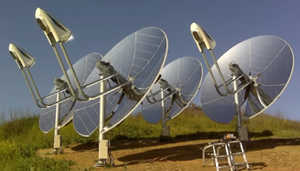
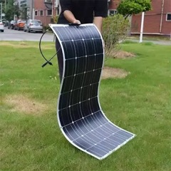
Stirling heat solar system
A Stirling heat solar system uses a large parabolic dish of mirrors to concentrate sunlight onto a Stirling engine, which drives a generator to produce electricity
The engine runs on the temperature difference created by the focused solar heat. It is modular, water-free, and emission-free during operation, making it appealing for utility-scale solar farms in sunny, arid regions
It is not used in homes because of high cost, complexity, maintenance
A single unit can cost tens of thousands of dollars while producing modest output, making solar PV far more economical
The system has many moving parts requiring skilled maintenance, needs direct clear-sky sunlight (no performance on cloudy days), and the large rotating dish is impractical for rooftops
Silicon solar panels, by contrast, have no moving parts, dropped below $0.10 per watt, and work even in diffuse light
A peel-and-stick solar film thinner than a human hair generates as much electricity as a twenty-thousand-dollar silicon panel system
Can be easily installed without a single tool, rack, or contractor
MIT spinout Active Surfaces, founded by PhD graduate Richard Swartwout and backed by over ten million dollars in funding, has built this technology on perovskite - a crystalline semiconductor that has surpassed silicon efficiency records certified by the National Renewable Energy Laboratory, manufactured through roll-to-roll printing at a fraction of silicon's cost
For conventional rooftop solar, up to fifty percent of total system cost is pure labor. Active Surfaces eliminates that entirely.
This technology has been sidelined by a forty-billion-dollar installation industry whose entire business model collapses the moment a homeowner can roll their own power system onto a roof in an afternoon.
https://www.youtube.com/watch?v=I3nZFFlIVCY

Slide 14
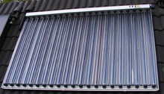
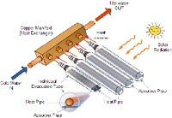
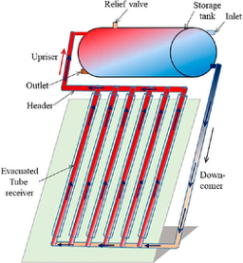
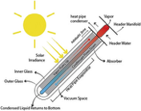
Evacuated Tube Collector
A type of solar thermal collector used for heating water or fluids
The heat loss is minimized by surrounding the absorber with a vacuum (evacuated) glass tube (works like a thermos)
https://www.sciencedirect.com/topics/engineering/evacuated-tube-solar-collector
Each collector consists of rows of parallel, double-walled borosilicate glass tubes connected to a header pipe
The space between the two glass walls is evacuated (air removed), creating a near-perfect insulating vacuum that prevents convective and conductive heat loss
Inside the tube, a selective coating on the inner glass absorbs solar radiation, and aluminum fins transfer that heat to a copper heat pipe
The heat pipe contains a small amount of that vaporizes from the heat, rises to a condenser at the top, and transfers its energy to the circulating heat transfer fluid (typically a water/propylene glycol mix) in the manifold
https://www.reddit.com/r/solar/comments/rvgyfv/evacuated_tube_solar/
Tube interior can reach ~400°F while the outside remains cool to the touch; Works well even in cloudy, cold climates (northern US, Canada); The cylindrical shape means sunlight always strikes at roughly a 90° angle, performing well in morning, evening, or overcast condition; If one tube breaks, the rest of the system continues operating at reduced capacity
Used for domestic hot water heating, space heating, and industrial process heat

