Slide 1


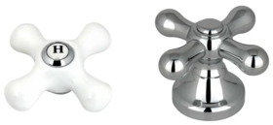
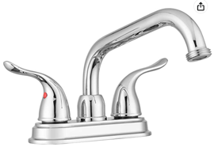
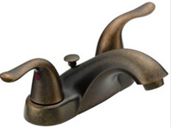
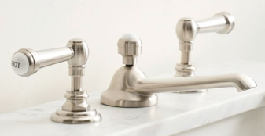
Bathroom Faucets
Cross Handle
Drain Stopper
with overflow
pop-up drain stopper
with overflow
Lever Handle
Central piece
4", 3-hole
Swivel Spout
Wide Spread

Slide 2
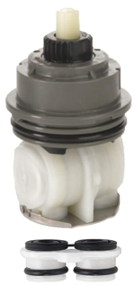
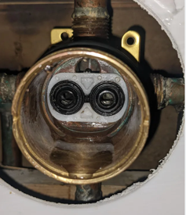
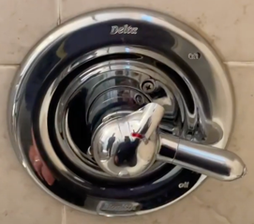
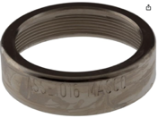
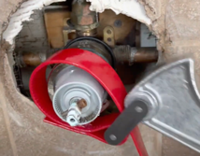
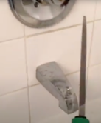
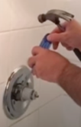
Delta Monitor shower faucet
RP46463 cartridge
Delta Monitor 1700 series shower faucet
with RP46463 cartridge – made after 2006.
Delta faucets have lifetime warranty.
Just contact Delta at the email
customerservice@deltafaucet.com
Send them the picture of the faucet.
They will send the repair parts FREE!!
RP28603 seal kit sent to me directly from Delta.
https://www.youtube.com/watch?v=PrzEz4_SJL8
Search youtube for "RP46463" to find videos explaining
how to replace, for example:
https://www.youtube.com/watch?v=nF9jWuetjYA
Used Delta RP32104 Cartridge Kit (white, for models before 2006)
https://www.youtube.com/watch?v=32SHxO1NNSA
STOP!!! Don't damage your DELTA Shower valve!
https://www.youtube.com/watch?v=meRdEynmPVo
Which delta cartridge do you have how to replace a delta cartridge
https://www.youtube.com/watch?v=mVLKFwymZL4
Delta:
https://www.deltafaucet.com/service-parts/contact-us
1-800-345-DELTA (3358)
M-F. 8am-6pm EST, Sat 9am-6pm EST
https://www.amazon.com/dp/B07G2TCSKF
Delta rp22734 bonnet nut
https://www.amazon.com/dp/B001DU0GLY
Taking off the bonnet nut using jar opener
Taking off the bonnet nut – cut with a file, then use screwdriver and hammer:
https://www.youtube.com/watch?v=qD6j2vWpP4A
https://www.youtube.com/shorts/sH63hY-eUzg

