Slide 1
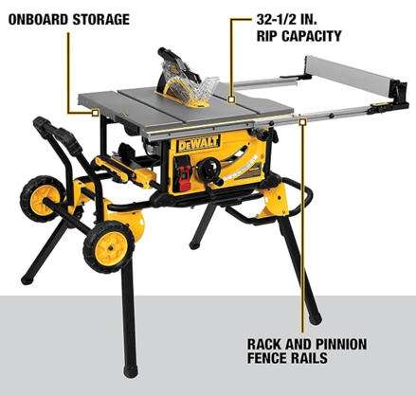
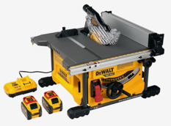
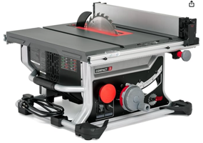

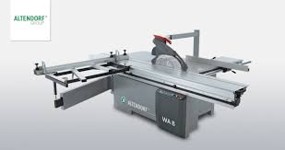
Table Saw
DEWALT DWE7491RS
10-Inch Table Saw,
32-1/2-Inch Rip Capacity
$550 on amazon
DEWALT 60V MAX Table Saw DCS7485T1-EB
8-1/4-Inch blade
$420 on amazon (batteries and charger sold separately)
Sliding Table Saw (European)
SawStop CTS-120A60 Compact Table Saw - 15A,120V,60Hz
$900 on amazon

Slide 2
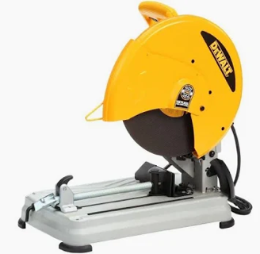
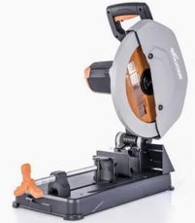
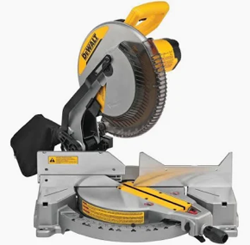
Chop Saw
Cutoff Saw
Miter Saw
Chop Saw = Cutoff Saw
designed to "cut off" sections of material; may refer to any chop saw (metal, masonry, or wood) Usually 4,000 RPMs. Not good for Wood (too fast)
Miter Saw (woordworking)
It can make straight, angled (miter), and bevel cuts.
Ideal for finish carpentry, trimming, and framing.
Evolution R355CPS
14-inch blade Multi-Material Chop Saw 1,450 RPM.
comes with Tungsten Carbide Tipped (TCT) blade suitable for wood
$350

