Slide 1
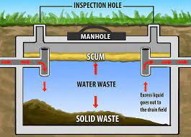
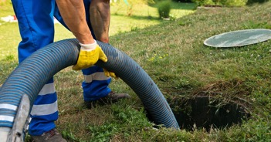
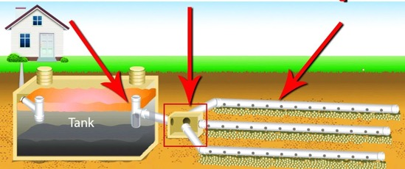
Septic System
We have a very simple single tank system.
Septic tank is made of metal reinforced concrete
Size: 4' x 8'.
May 2025 - we used metal detector to locate it and mark with red flags
There is one hatch 20" (50cm) across made of steel.
4-6" below ground level.
Previous owners don't remember when it was pumped (if ever).
It actually should be inspected annually and pumped every 3-5 years
to avoid overflowing and blocking the output leach field tubes:
.. https://www.youtube.com/watch?v=rAGEuk3RgHg
Here is how to locate the lid of the septic tank, open and inspect:
.. https://www.youtube.com/watch?v=QkP5PLcY5UM
Video on how to use Roebic K-57 (flush down toilet) to preven leach field blockage
.. https://www.youtube.com/watch?v=a0_plfSMEmI
.. https://www.amazon.com/dp/B07ZJWY9CT - Roebic Laboratories,Inc. K-57 Septic System Treatment, 32-Ounce - 3 Pack. Use one bottle once a year
Septic Surgeons
57B Lester Rd, Equinunk, PA 18417
https://www.facebook.com/SepticSurgeons
570-224-4822
Koberlein Environmental Services
188 Beach Lake Hwy, Honesdale, PA 18431
https://www.koberlein.com
570-671-2940

Slide 2
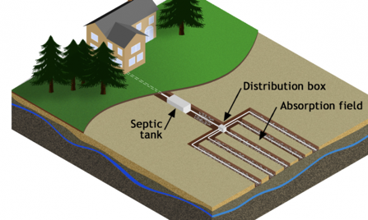
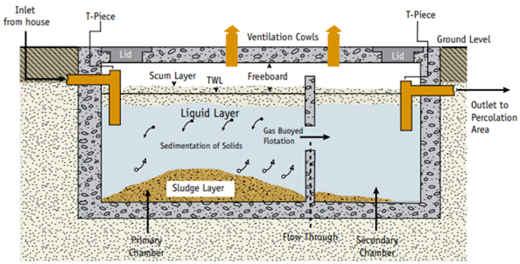
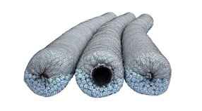
More about Septic Systems
Using second camera for cleaner output
Leach tubes (also called leach lines or drain pipes) should be surrounded with gravel or a similar permeable material
.. prevents Soil Blockage of Pipe Perforations
.. Enhances Drainage and Effluent Distribution
.. Increases Surface Area for Filtration**
.. Structural Support and Protection
.. Additional Filtration when using Geotextile Fabric
Alternatives to Gravel: protective wraps, sand or select fill

Slide 3
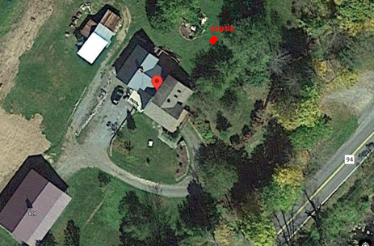
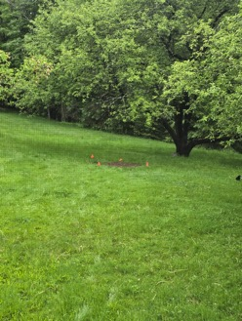
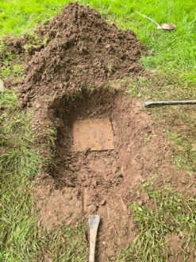
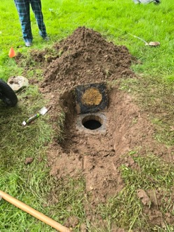
Our septic
Our septic – cement 8 ft x 4 ft
square lid 16" x 16"
Depth 5 ft 2 inches (62") from top to bottom

