Slide 1
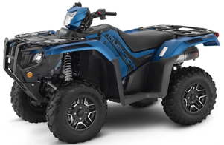
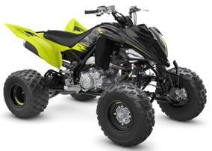
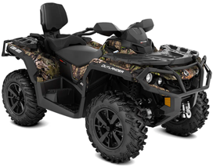
All Terrain Vehicle (ATV). ( $5K-$9K )
Honda Fourtrax Foreman Rubicon 520 DCT Deluxe
Polaris Sportsman XP 1000 Ride Command
Yamaha Raptor 700R
Can-Am Outlander MAX XT
CFMoto CForce 1000 Overland
One Response
Honda Fourtrax Foreman Rubicon 520 DCT Deluxe
Yamaha Raptor 700R
Can-Am Outlander MAX XT

Slide 2
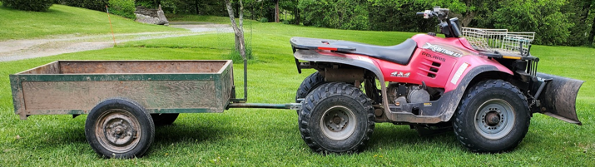
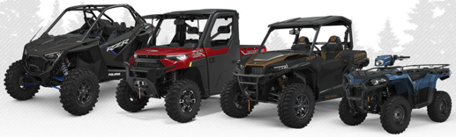
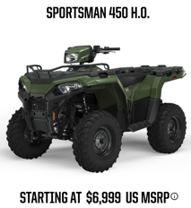
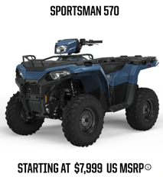
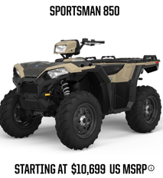
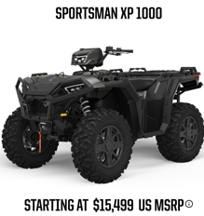
Previous owner had 20-y.old Polaris
Polaris Xpedition 425 (years 2000-2002)
price new - $6K+, price today - $1.4K
27 HP
modern off-road Polaris
https://offroad.polaris.com/en-us/
with trailer and plow
33 HP
90 HP

Slide 3
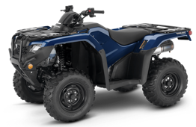
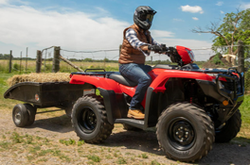
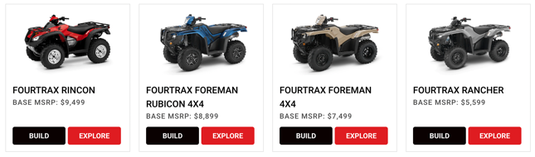

Honda is the most reliable ATV
Which ATV Is Most Reliable? Brand Comparison .. https://atvhelper.com/which-atv-is-most-reliable-brand-comparison/#
Honda ATVs since 1970, reputation for performance and reliability.
Bomb-proof transmission, metal gears, very durable, can take lots of abuse.
Multiple models (utility):
Rancher – smallest, doesn't lock 4 wheels (not good for snow pushing).
Foreman - good
Foreman Rubicon 518cc engine, auto-transmission with wet clutches (DCT)
Rubicon 700 675cc engine, auto transmission with hydraulic converter
DCT (Dual-Clutch Transmission == Automatic transmission)
ES (Electric-shift transmission)
EPS (Electrical Power Steering)
FourTrax Rubicon 700 4x4 Automatic
4WD, 675cc engine
Auto-transmission w. hydraulic converter
https://powersports.honda.com/atv/recutility/fourtrax-rubicon-4x4
before 2012 – carburetor
2012 – fuel injection
2015 – redesign, 50% more load, better transmission (DCT)
2020 – redesign, 10% more load
2025 – Rubicon 700 - transmission with hydraulic torque converter
Build your Honda ATV:
.. https://powersports.honda.com/atv/recutility/fourtrax-foreman-4x4/build
Honda FourTrax Foreman 4x4 TRX520FM1LN (2022) MSRPrice - $7.5K
Engine - 4-stroke liquid cooled 518cc
.. https://www.youtube.com/watch?v=Bd_8UyRdxuY
Honda TRX450R (2022) – a race ATV
Engine - 39 HP, Weight – 350 lbs,
Top speed – 74 mph, MSRPrice - $6.7K

Slide 4
Honda Dealers – search on https://powersports.honda.com
For zip code 12741:
===========================
RUSTY PALMER, INC.
19.5 miles away
1175 Texas Palmyra Hwy, Honesdale, PA 18431
http://rustypalmer.net/honda/
(570) 253-4507
===========================
NORTH AMERICAN WARHORSE, INC.
38.2 miles away
1000 Dunham Dr., Dunmore, PA 18512-2666
https://www.nawarhorse.com
(570) 346-2453
===========================
MAVRIX MOTORSPORTS
44.4 miles away
21 Dunning Rd., Middletown, NY 10940-2212
https://www.mavrixmotorsports.com
(845) 344-2453
===========================
BINGHAMTON Honda
47.5 miles away
120 E Service Hwy, Binghamton, NY 13901
https://binghamtonhonda.net
(607) 722-7433
===========================

Slide 5
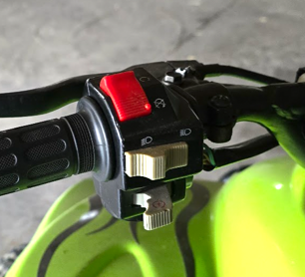
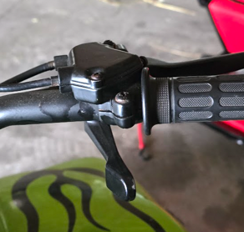
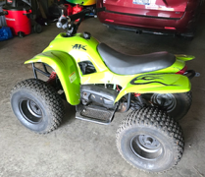
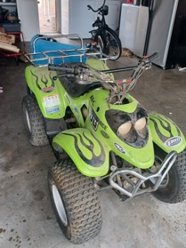
APC EDGE 90cc atv
APC Motor Company – importing and selling budget (Chinese) youth ATVs,... Basic, no-frills, cheap, 50 .. 125cc
The left handlebar usually includes the rear brake lever, a red kill switch (emergency engine stop), and an electric start button or switch. The dials and toggles near the grip are often used for headlight control or ignition and sometimes for throttle governor adjustment (speed limiter).
The right handlebar typically provides the front brake lever and, on some models, and the thumb throttle lever just beside the grip.
2002 APC EDGE 90cc atv It is a clone of Polaris Scrambler 90cc 2-stroke (search for 2002, 2003 Polaris scrambler, predator, sportsman)
APC green ATV, 90cc, electric start
Two wheel drive
Two-stroke, oil injected, high output engine,
single-cylinder, air-cooled, horizontal, oil-injection lubrication
Up to 300 lbs capacitym 2..3 horse power
Maker: gy6 ?? Tao ??
Two Stroke 2 APC 90cc 4 Wheeler APC
https://www.youtube.com/watch?v=9p4mn1336yw
https://www.youtube.com/watch?v=-Lekb7Exnxw
https://www.youtube.com/watch?v=rV6NRiy05sg
https://www.youtube.com/watch?v=xGUp04KyB7w
START: Put red kill switch in the ON or RUN position (not STOP/OFF); Turn the ignition key (if present) to the ON position; Some models require squeezing the left brake lever to enable the electric starter.
Press the start button (usually near the red kill switch) to crank the engine.
If the engine doesn’t start, check that the ATV is in NEUTRAL and the kill switch is not set to OFF.
Twist the right handlebar throttle or press down the thumb lever to increase engine speed
Speed limiter. Many youth ATVs have adjustment screws or knobs near the throttle. You can limit maximum throttle and speed by turning these screws in.
Shut Down - Move the red kill switch to OFF/STOP to immediately cut engine power. Turn off the ignition key.
The CVT Transmission at idle doesn't pull. It engages when you give more gas.
There are two conical sheaves on the engine's crankshaft.
The spring pushes them apart.
One of these sheaves has an assembly with "fly weights". As RPM increases, these weights (arms) are pushed by centrifugal force out, causing the sheave to move along the crankshaft overpowering the spring to squeeze the belt between those two conical sheaves
https://www.youtube.com/shorts/l83OZUWh3Us
Supervise young riders at all times, Wear helmets and protective gear.
https://media.tractorsupply.com/is/content/TractorSupplyCompany/tsc/product/1/55/55/14/1555514_Man1.pdf
https://www.offroad-ed.com/wisconsin/studyGuide/Common-ATV-Controls/40105103_173650/

