Slide 1
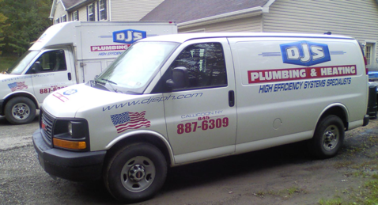

Oil - 550 Gallon Tank
Service?
Cleaning?
Delaware Valley Oil
http://dvoil.com
Phone (845)-887-6090
Office: M-F 8am-4pm
3 Bridge Street, Callicoon, NY 12723
P.O. Box 838 Callicoon NY 12723
Email delawarevalleyoilllc@yahoo.com
Email: LeanaStanton@aol.com
Owner wife: Casey Milk
Truck driver: Larry, Kevin
Brian
845-645-9403 cell
Plumber
(Boiler/Filter mainenance)
2022-07-06: ordered 150 gal ($5.79/gal) = $868.50
2022-11-22: ordered 150 gal ($5.59/gal) = $838.50
2023-01-07: gauge reading: 1/4 = 108 Gal
2023-01-07: ordered 150 gal ($4.29/gal) = $643.50
2023-01-14: gauge reading: 1/2 = 275 Gal
2023-02-05: gauge reading: 3/8- = 175 Gal
2023-02-10: ordered 250 gal ($4.19/gal) = $1,047.50
2023-02-11: gauge reading: 3/4+ = 455 Gal
2023-05-30: ordered 200 gal ($3.52/gal)
Gage new reading close to 465 gal
DJS Plumbing and Heating
Doug Santoro
(845) 887-6309 office
(845) ... mobile
email: djsph@hvc.rr.com
.. https://www.djsph.com
.. https://www.facebook.com/DJSPlumbingHeating/
.. 9 Del Vue Rd, Callicoon, NY 12723
.. 4-6 weeks waiting for scheduled service
Hook Well Drilling. 570-224-....
Head Electric Plumbing & Heating, Inc
(845) 807-7676
4499 St Rt 17B, Callicoon, NY 12723
pat costello plumbing PA. 570-224-....

Slide 2
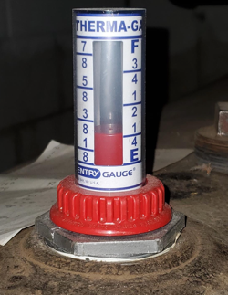
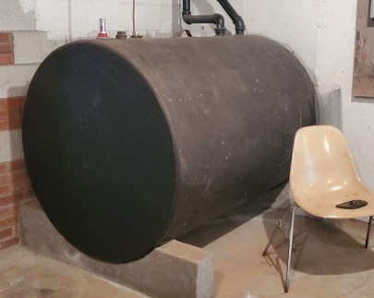
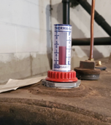
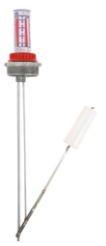
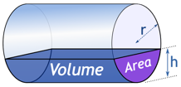

Oil Tank 48" diameter, 550 gal
inch | part | part | gals | inch | part | part | gals
1 | 0.02 |  | 3 | 25 | 0.52 |  | 290
2 | 0.04 |  | 8 | 26 | 0.54 |  | 304
3 | 0.06 |  | 14 | 27 | 0.56 |  | 319
4 | 0.08 |  | 22 | 28 | 0.58 |  | 333
5 | 0.10 |  | 30 | 29 | 0.60 |  | 347
6 | 0.13 | 1/8 | 40 | 30 | 0.63 | 5/8 | 362
7 | 0.15 |  | 50 | 31 | 0.65 |  | 376
8 | 0.17 |  | 60 | 32 | 0.67 |  | 390
9 | 0.19 |  | 71 | 33 | 0.69 |  | 403
10 | 0.21 |  | 83 | 34 | 0.71 |  | 417
11 | 0.23 |  | 95 | 35 | 0.73 |  | 430
12 | 0.25 | 1/4 | 108 | 36 | 0.75 | 3/4 | 442
13 | 0.27 |  | 120 | 37 | 0.77 |  | 455
14 | 0.29 |  | 133 | 38 | 0.79 |  | 467
15 | 0.31 |  | 147 | 39 | 0.81 |  | 479
16 | 0.33 |  | 160 | 40 | 0.83 |  | 490
17 | 0.35 |  | 174 | 41 | 0.85 |  | 500
18 | 0.38 | 3/8 | 188 | 42 | 0.88 | 7/8 | 510
19 | 0.40 |  | 203 | 43 | 0.90 |  | 520
20 | 0.42 |  | 217 | 44 | 0.92 |  | 528
21 | 0.44 |  | 231 | 45 | 0.94 |  | 536
22 | 0.46 |  | 246 | 46 | 0.96 |  | 542
23 | 0.48 |  | 260 | 47 | 0.98 |  | 547
24 | 0.50 | 1/2 | 275 | 48 | 1.00 | "1" | 550
Calculator:
https://www.mathsisfun.com/geometry/cylinder-horizontal-volume.html
Krueger Sentry Therma Tank Gauge
https://www.jmesales.com/krueger-sentry-type-h-2-in-galvanized-therma-tank-gauge/

Slide 3
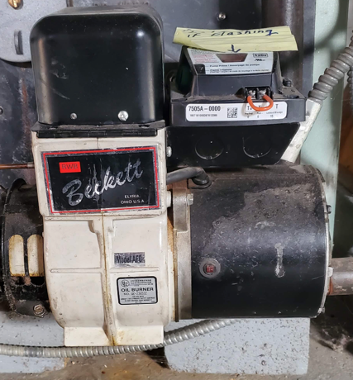

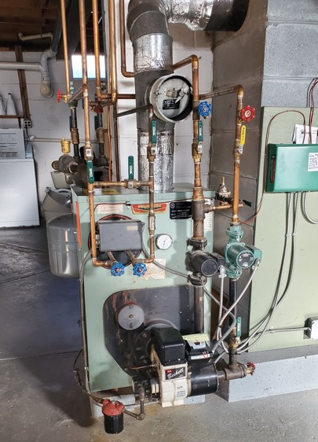
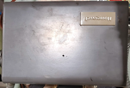
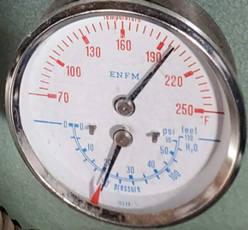
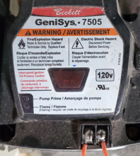
Peerless Boiler WB-3 Series (WBV-110-WPD ?)
residential, oil-fired boilers
https://www.peerlessboilers.com
https://www.peerlessboilers.com/products/series-wbv/
https://www.youtube.com/watch?v=5GbXgEYw5TE
12-18 Gal of water
Honeywell boiler aquastat (thermostat)
sends "more heat" signal
to 7505 burner control unit
Specific model 7505A
Beckett GeniSys™ 7505 oil burner control https://www.beckettcorp.com/product/genisys-7505-oil-burner-control/
used with a suitable cad cell flame sensor to control the oil burner motor, igniter, and optional solenoid valve
has 24 VAC thermostat terminals
can provide interrupted or intermittent duty ignition, and it has a 15 second lockout time

Slide 4
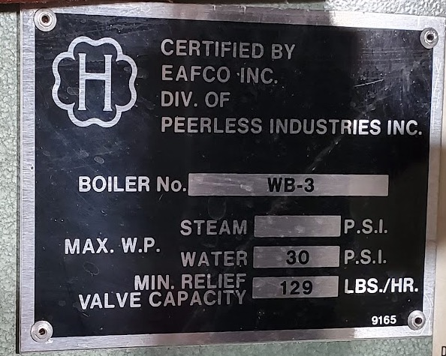
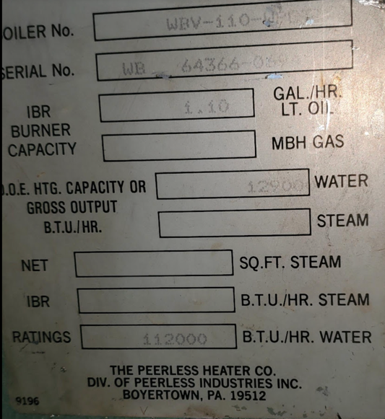
Boiler
https://www.peerlessboilers.com
https://www.peerlessboilers.com/products/series-wbv/
Water Pressure in kitchen sink – 40-60 PSI
Water Pressure in house heating should be low (15 psi ?)
Test – time to fill a 5 Gal bucket
(20 sec – excellent, 60 sec – fine)

Slide 5
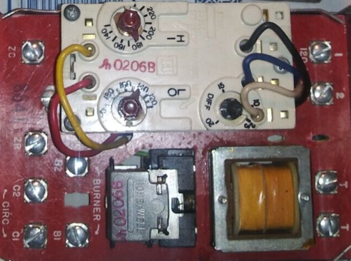
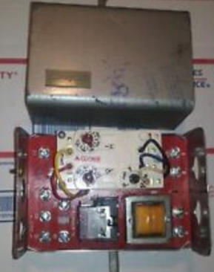
Honeywell Aquastat
Pictures from internet
Maybe different model
$120

Slide 6
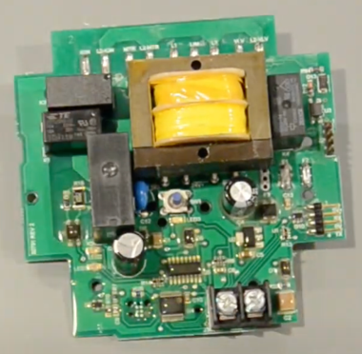
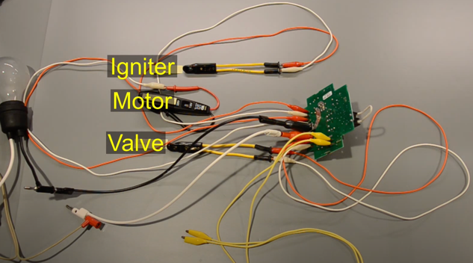
Troubleshooting Genisys 7505
Google for:
Genisys 7505 won't start after power outage
Video troubleshooting the 7505
.. https://www.youtube.com/watch?v=Wd7vrkUDaz4
Checks for flame presence
Ignites – and checks that it is ignited
reacts to signal "more heat" to start/stop blower (and shut off the valve)

Slide 7
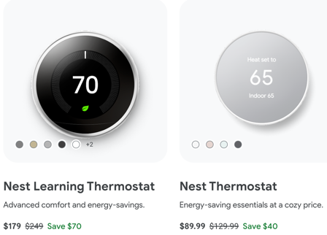

Google Nest
Google Nest Thermostat:
.. https://store.google.com/us/product/nest_thermostat
Nest Wifi requires a Nest Wifi router (or Google WiFi)
Latest - Nest Wifi Pro router ($200)
The devices are controlled using Google Home App
https://www.cnet.com/home/internet/nest-wifi-vs-nest-wifi-pro-wi-fi-6e-mesh-routers/
https://www.doityourself.com/forum/thermostatic-controls/602985-connecting-nest-thermostat-genisys-7505-oil-burner.html
https://www.youtube.com/watch?v=WFDPWIKKBHY
.. https://store.google.com/us/widget/compatibility/thermostat
Google Nest thermostats are designed to work with most 24 V systems, even older systems
Online Compatibility Checker: .. https://support.google.com/googlenest/answer/9246656
Nest Learning Thermostat is more compatible
Older Regular Nest Thermostat may need C wire or Nest Power Connector
We have the latest Nest Learning Thermostat (3rd generation) I was following youtube videos and online guides, for example:
.. https://support.google.com/googlenest/answer/9248184 - docs .. https://support.google.com/googlenest/answer/9373007?hl=en – PDFs
.. https://www.youtube.com/watch?v=rdfUbAZi7k0 – missing manual .. https://www.youtube.com/watch?v=7SzjOU30AYg - How to Use ... .. https://www.youtube.com/watch?v=iXi8asdsXTM – How to Use ... for beginners .. https://www.youtube.com/watch?v=AdGDXpb4VzE - How to Use and Program ... .. https://www.youtube.com/watch?v=iKcSKpR9KAM - How to Make Nest Thermostat Manual
(remove learning automation parts)
Note about Nest Learning Thermostat.
It has many settings to automatically adjust temperature based on history, etc.
I turned them all off because it was overriding my wishes. For example, we had two bedrooms with thermostats. Last several weeks we had visitors and were using both bedrooms. This week we using only one, so I decreased the thermostat setting to 56F. But it by itself warmed up to 68F.

Slide 8
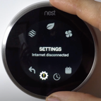
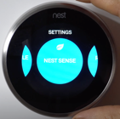
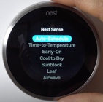
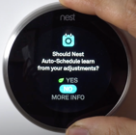
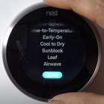
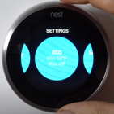
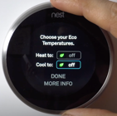
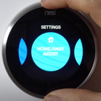
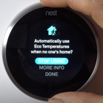
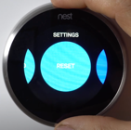
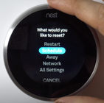
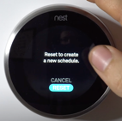
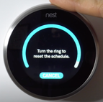
How to Make Nest Thermostat Manual
.. https://www.youtube.com/watch?v=iKcSKpR9KAM
Go to Settings
Nest Sense
Auto Schedule
No (to learning)
DONE
ECO
off both
Home Away Assist
STOP Using ECO
RESET
Schedule
Reset
Turn right to reset

Slide 9
Nest Thermostat Loses WiFi Randomly
https://www.youtube.com/watch?v=eM_2CXz45RE
Check WiFi stability and speed
Turn router off for 30 sec – and then turn on again
Check that battery level > 3.6V
Reset-Restart the Thermostat
After restarting check Network settings in the Thermostat
ping speed should be < 1500 ms
ping speed == 0 – no communication with server
signal strength should be > 50
Reset Network Settings
Install updates on your Thermostat
Install updates on phone app
Use the interactive Guide: https://widgets.nest.com/nest-thermostat-troubleshooter/
Contact Google Nest Help: Twitter @GoogleNestHelp

Slide 10
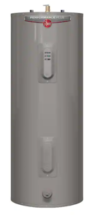
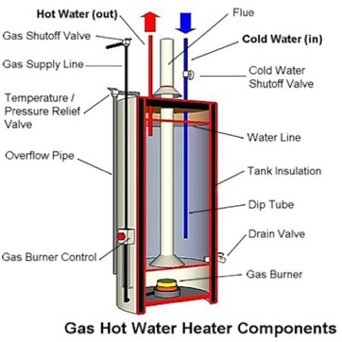
electric tank water heaters
at home depot ~ 50 gal, ~$500
combination / hybrid,
for example electric + gas
or electric + boiler
gas tank water heater

Slide 11
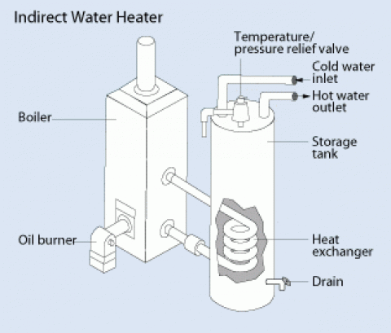
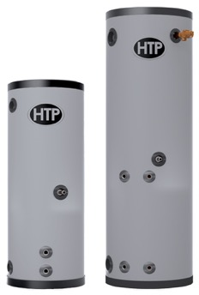
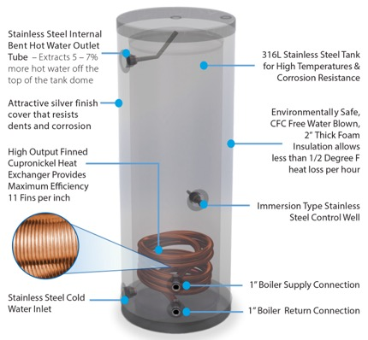
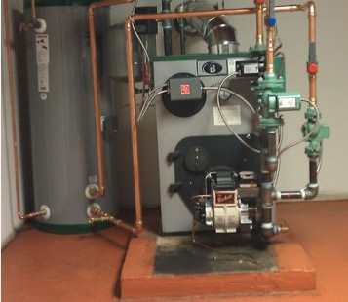
SuperStor ULTRA water heater
https://www.htproducts.com/superstor-ultra-waterheater.html
SuperStor ULTRA
316 Liters
Indirect water heaters – uses hot water from boiler going through
the coil to heat the tank.
Has its own thermostat.
Has good thermal insulation.

