Slide 1
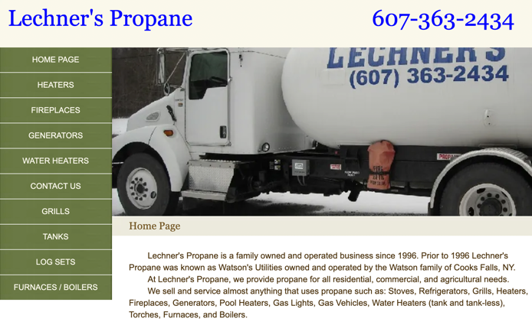
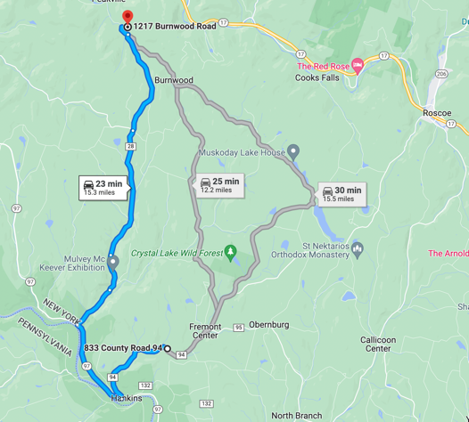
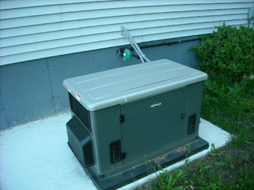
Propane
Leecher's Propane family business - George & Kevin Leecher George@LechnersPropane.com Kevin@LechnersPropane.com +1(607) 363-2434 • Work
1217 Burnwood Rd, East Branch, NY 13756-2109
https://www.lechnerspropane.com
Price (June 2022): 4.65/gallon
Expect $60 refill every 2 months
Backup Generator
min 12KW
better 20-26KW

Slide 2
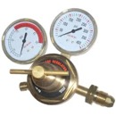
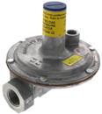
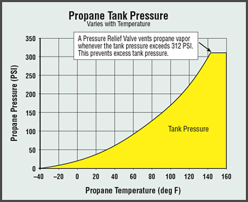


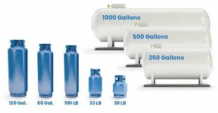
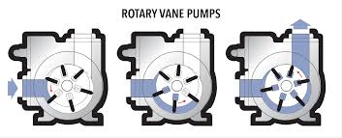
Propane
Line Regulator
(pressure regulator)
Tank pressure depends only on temperature (not on tank's size) 100PSI at room temperature, up to 250 PSI in hot weather and full tank
Cooking stove uses 0.4 PSI
The reduction of pressure in two steps: to 10 PSI, then to 0.4 PSI
Tank should be transported only in vertical state
Tank should be filled no more than 80% (to leave some space for expansion)
A full100 lb propane tank weighs ~ 170 lbs. It holds ~23.6 gallons of propane, and propane weighs around 4.2 pounds per gallon.
Measure fulness: by weight, by sound, by temperature,
ultrasound meter - truma propane level check
| T-°F | P-PSI|
|------|------|
| 0 | 24 |
| 10 | 31 |
| 20 | 39 |
| 32 | 50 |
| 40 | 59 |
| 50 | 71 |
| 60 | 84 |
| 70 | 100 |
| 80 | 117 |
| 90 | 136 |
| 100 | 157 |
Transfer propane from one tank to another: - pour liquid via high-pressure hose and fittings - use a pump for LPG (Liquid Petroleum Gas), proper fittings, hoses and safety valves.
Most common pump type is a sliding vane pump, it has a rotor with sliding vanes that create sealed chambers to move the liquid propane without allowing it to vaporize.

Slide 3
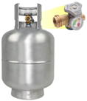

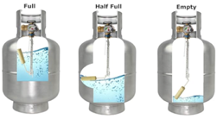

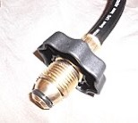
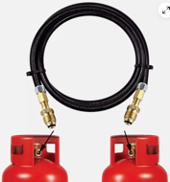
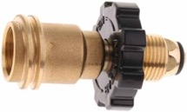
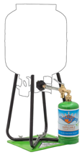


Retail Propane Tank Fittings in USA
POL fitting (CGA-510) - For standard 20 lb and 100 lb propane tanks POL = Prest-O-Lite; CGA = Compressed Gas Association Uses 3/4" NGT (National Gas Thread) left-hand thread at 14 threads/inch; may have a check valve that prevents gas flow when disconnected.
3/8" Flare Connector - RV and camping, has 45-degree "flare" shape for a tight, metal-to-metal seal, no sealant or Teflon tape, up to 350 PSI
Type 1 ACME - a.k.a. QCC1 (Quick Closing Coupling) - grills, stoves, ... up to 350 PSI
CGA-600 connection - for small 1lb disposable cylinders
To interconnect 2 tanks, you'll need a "tank-to-tank" transfer hose or "propane tank equalizer hose" with POL fittings on both ends. Look for hoses labeled for LP (Liquid Propane) or LPG (Liquid Propane Gas)
Flame King 20LB – tank with Gauge & OPD Valve, (OPD = Overfill Protection Device)
both POL and Type 1 ACME fitting
Aluminum - $200 - https://www.amazon.com/gp/aw/d/B0DR3SSBV8/
Steel - $60 - https://www.amazon.com/dp/B08XYH6TND/
3/8" flare
Type 1 ACME Male
POL male
POL female
swivel = rotating connector
CGA-600
https://www.ebay.com/itm/224568534085
Male POL fitting with swivel
"Propane hose with swivel POL connection"
"Rotating POL propane hose"
"Hand-wheel swivel POL propane hose"
"Propane hose with rotating connector"
"Propane hose with twist handle POL fitting"
POL Female to Female
Flame King Refil Kit
https://www.amazon.com/dp/B07F9LCYRT/

Slide 4
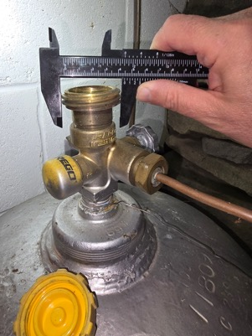
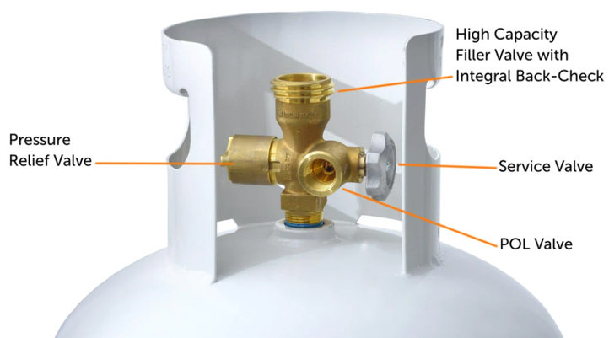
Our 100 lb tank connector
Our tank is a cylinder approx 45 inches heigh and 15 inches in diameter
Which is typical size of a 100 lb tank which typically holds about 23.6 gallons of propane when full.
The weight of an empty tank is ~ 75 lbs, full - ~ 175 lbs
This is a 1-3/4 inch filling connector (larger than the standard Type 1 ACME/QCC1 which is 0.885 inches).
This appears to be an industrial-grade REGO quick-connect fitting designed for larger propane tanks (100 lb and up)
Search for: "REGO industrial quick-connect" , "1-3/4 inch REGO propane fitting"
Visit a commercial propane supplier rather than a standard hardware store

Slide 5
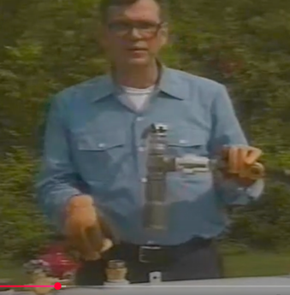
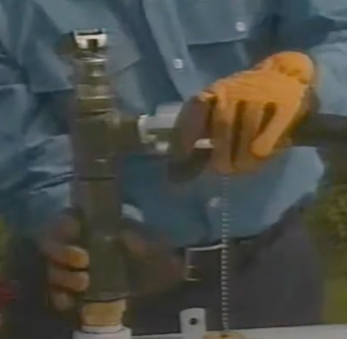
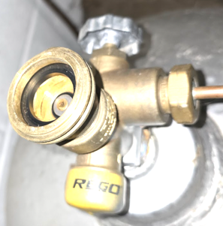
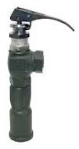
Our 100 lb tank connector
The 1-3/4 inch REGO industrial fitting on your 100 lb propane tank likely includes a check valve in the center. This valve typically requires a special connector like
RegO A7797
https://www.jmesales.com/jme-a7797a-1-in-fnpt-x-1-3-4-in-facme-16-gpm-quick-acting-minimum-loss-hose-end-angle-valve-w-locking-handle/
RegO A7793
https://www.jmesales.com/jme-a7793a-3-4-in-fnpt-x-1-3-4-in-facme-16-gpm-quick-acting-minimum-loss-hose-end-angle-valve-w-locking-handle/
video: https://www.youtube.com/watch?v=80aiXv-Yaw4
video - https://www.youtube.com/watch?v=KgiYjjl-xzg
REGO Hose End Valves A7793A A7797A for LPG Gas Bobtail Truck
The RegO A7797A is a quick-acting minimum loss hose-end angle valve designed for efficient and safe propane refilling operations, used on delivery trucks and dispensing stations.
1-inch FNPT inlet connection (3/4-inch for A7793)
1-3/4 inch F ACME outlet connection
flow rate of 16 GPM (gallons per minute) for propane at 1 PSIG pressure drop
locking handle for added safety during use and transport
Instant full-on flow and shutoff capabilities with minimal effort
A design that minimizes product loss during disconnections, reducing vented propane

Slide 6
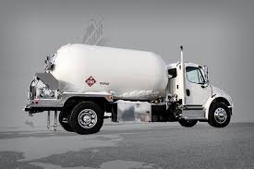
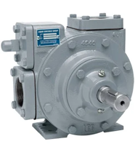
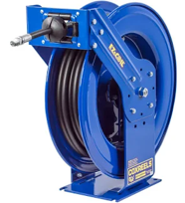
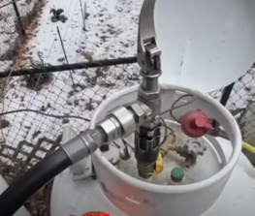
Propane Bobtail Truck
"Bobtail" is a general term in trucking that refers to a truck driving without a trailer attached
A "propane bobtail truck" is a specialized truck for delivering propane. It has a large storage tank holding 1,000+ gallons of liquid propane. It has pumps, hoses, and safety features.
The deck behind the storage tank on a propane bobtail truck is typically referred to as the "rear deck" or "open deck" and typically has the following equipment:
.. A meter in a metal box
.. Hose reel with 150 feet 1 inch hose
.. a Blackmer or Corken pump
.. Various valves including Fisher and Rego valves
.. BASE remote control multi-function system for operations like emergency shutdown, PTO control, and hose reel operation
.. Stainless steel or welded/flanged liquid piping
.. Lights, tool boxes, pressure gauge and thermometer, float gauge, air operated controls for internal valves
Both Blackmer and Corken pumps operate on similar principles.
Blackmer sliding vane pump can create 125 psi differential pressure
Corken Coro-Vane Pumps can be "Sliding Vane" or "Regenerative Turbine" (Coro-Flo) and can go up to 400 psi
Typic. Typical pump cost $2K-$4K
https://www.youtube.com/watch?v=VEs8n_bqMLc – propane delivery driver
https://www.youtube.com/shorts/bXqpQ8w2ZRA – truck driver filling propane tank

