Slide 1
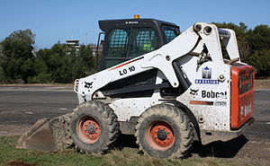
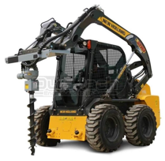
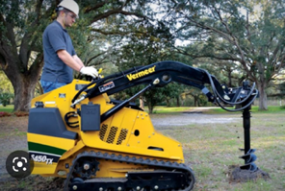
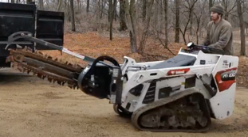
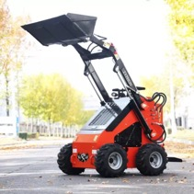
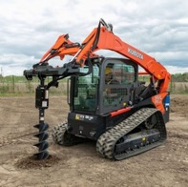
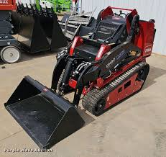
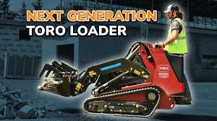
Skid Steer
https://en.wikipedia.org/wiki/Skid-steer_loader
A skid loader, skid-steer loader, SSL, or skidsteer:
compact vehicle with lift arms
typically four-wheeled or tracked
extremely maneuverable , can turn in place ("zero-turn")
right and left wheels are independent (have separate transmissions)
wheels don't turn
turning accomplished by different speed of left and right sides
Bobcat LT-113 Trencher and MT100
Post Hole Auger Drive
Mini Skidsteer with Post Hole Digger
Honda EPA Gas 22.1 HP Engine Mini Skid Steer Loader $9K
Toro Dingo Loader

Slide 2
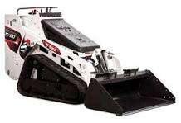

Bobcat MT100 Skid Steer – expensive but good
https://www.youtube.com/watch?v=rG7cya22ksI – good video review
$26K - $35K used, $42K new
Bobcat LT-113 Trencher and MT100

