Slide 1
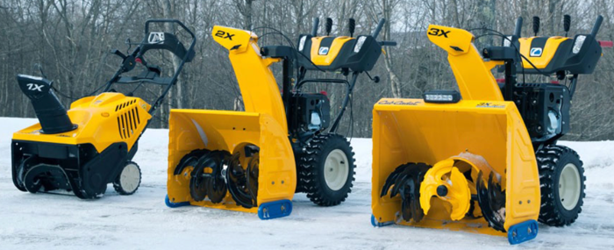



Single-Stage Models: The auger both pulls up and discharges the snow.
The snow discharge distance is usually limited to about 3".
Because the auger touches the ground, it is covered in rubber
to protect the surface.
Works only on paved surfaces.
Two-Stage Models:
The auger only pulls up the snow from the ground.
A separate component within the snow blower, the impeller,
discharges the snow from the chute.
This allows the snow blower to send the snow up to 60"
Because the auger does not touch the ground, it is all metal
(not rubber-tipped, as with the single-stage models).
Works on any surface (paved, gravel, dirt).
Three-stage Models:
same stages as the two-stage snow blower, but the addition
of a third stage, the accelerator.
Accelerator allows snow to be driven through the impeller
quickly – more power, speed, heavy snow removal
single stage
two stage
three stage
auger
impeller (throws snow through the tube)
accelerator (pushes snow to impeller)
24" width is good.
gas engine (at least 6 hp)
should be 2-stage or 3-stage
Electrical start
can have Fuel Injection, but not required

Slide 2
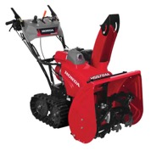
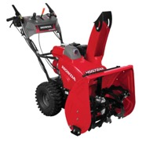
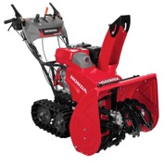
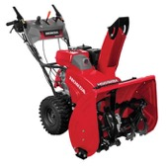
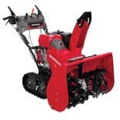
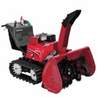
Honda – best snowblowers
https://powerequipment.honda.com/snowblowers
$3,300
$3,100
$3,700
$3,500
$4,100
$9,300
HSS724AT / HSS724ATD
Two stage 24"
Track drive (better)
adjustable auger height
24" wide
1500 lb./min
Throws snow 49 feet
Self propelled
hydrostatic drive
Electric start (ATD only)
HSS724AW / HSS724AWD
Same, but with Wheel drive
HSS928AT / HSS928ATD
Two stage 28"
Track drive (better)
adjustable auger height
28" wide
1900 lb./min
Throws snow 52 feet
Self propelled
hydrostatic drive
Electric start (ATD only)
HSS928AW / HSS928AWD
Same, but with Wheel drive
HSS1332AT / HSS1332ATD
Two stage 32"
Track drive
adjustable auger height
32" wide
2750 lb./min
Throws snow 56 feet
Self propelled
hydrostatic drive
Electric start (ATD only)
HSM1336i
Two stage 36"
Hybrid:
two electrical motors: drive
gas motor: auger+impeller
Mode:
Auto,
Semi-Auto
Manual
36" width
up to 3000 lb./min
Track drive
Electric start
Best Choice

Slide 3
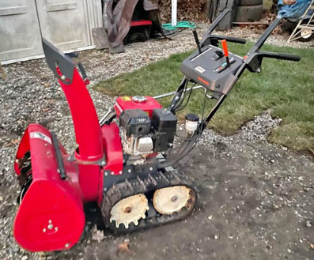
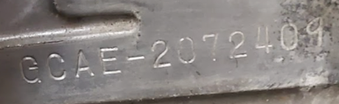
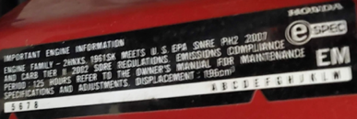
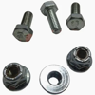
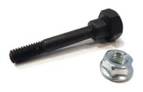
I bought used Honda HS724 in December 2022
Auger Belt - Spins the auger/fan
Part # 22432-736-A01
5/8" x 37" (LB-33)
Drive Belt - Moves the machine
Part # 22431-767-003
1/2" x 28" (SA-27)
Auger Shear Bolts (Quantity: 2 - left & right)
Size: 6mm x 16mm.
Part # 92101-06016-0A (Bolt)
Part # 90114-SA0-000 (Nut)
Blower (Impeller) Shear Bolt (Quantity: 1)
Located behind the auger on the impeller fan
Special 6mm bolt with a specific shoulder
(approx. 10mm diameter shoulder)
Part # 90102-732-010 (Bolt)
Part # 90114-SA0-000 (Nut)
Missing lamp/light.
The manual shows copyright year 2001.
Honda Engine Serial # GCAE-2072409
The label on the frame says that
it meets the US "EPA SNRE PH2 2007",
Does "2007" mean the year?
Missing lamp/light.
The manual shows copyright year 2001.
Honda Engine Serial # GCAE-2072409
The label on the frame says that
it meets the US "EPA SNRE PH2 2007",
Does "2007" mean the year?
Auger Shear Pins
We may install impeller kit which uses rubber pieces to attach to the blades to reduce the spacing between the impeller and the walls – thus preventing snow accumulation.
For each blade we get pre-cut rubber paddle, stainless backing plate, bolts, washers, nuts.
https://www.jackssmallengines.com/jacks-parts-lookup/manufacturer/honda/snow-blower
Impeller Shear Bolt

Slide 4
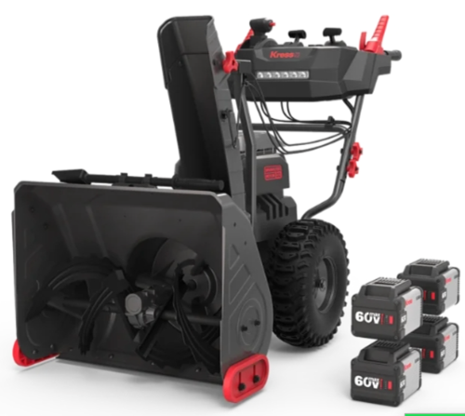
I bought this electric snowblower in Feb 2026
Kress KG471 professional-grade 60V battery-powered 2-stage snow blower

Slide 5
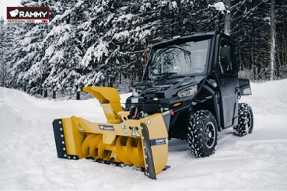
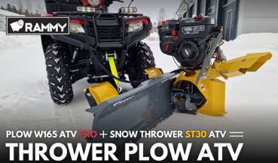
UTV Snow Blower
XUV590M width: 56.5" (144 cm)
==================================
Bercomac from Canada:
https://us.bercomac.com/en_US/taxons/category/snowblower?limit=27
Bercomac Versatile Plus 54" (20HP Honda engine) $7K
Bercomac Premium 54" (22-24HP Honda engine) $8,500
Bercomac Vantage 66" $8,500
==================================
Rammy from Finland:
Rammy 155 UTV PRO 61" (B&S engine, 13HP) $6,400
https://rammy.fi/en/rammy-snowblower-155-utv-pro-3/
==================================
Erskine 60" (SB300 Hydraulic model) - USA
https://erskineattachments.com/products/hydraulic-snowblower-sb300-series/
==================================
Also considered this ATV blade + snowblower combo: Rammy W165 Plow + ST30 Combo
Unfortunately it is only 118 cm (46") with ST30 mounted, which is much narrower than our gator (144 cm) – so we will not be able to advance through the field of snow.
Yes, it is not as heavy, but the difference in weight is only 30 kg.
W165 Plow + ST30 Combo - 120 kg total (plow 50kg + ST30 70kg)
Rammy 155 UTV PRO - 150 kg total (125 kg snowblower + 25kg frame)

Slide 6
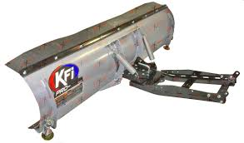
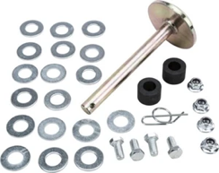
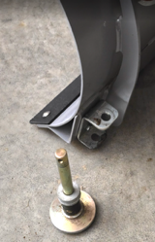
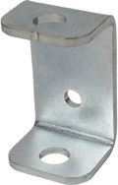
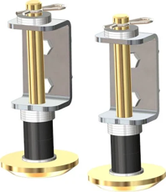

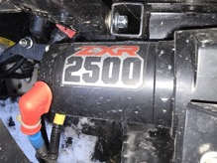
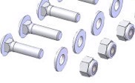
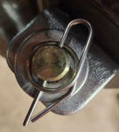
72-inch "KFI Plow" Snow Blade
standard plow shoes (skid feet)
part # kfi 105490:
Shoe (Base) Diameter - 3.5 inches
Shaft Diameter - 0.63 inches (approx. 5/8")
Pad Thickness 0.5 inches (1/2" Grade 50 Steel)
Total Bolt Length 6.5 inches
KFI Plow Foot Bracket 105006-R
Attached to the blade with two 3/8"-16 x 1.00" carriage bolts and two nuts.
The distance between bolts 1.75 inches center-to-center
Insalation:
https://www.youtube.com/watch?v=jcAqaNDId9k
Spring Locking Cotter Pin
ring cotter pin
clevis pin with a rue ring locking cotter pin
hairpin cotter pin
hairpin clip
R-clip
https://www.youtube.com/watch?v=TlP_BgXcdBk
Our winch is Badlands ZXR 2500 lbs with 50 ft 3/16 inch Synthetic Winch Line Cable Rope 8,350 LBs

Slide 7
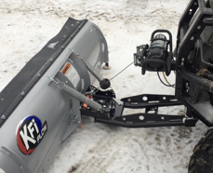
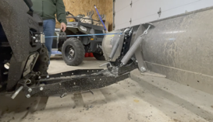
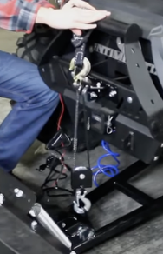
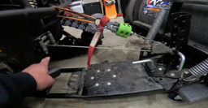
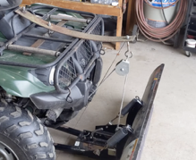
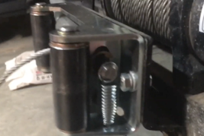
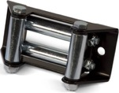
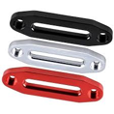
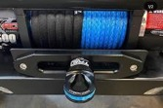
Solutions to prevent the winch and cable
from breaking when plowing
Better angle, brackets, pulleys
Solution 1.1 - mount the winch higher
- https://www.youtube.com/watch?v=walB-pyDaYE
or change the hook point:
- https://www.youtube.com/watch?v=QB3OdEiAtSg
Solution 1.2 - use brackets with blocks and pulleys
- https://www.youtube.com/watch?v=xptbCmz50AE
- https://www.youtube.com/watch?v=lIwT-UqNNQw
Prevent cable tangling
Solution 2.1 - use a spring to keep tension
Example - using leaf spring
- https://www.youtube.com/watch?v=MSzYsjSwWq0
Example - commercial tensioner
- https://www.youtube.com/watch?v=JiPT2l71U3U
- https://zips.com/products/winches-cables/winch-parts/winch-tensioners
Solution 2.2 - use a synthetic rope or flat tow strap instead of the metal cable.
Use a "roller fairlead" for synthetic line, or use "hawse fairlead" for flat strap to avoid tangling
- https://www.youtube.com/watch?v=b4dRQ-H7ffM
- https://www.youtube.com/watch?v=oim648rsuI8

Slide 8
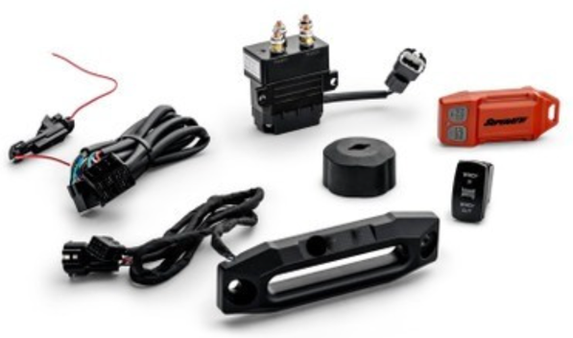
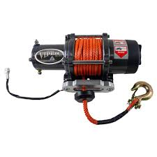
Polaris Ranger UTV Winch
Auto-Stop Fairlead Kit
by SuperATV
$223
https://www.everythingpolarisranger.com/polaris-ranger-utv-winch-auto-stop-fairlead-kit-by-superatv/
A plastic stopper cylinder is put onto the cable.
When the stopper approaches and touches the mouth of the fairlead, the winch shuts off

Slide 9




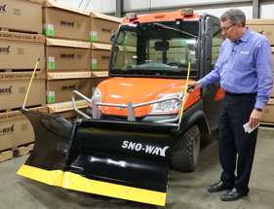
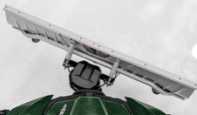
72" Snow Blade $1,800 - current
Western IMPACT UTV V-Plow is the best choice because it explicitly includes back drag.
But it costs $4K+
DENALI Hydro-Turn System
http://motoalliance.com/denali-snow-plow-hydroturn-with-joystick
-----
Hydraulic Angle Control Systems
Western Impact Mid-Duty and HD Series: 72" HD V-Blade
https://www.tricountyequipment.net/new-equipment/residential/tractor-packages/gator-snow-packages/xuv835r-and-western-impact-hd-v-blade/
-----
Blackline Solutions: Offers hydraulic electric lift and angle plow systems with simple joystick controls and down pressure with float functionality.
https://www.blackline-solutions.com
-----
SuperATV Plow Pro Angle Actuator: This electric actuator kit delivers 1,800 pounds of force and uses a rocker switch mounted in your cab. It provides 30 degrees of angle adjustment left or right of center and can be adjusted on the move
https://www.everythingdeeregator.com/john-deere-gator-plow-pro-utv-plow-angle-actuator-kit-by-superatv-hc-u-001-ejd
-----
Kolpin High Rise Power Angle: This electric system rotates the blade 56 degrees with dash or handlebar-mounted button controls. It uses a self-locking steel gear drive and installs in under 30 minutes with just 5 bolts
https://www.utvsource.com/kolpin-outdoors-high-rise-snow-plow-power-angle/
72" Western Impact HD Straight Blade
Back drag solutions:
Back Drag Blade Can-Am
https://can-am-shop.brp.com/off-road/us/en/back-drag-blade-can-am-715007794.htm
Western 66892 8 ft. Back Drag Edge
https://www.4qte.com/prd-583-western-66892-8-ft.-back-drag-edge
https://snoway.com – Sno-Way V-plow similar to Western

Slide 10
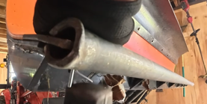
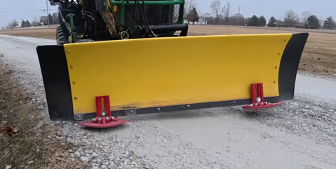
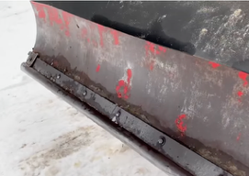
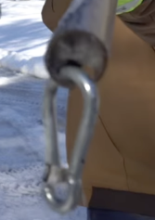
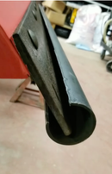
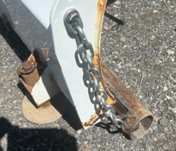
Snow Tamers
https://www.r2manufacturing.com
https://www.youtube.com/watch?v=5VuD0MhxcQ0
Plowing snow on gravel
Using tube at the bottom of the snow blade
https://www.youtube.com/watch?v=K8zB1X35QtI
He uses 1-3/8" galvanized steel fence top rail.
It is a galvanized steel pipe.
Sizes (diameter):
1 1/4"
1-3/8"
1 1/2"
In this video he used size 1-3/8"
Even better solution - replaceable :
https://www.youtube.com/watch?v=wCxOjqdGEjw
Yet another one ( steel pipe 2 in inner, 2 3/8 outer, and 3/16 thick):
https://www.youtube.com/watch?v=MVhIKQvNplc
Some people attach using chain
https://www.youtube.com/watch?v=ublecStrYAE
Yet another way to attach it.
He welds steel brackets with holes to the pipe that align with the plow's existing mounting bolts.

Slide 11

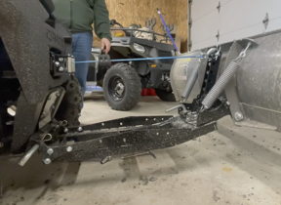




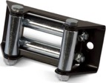
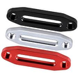
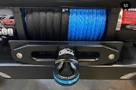
Solutions to prevent the winch and cable
from breaking when plowing
--------------------------------------------
Better angle, brackets, pulleys
Solution 1.1 - mount the winch higher. Or change the point where the hook attaches
Solution 1.2 - use brackets with blocks & pulleys
--------------------------------------------
Prevent cable tangling
Solution 2.1 - use a spring to keep tension. Or use a commercial tensioner
Solution 2.2 - use a synthetic rope or a flat tow strap instead of the metal cable
Solution 1.1 - mount the winch higher
https://www.youtube.com/watch?v=walB-pyDaYE
or change the hook point:
https://www.youtube.com/watch?v=QB3OdEiAtSg
Solution 2.1 - use a spring to keep tension
Example - using leaf spring
https://www.youtube.com/watch?v=MSzYsjSwWq0
Example - commercial tensioner
https://www.youtube.com/watch?v=JiPT2l71U3U
https://zips.com/products/winches-cables/winch-parts/winch-tensioners
Solution 1.2 - use brackets with blocks and pulleys
https://www.youtube.com/watch?v=xptbCmz50AE
https://www.youtube.com/watch?v=lIwT-UqNNQw
Solution 2.2 - use a synthetic rope or flat tow strap instead of the metal cable.
Use a "roller fairlead" for synthetic line, or use "hawse fairlead" for flat strap to avoid tangling
https://www.youtube.com/watch?v=b4dRQ-H7ffM
https://www.youtube.com/watch?v=oim648rsuI8

Slide 12
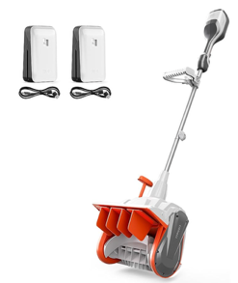
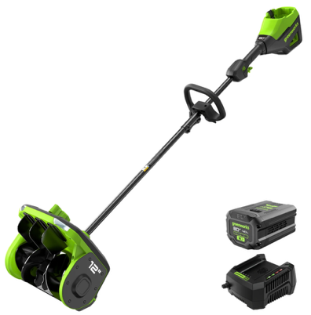
Snow Shovels
https://www.youtube.com/watch?v=M3OsMTyofe0 - video comparison
https://www.amazon.com/dp/B0G1YBMSVL - Litheli 40V (2×20V) Cordless Snow Shovel with Directional Plate & Adjustable Handle, 14-Inch
Greenworks
80V 12" Cordless Battery LED Snow Shovel
w/ 4.0Ah Battery & 6A Charger
https://www.greenworkstools.com/products/80v-12-cordless-battery-snow-shovel-w-4-0ah-battery-6a-charger
https://www.youtube.com/watch?v=0obvIOD0fKY
$252
► 3. EGO Power+ Electric Snow Shovel - https://geni.us/WBJ5A. -expensive
► 2. Toro 60V Power Shovel - https://geni.us/IYwEh - heavy
► 1. Greenworks 80V 12" Cordless Snow Shovel - https://geni.us/JMkppek

