Slide 1
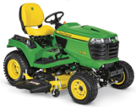
John Deere X758
X758 is a diesel-powered, full-time 4WD garden tractor
Built for heavy residential and estate use
24 hp (17.9 kW) liquid‑cooled Yanmar 993 cc 3‑cylinder diesel engine
K90 hydrostatic transmission
Twin‑Touch foot controls
Full-time four‑wheel drive
power steering
Internal wet disc brakes
Excellent traction and control on slopes and in snow
Supports 48", 54", and 60" mid‑mount mower decks
Optional front and rear PTO and 3‑point hitch for implements
Wheelbase is 54.5 in (138 cm)
Weight 1,030–1,040 lbs (tractor only)

Slide 2
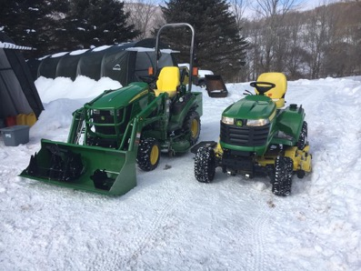
1025R vs X758
X700 series 4WD models: X738, X739, X758
https://www.deere.com/en/mowers/lawn-tractors/x700-series/
All accept mowing decks 48, 54, 60 inches
All have power lift - two-function hydraulic lift system to raise and lower attachments (mower decks, front blades, snow blowers, or rotary brooms)
Prices: $17..$19K
X738 4wd, gas, fuel injection, V-twin, power lift, 947 lbs
X739 4wd, gas, fuel injection, V-twin, power lift, 4-wheel steer
X758 4wd, diesel, power lift , 1,038 lbs
1025R vs X758
1,444 lbs 1,038 lbs
JD-425 2wd gas carburetor
JD-445 2wd gas fuel injection
JD-455 2wd diesel - link
--------- 4WD Diesel of Fuel Injection ----------
X585 – Gas EFI, 2002–2006 ($3K–$7K)
X595 – Diesel, 2002–2005 ($6K–$12K)
X728 – Gas EFI, 2006–2012 ($6K–$8K)
X729 – Gas EFI, 2006–2012 ($6K–$9K)
X738 – Gas EFI, 2013–present ($9K–$13K+)
X739 – Gas EFI, 2013–present ($10K–$14K+)
X748 – Diesel, 2006–2012 ($7K–$10K)
X749 – Diesel, 2008–2012 ($8K–$11K)
X758 – Diesel, 2013–present ($11K–$15K+)
Both have diesel engine.
X758 is a garden tractor (mowing, with optional 3-point hitch and PTO)
1025R is a true sub-compact utility tractor (loader, backhoe, ...), heavier

Slide 3
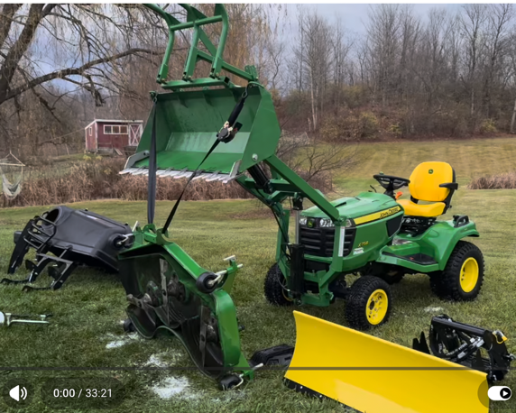
John Deere X758
Attachments: mower deck, snow plow, snow blower, snow broom, aerators, thatchers, material collection systems, utility carts, spreaders
https://www.youtube.com/watch?v=ymtZBvOIQdw
54-inch mowing deck - shaft driven (no belt)
Power Flow Bagger System (3 bags)
Little Buck Loader (Aftermarket, front-mounted)
Grapple - mechanically controlled (closes when the bucket is curled and opens when tilted)
Piranha Bar - A jagged tooth bar bolted to the bucket edge to improve digging in dirt and rock
54-inch Blade (snow plowing or pushing dirt/leaves)
Click-and-Go System - a bracket system that allows for very fast switching of rear attachments
(like the bagger or weight brackets) without a full 3-point hitch
Weights - used on the rear for traction
Spreader - a 125lb electronic spreader for salt, seed, or fertilizer
Tires - HDAP (Heavy-Duty All-Purpose) tires
Bulbs - change to LED (ebay)
The user "shimmed" the Implement Relief Valve to increase hydraulic pressure from roughly 1,000 PSI to 1,350 PSI to improve the lifting power of the loader
"Autoconnect" drive shaft for the deck is noisy and vibrate. Better swap it for a manual shaft connection for a smoother, quieter ride.
Note: It is possible to install the a CAT‑1 style hitch kit at the back. This will give ability to attach standard 3-point attachments, like a compact 3‑point log splitter powered by tractor’s hydraulics

Slide 4
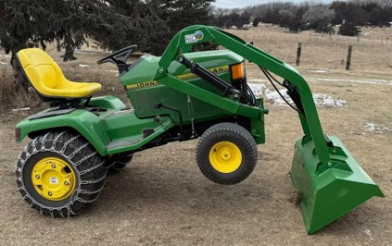
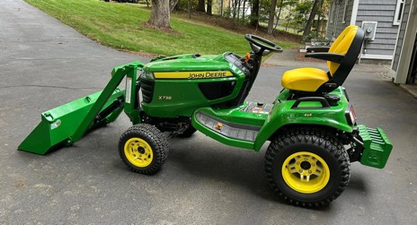
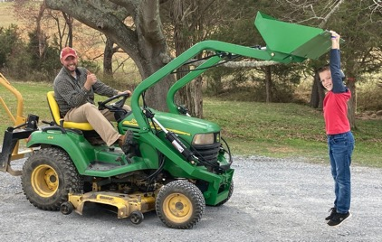
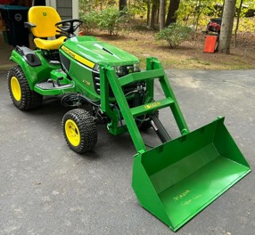



Little Buck Loader vs Little Bull Loader
 | Buck | Bull
Weight lbs | 200 | 300
Install time (min) | 2-3 | 5-10
Lift weight lbs | 340 | 440
Price | $2,300 | $3,300
AM134625 - Flow control valve - $283.36
Close for mowing, open for using FL
M146148 - neutral control rod - $50.73
https://www.littlebuckloader.com/shop/p/little-bull-loader-front-end-loader-john-deere
MIA885144 - Pressure relief valve (transaxle) - $465.71
https://shop.deere.com/us/product/MIA885144%3A-Pressure-Relief-Valve/p/MIA885144

Slide 5
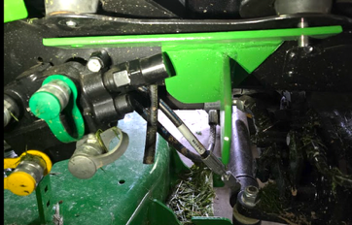
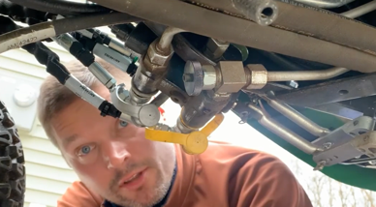
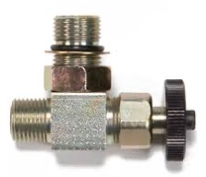
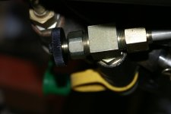
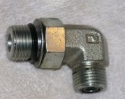
Little Buck Loader - valves
AM134625 valve use:
shut it off when using Front Loader so that oil doesn't go to mowing deck and rear. This makes FL tilt faster.
open it – then oil will go to the rear – and thus the Front Loader tilt will be slower
AM134625 installation instructions:
https://www.tractorbynet.com/forums/threads/x700-series-hydraulic-lock-out-valve-am134625-installation.228998/
https://www.youtube.com/watch?v=EIQnRFgVMG0
https://www.youtube.com/watch?v=iv3qfw-JJZk
https://www.youtube.com/watch?v=_6_KFG1wcUQ
The valve is installed right behind the 4 hydraulic ports on the right side. Specifically, behind the yellow hydraulic connector.
Installation requires removal of one elbow connector - and substituting it by the valve.
AM134625 - Flow control valve - $283.36
Close for mowing, open for using FL
M146148 - neutral control rod - $50.73
MIA885144 - Pressure relief valve (transaxle) - $465.71
https://shop.deere.com/us/product/MIA885144%3A-Pressure-Relief-Valve/p/MIA885144
A_black B_green - raising
D_Yellow E_silver - tilting

Slide 6
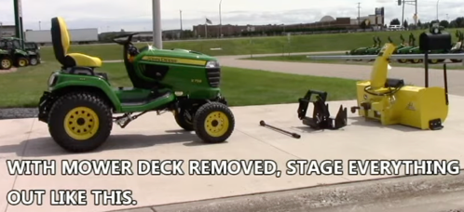
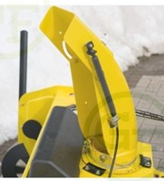
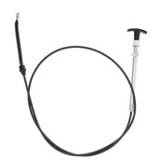
Snowblower Install
Here is a 5-min video step-by-step
https://www.youtube.com/watch?v=jAjLZqK2zy0
https://www.youtube.com/watch?v=6TV8WRo6v9M
Auger rotation – from shaft that used for mowing blades
Hydrolics – up/down, left/right
.. 02C2M, 54-in. (137-cm) Quick-Hitch Snow Blower, $3,525.00
.. 6940, Front quick-hitch, $731.00
.. 6838, Snow blower upstop and drive shaft, $318.00
.. 6890, 2000-rpm front PTO (4-wheel drive), $399.00
.. BM20960 – Remote Spout Cap Control Kit
Additional:
- Chute control option (electric vs. manual)
- Weight bracket + weights at the back
- Tire chains
- remote spout cap control kit

Slide 7
John Deere X758
21 modifications to X758:
https://www.youtube.com/watch?v=5bkI9KLGFZs
Snowblower Lights;
Chute Actuator (up/down);
Chute Rotator (more turning);
Enclosed Chain for impeller;
Rubber extensions for impeller;
Seat Cover;
Seat Heaters;
Heated Vest Plug;
Steering Wheel Ball (spinner);
LED Headlights;
LED Rear Lights;
Dash Light;
Custom Relay for Chute Switch
Throttle Spring to throttle lever to prevent it from backing down
Hazard Lights;
Pattern-Changing Hazard Switch;
USB Output & Voltmeter showing battery voltage;
Toolbox Handle;
Secondary Alternator (to handle electrical load of lights and heaters)
Bypass Modifications & Lubrication - 3 smaller sub-tweaks: bypassing the reverse implement option (RIO), bypassing the seat safety switch with a jumper, and using "Fluid Film" to stop pedal squeaks and prevent rust
Bonus/Technical Fix: - shimming the four-wheel steer transfer shaft with feeler gauges and adding a grease zert to eliminate "shimmy" in the rear wheels
I want BM20780 - a 7-bu (247-L) 2-Bag Hopper Assembly
(X400/X500 HDGT and X700 Series)
I don't like the JD 20-bushel Click-N-Go Material Collection System,
It is too heavy, requires weights at the front of the tractor for balance
My current bagger on JD-425 is 7-bu (two bags, each one is 3.5 bu) – I like it.
Deere lists for X700 Signature Series (including X758):
- a 7‑bu two‑bag Power Flow hopper – my preference
- a 14‑bu three‑bag hopper – I don't need 3 bags
The BM20780 7‑bu 2‑bag hopper is specifically
designed to mount to the rear Click‑N‑Go system BM20714
on X700‑series tractors, including the X758

Slide 8
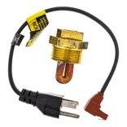
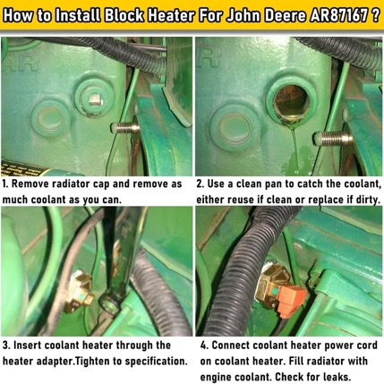
John Deere X758
What to do at low temperature: -20°C (-4°F):
Engine oil: use lower viscosity 0W-40 or 5W-40 synthetic diesel oil
Hydraulic fluid – use premium synthetic hydraulic fluids with cold-flow improvers.
Fuel Additives (anti-gel additives) – need to be added at temperatures below -12°C (10-15°F), they prevent wax crystals from sticking together, and disperse moisture to prevent ice formation in fuel filters.
John Deere Recommended its own Additive - John Deere Fuel-Protect Winter Formula (TY27786). It contains wax crystal modifiers that prevent fuel gelling by changing the shape and size of wax crystals as they form. This allows smaller crystals to pass through the fuel filter instead of clumping together and blocking flow.
The winter formula typically protects 15-20°F below the fuel's cloud point (which is 15-19F, so with additive we can go down to approx 0°F )
Products like Hot Shot's Secret Diesel Winter Anti-Gel or Archoil AR6300 can protect diesel fuel down to -40°F (-40°C) when used at every fill-up.
Important - the additives should be mixed with fuel before temperatures drop, as they cannot reverse gelling once it has already occurred.
K100 - is a premium all-in-one diesel fuel treatment and anti-gel additive that eliminates water in fuel systems and prevents fuel gelling in cold weather. The product chemically bond with water molecules, encapsulating them and allowing them to burn harmlessly through the engine rather than causing problems.
------------------------------------------------
Keep fuel tank full to reduce air space and reduce moisture condensation inside the tank which can freeze and cause additional fuel system blockages. The anti-gel additive should be added to the tank before filling so it mixes thoroughly with the incoming fuel.
Engine block heater – JD engine coolant heater (part number AR87167) requires an adapter kit (MIA881629) for installation on the X758 and should be plugged in for at least one hour before starting.
Replace fuel filters before cold weather arrives, as dirty filters trap moisture and accelerate gelling.
Engine Warm-Up - the X758 has glow plugs that warm the cylinders before starting. Turn the key to the "ON" position, wait for the glow plug indicator light (squiggly line) to go off before cranking the engine. Then let the tractor idle for several minutes to allow both the engine and hydraulic oil to warm up before operating implements or the power steering system under load
The warmth spreads through the entire engine via natural convection of the coolant. It takes 1-2 hours

Slide 9
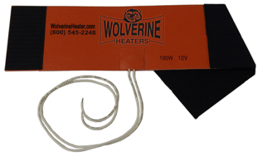
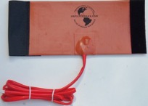
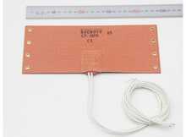
John Deere X758 – Fuel Filter Heater
ZeroStart 3400037 - 100W 12V flexible silicone wrap measuring 12" x 4", designed for fuel filter diameters between 3.5" and 5.0". It uses velcro/hook-and-loop straps to secure around the filter housing and connects directly to your 12V battery with a toggle switch (switch sold separately).
https://www.drivetrainamerica.com/3400037-zerostart-flexible-diesel-fuel-warmer-100w-120v-12-x-4/
US Filtermaxx Fuel Filter Heater - A thermostat-controlled 12V 100W wrap-around heater that fits most standard filters up to 4.5" diameter. The built-in thermostat is preset to 150°F and automatically regulates temperature, which prevents overheating without requiring manual monitoring https://usfiltermaxx.com/en/home/55--12-volt-fuel-and-oil-filter-heater-for-wvo-and-biodiesel.html
Keenovo Silicone Heating Pad - Available in various sizes with 12V 100W configurations, featuring built-in thermostats for over-heating protection. These use metal grommets for securing and can easily transfer between filters.
https://keenovo.store/products/keenovo-silicone-heating-pad-wvo-svo-fuel-filter-diesel-heater-nos-bottle-heater
The X758 fuel filter is mounted on the front of the engine, making it accessible for heater installation. Wire the heater to your 12V battery system through a toggle switch so you can activate it 15 minutes before starting on cold mornings. Position the switch conveniently on your dashboard or near the operator seat for easy access.

Slide 10
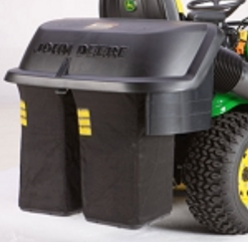
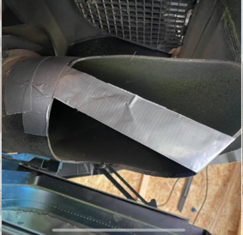
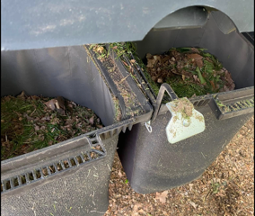
Bagger = Hopper
I have a bagger with 2 bags.
It has an annoying problem.
It fills the left bag first & only the over-flow goes to the right bag.
This makes the left bag heavy while right bag is empty
Easy fix – block part of the chute opening as shown.
Two layers of duct tape facing each other, nothing is sticking to them.
The 2 bags now got filled up at similar speed.
https://www.facebook.com/groups/781254733349946/posts/803478744460878/

Slide 11
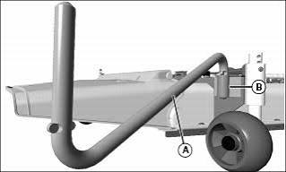
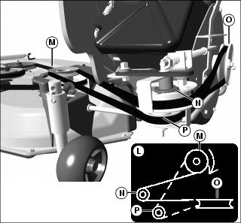
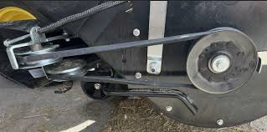
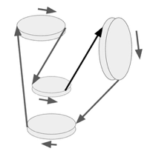
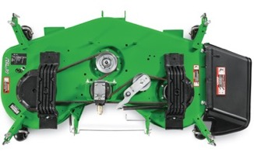
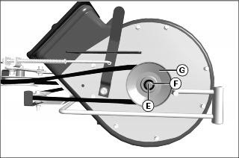
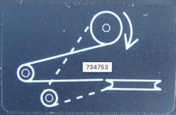
JD PowerFlow
john deere 54 inch high capacity mower deck with Power Flow attachment to throw grass to the back.
When looking at the mowing deck from above, the spools (sheaves) rotate clockwise (CW).
When looking from below – CCW (Counter-clockwise).
When looking at the Power Flow from the right side of the tractor (where the Power Flow is attached), the impeller rotates CW (clockwise) collecting grass from the bottom by moving from front to back – and throwing it to the back
There is a belt (a rubber loop) to pass rotation from the deck to the impeller. It goes from top sheave M on the deck (horizontal disk) to the (N) tensioner idler (top horizontal disk), then to the top side of impeller sheeve (O), then leaving from the bottom side of impeller sheeve (O) to the V-idler sheave P (the lower horizontal disk), and finally, back to the sheave M on the deck.
(N) — the tensioner idler — sits closer to the deck, and the belt contacts its back/flat side to maintain tension.
(P) — the V-idler sheave — sits on the return path from the blower (O) back to the deck sheave (M), guiding the belt in the V-groove. It is lower/closer to the blower on the return side.
In short: (N) is above/closer to the deck and acts as a tensioner; (P) is below/on the blower side and acts as a fixed V-groove guide
Note: when installing the power flow, the longer leg of the Z‑rod goes into the impeller (Power Flow) housing, and the shorter leg goes into the deck bracket

Slide 12
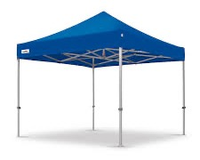
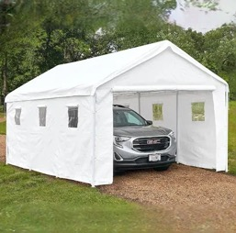
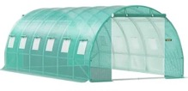
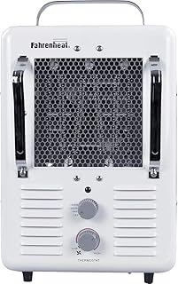
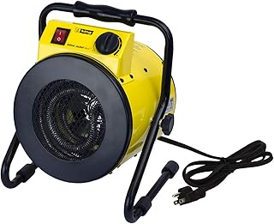
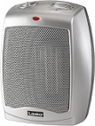
Heating Electric Charges, snow blowers, tractor
At cold weather electric charges have difficulty charging the batteries. And diesel tractor has difficulty starting.
Idea is to create an enclosure (12' x 6' x 6')
and warm equipment inside it.
This size is big enough (approx 4×2×2 meters) to fit a tractor with a snow blower. It can definitely fit a walk-behind snowblower and multiple electric chargers.
We can use a canopy, portable car shelter (garage) canopy, or a green house.
Or create a DIY construction - a light rectangular frame made of PVC tubes hanging above tractor, then hang tarp walls around the tractor (and put tarp on top)
Then push the hot air from a portable heater (with thermostat and overheat protection). For example:
King Electric PSH1215T Portable Utility Heater
QMark Portable Utility Heater (MMHD)
Lasko Ceramic Heater 754200

Slide 13
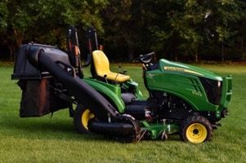
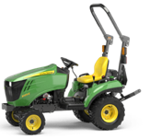

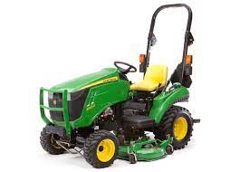
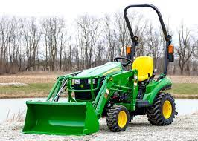
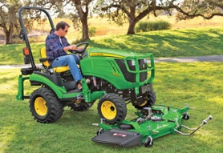
John Deere Sub-Compact Tractor
Prices in 2023:
1023E - $15,600.
1025R - $18,400
2025R - bigger wheels, longer, heavier)
https://www.deere.com/en/tractors/compact-tractors/1-series-sub-compact-tractors/1023e/
https://www.deere.com/en/tractors/compact-tractors/1-series-sub-compact-tractors/1025r/
https://www.youtube.com/watch?v=TeHIpRNJ3LU
Engine - diesel , 21.5 or 24 hp
PTO – 14.5 or 17.2 hp
weight: 610 kg or 654 kg
mower deck, 120R loader, ...
1025R is better – more PTO power, can use 3-point hitch implement, PTO precision handling, better seat, better steering
1025R base weight – 1,440 lbs
(compare with 805 lbs for jd-425)
Front loader
Quick attach
back counter-weight
mower platform + bagger
tires, dual-tires
additional hydraulics
Auto-connect mower platform

Slide 14
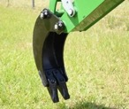
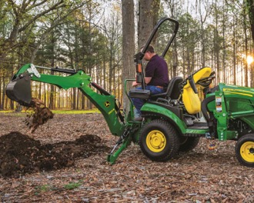
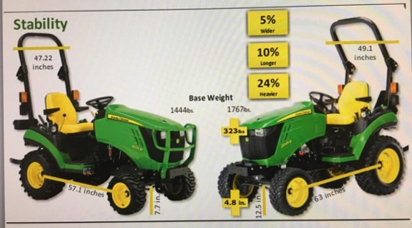
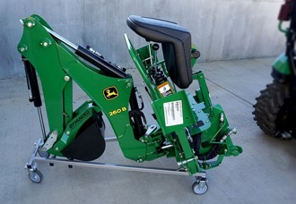
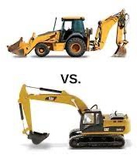
Backhoe 260b – use with 1025R
$6K
has its own seat
regular bucket, trenching bucket
trenching bucket
1025R vs 2025R
Wheeled Backhoe – smaller, lighter, more agile
Backhoe 260b – use with 1025R
Tracked Excavator - heavier duty, can dig more, father and deeper

Slide 15
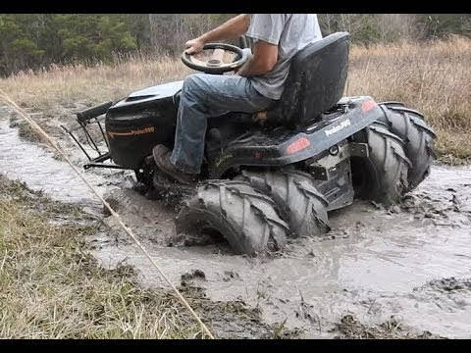
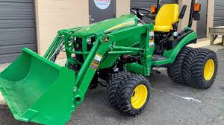
Dual Tires (Dualies)
https://www.youtube.com/watch?v=oDdR-KLIF-Q
Can potentially help in muddy conditions
Distribute the weight over a larger surface area, which can reduce ground pressure, thus preventing the tractor from sinking into soft or muddy ground
Increase traction since there are now twice the number of lugs (the raised patterns on a tire) making contact with the ground.
Downsides:
Added Weight
Turning Resistance
Cost and Installation
Wider Profile (harder to navigate)
Soil Compaction
Other solutions to consider:
tire chains
wider single tires

Slide 16
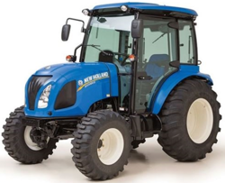
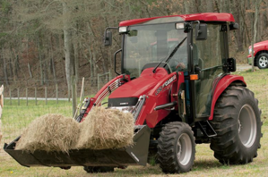

Other tractors with PTO $30-$50K
https://www.tractor.com/news/5-of-the-best-compact-tractor-choices/
Power Take-Off (PTO)
The tractor's stub shaft, often called the PTO,
rotates at 540 or 1000 rpm (9..17 times/sec)
and used to transfer power to external attachments.

