Slide 1
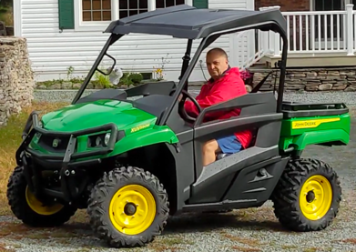
John Deere Gator UXV590M
This is not a tractor.
It is called Gator or "Side-by-side"
This specific model is UXV590M
UXV = Utility Crossover Vehicle
UTV = Utility Task Vehicle
October 8 - received basic John Deere Gator
XUV590M Power Steering Winch Ready
(Model Year 2023)
On Order For Future Installation:
.. Windshield + wiper
.. Ops Kit (OPS = Occupant Protection System) – lights & wires
.. Bumper (rear)
.. Snow Blade
.. Winch Kit
Tires:
26” Maxxis Bighorn 2.0 extreme terrain radial tires on 14” Yellow Steel Wheels
Pressure:
.. front: 14 PSI
.. rear: 32 PSI
Winch:
How To Get Your UTV unstuck in seconds - UTV winch basics https://www.youtube.com/watch?v=5BqKBDXpihM
Winching techniques beginners to Advanced https://www.youtube.com/watch?v=OXxLh8shMu8
Buying rear view mirrors on amazon:
The top bar and side bars are 1.75" diameter.

