Slide 1
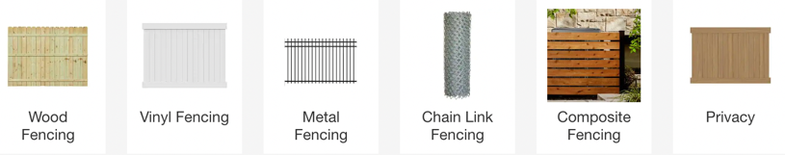
Fencing

Slide 2
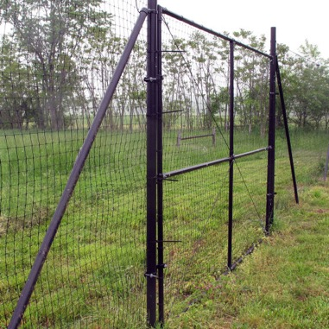
Fence Against Deer
https://www.deerbusters.com
Probably the most common deer fencing type, black mesh deer netting fastened to wooden 4x4s or metal t-bar garden posts is an effective way to keep deer out of the garden.
It must be at least eight feet tall to keep the deer from jumping over it.

Slide 3
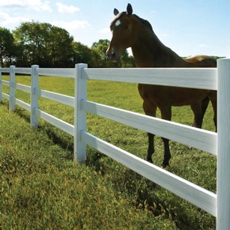
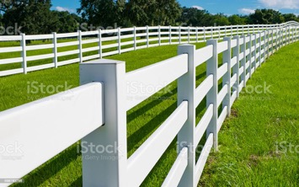
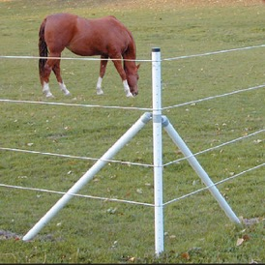
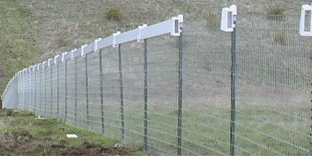
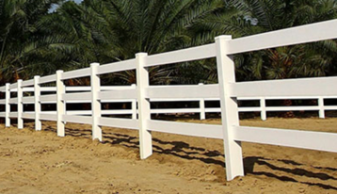
Fence for Horses – Vinyl, wood, metall
Horse Fencing using T-Posts

Slide 4
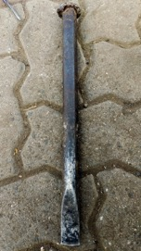
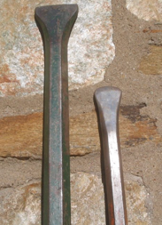
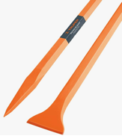
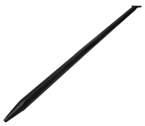
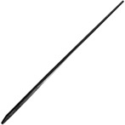
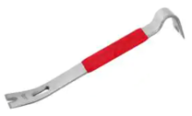
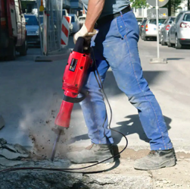

Digging Bar, Crow Bar, Truper Bap
Digging Bar:
Length: 72"
Width: 1" (or 2.5")
Weight > 30 lbs
Has a sharp pencil pointed end and a chisel edge.
Good for cutting and carving stone, concrete, metal and wood.
https://www.amazon.com/WESTWARD-Digging-Bar-Pencil-Point/dp/B07CSD7P4Z/
TRUPER BAP-150 San Angelo Bars 1"x 60"(150cm) 13Lb (6 Kg)
https://www.amazon.com/TRUPER-BAP-150-Angelo-Bars-150cm/dp/B00UY1RLKC/
True Temper 60"
Pinch Point Crow Bar
Digging Bar
Pry Bar
Wrecking Bar
Jackhammer

Slide 5


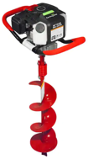
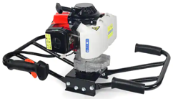

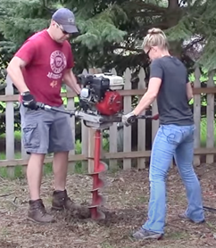
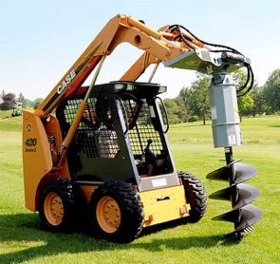
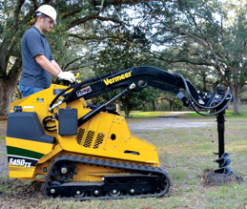
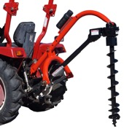
post hole digger
digging/tamper spud bar
to crush stones and roots
Example of holes: 10 inches wide x 43 inches deep
if the soil is too dry, drill just a little bit, then fill the small holes with water, wait a bit and then drill again to the bottom. It's much easier!
I use a 20 lb electric hammer with a digging bit, spud bar, and a manual post hole digger in the hard rock and clay here in Arizona... Works much faster than using one of those gas-powered augers
manual post hole digger to pull out pieces from the hole
43 cc Earth Auger Powerhead
with 8 in. Auger Bit
$284 at Home Depot
Reciprocating saw like the Milwaukee Sawzall
2-Man Auger
skid steer auger
mini skid steer auger
A 3-point post hole digger is called "3-point" because it connects to a tractor using a 3-point hitch system.

Slide 6
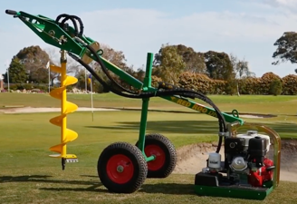
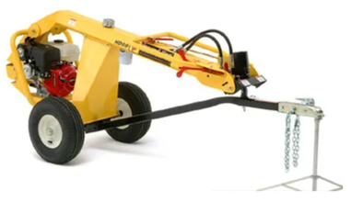
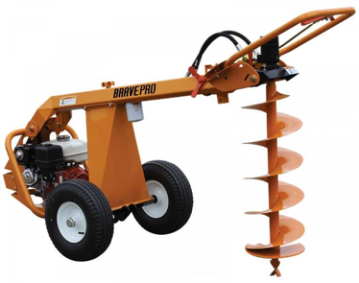
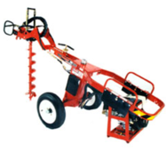
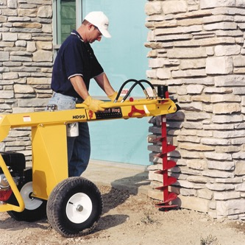
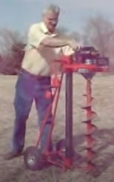
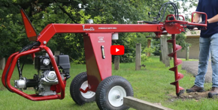
Ground Hog HD99 Hydraulic Earthdrill
BRAVE BRPA325H EARTH AUGER, TOWABLE, HYDRAULIC, GX270
$4,800
$4,700
Red Roo post hole digger 9hp
http://www.generalequip.com/product.php?prodid=15
EZ-Way Earth Drill ez-wayequipment.com

Slide 7
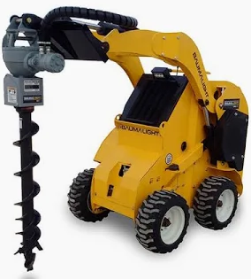
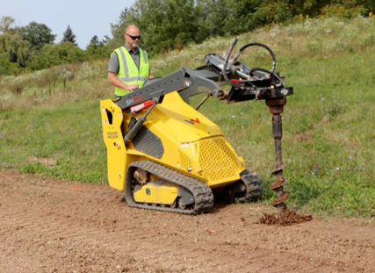
Baumalight Post Hole Auger Drive Unit Model RC442
$1,800
SM100 Track Loader by Wacker Neuson
$60,000

Slide 8
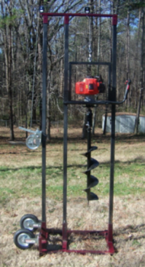
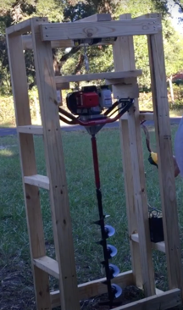
Drilling Auger, Post Hole Auger, Pier Foundation, faragedesignworks.com
https://www.youtube.com/watch?v=kOAWatK_7xQ
https://www.youtube.com/watch?v=R9YKKuNMq_s

Slide 9
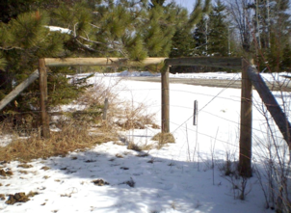
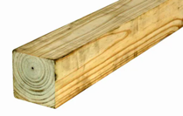
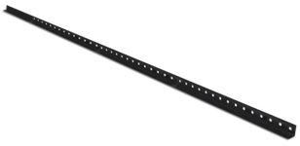
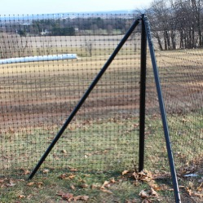
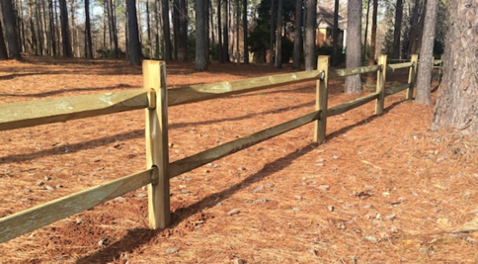
Poles
Severe Weather 3-3/4-in x 8-ft
Pressure Treated Pine Wood
Fence Flat-top Universal Post
Home Depot has 4x4 or 6x6 wooden posts 8', 10', and 12'
the 4"x4"x12' cost $23 each
https://www.deerbusters.com/posts-and-gates/
9' Angle Steel Posts
Corners
Severe Weather 4-in x 11-ft Pressure Treated Pine Wood Fence Top Rail

Slide 10
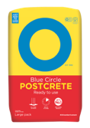
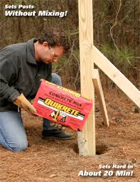
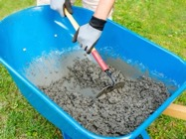
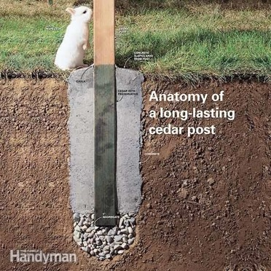
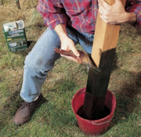

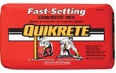
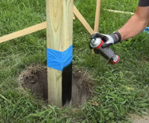
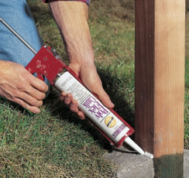
Setting up poles
regular concrete or QuickCrete, Blue Circle PostCrete, etc. 100 lbs per hole + water. can mix outside in a wheelbarrow (best), or you can pour dry with some water (or mix in the hole)
sika post fix foam
soak the bottom of the posts in a wood preservative containing copper napthanate, such as Cuprinol.
Example for QuickCrete :
25 posts * 100 lbs = 2,500 lbs
$8/100lbs, 25*8 = $200 total
Toyota Sienna max payload is 1,400 lbs (including driver)
Assuming we can drive 1,000 lbs, it will take us 3 trips
Or just one trip using a trailer (Toyota can tow 3,500 lbs)
QuickCrete (Fast-Setting Concrete Mix) is a blend of sand, gravel, and fast-setting cements.
It sets in ~ 20 min. But you don't have to wait. Once you fill the hole around the post, you don't have to stabilize it. You can immediately start working on another post.
Professionals do not stabilize the posts with external stabilizers - there is no need.
put ~ 6 inches of stones at the bottom
pour in the concrete, make it 2-3 inches above the soil level – to shape it with trowel - smooth and slope it so that water runs away from the post.
Seal the base with caulk - exterior acrylic latex caulk, or silicone specifically designed to adhere to concrete.
https://www.youtube.com/watch?v=elr7DukLChY
https://www.youtube.com/watch?v=CW3GDUznJPw
https://www.youtube.com/watch?v=pI-pCSxD0GY
https://www.youtube.com/watch?v=CCZBjkjP5CE

