Slide 1




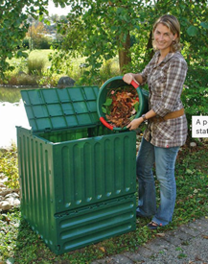


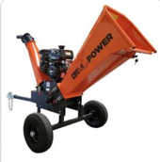
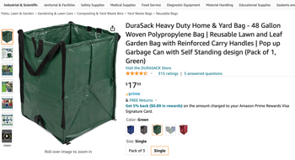

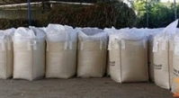

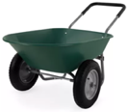

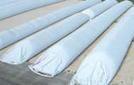

Silo Bags, Compost Bins
Silo bags
Compost Bins
Compost Starters/Accelerators
Wood Chipper
Wooden Compost Bin
using Pallets
Heavy Duty PE Bags
Trailer
Wheelbarrow

Slide 2
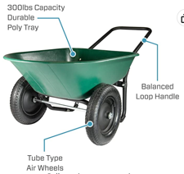
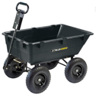
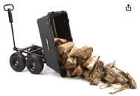
Wheelbarrow
Marathon Yard Rover – 2 Tire Wheelbarrow Garden Cart - $90 .. https://www.amazon.com/Marathon-Yard-Rover-Wheelbarrow-Garden/dp/B0721CX298/
Gorilla Carts GOR866D Heavy-Duty Garden Poly Dump Cart - $194 .. https://www.amazon.com/Gorilla-Carts-GOR866D-Heavy-Duty-Convertible/dp/B00B0C683K/

Slide 3
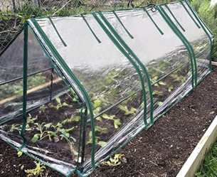
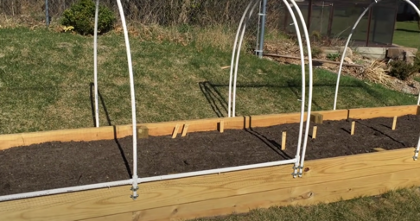
Грядка = Garden Bed
Quictent Waterproof UV Protected Reinforced Mini Cloche Greenhouse .. https://www.amazon.com/Quictent-Waterproof-Protected-Reinforced-Greenhouse/dp/B07SSS2K5M/
Easy and cheap – raised garden covers using plastic tubing as skeleton .. https://www.youtube.com/watch?v=yCoKPhr2r90 .. https://www.youtube.com/watch?v=x83ZwRHaDi4

Slide 4
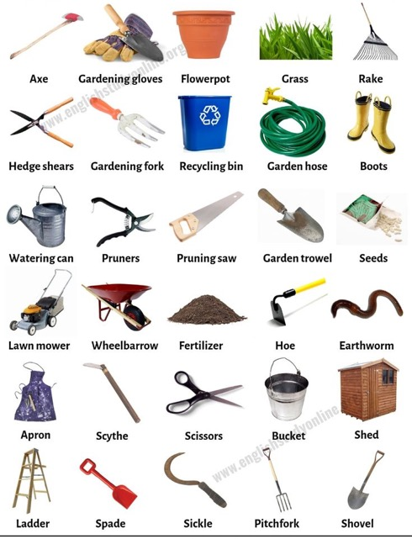
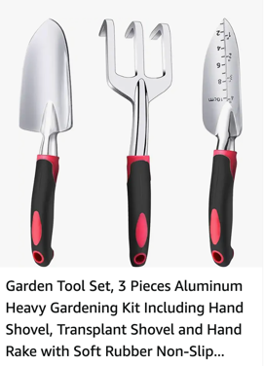
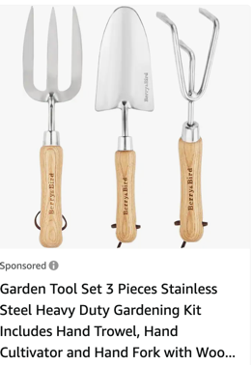

Slide 5
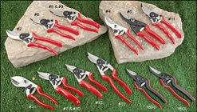


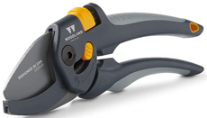
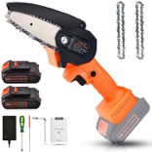
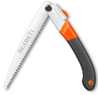

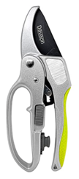
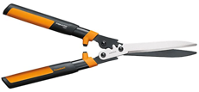
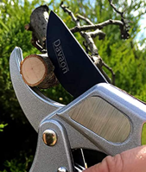
Pruner https://www.precisiontreemn.com/tips/5-must-have-pruning-tools.html
pruning shear - a garden tool to cut branches. There are three types: bypass, anvil, ratchets
Loppers - sheers with long handles (cut up to 2.5")
Pruning Saw - cut up to 5" branches
Pole (tree) Pruner - allows to reach high (8 ft) and cut branches up to 1.25". There are hand cutting and electric.
bypass pruner - cut soft branches & leaves. It has curved sharp blade and hook (like scissors).
Famous FELCO Pruners:
F2, F6, F15
Anvil pruners look similar to bypass pruners, has a sharp blade and a metal "pocket" that the blade crushes upon.
Mini Cordless Chainsaw Electric
Hedge Shears – to cut hedges, small shrubs, evergreens, or deadheading perennials
Rachet Shears – multiplies your hands’ power by up to 5 times, so you can cut through thick branches

Slide 6

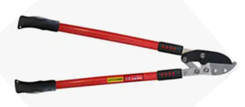
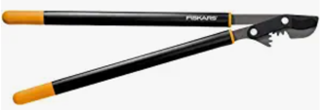
Loopers
Fiskars Ratchet Drive Anvil Lopper 27"
.. https://www.amazon.com/gp/product/B003BC79KS/
TABOR TOOLS GG12A Anvil Lopper 30"
.. https://www.amazon.com/dp/B01E5NQ2U4/
Fiskars-32-Inch-PowerGear-Bypass-Lopper 32"
.. https://www.amazon.com/dp/B00004SD74/

Slide 7
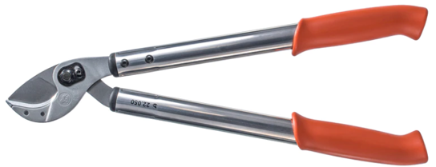
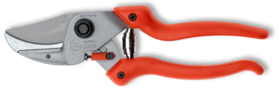
Best Hand Pruners
LÖWE 22.050 - 20"
LÖWE 22.080 - 32"
.. Very easy cuttings
.. Very robust and ideal for harder woods
.. Low-cost maintenance
.. https://farmerdresupply.com/products/anvil-loppers
$141.37
LÖWE 8.107 Anvil ergonomic pruner with curved blade
.. https://farmerdresupply.com/products/anvil-hand-pruner
$84.99

Slide 8
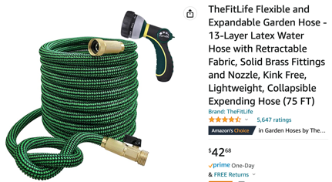
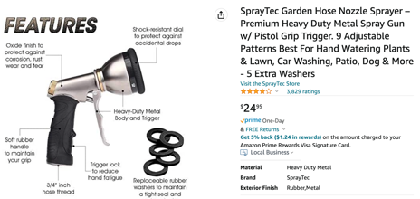
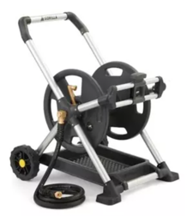
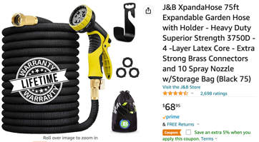

Garden Hose
Look for:
solid brass fittings (connectors) - 3/4 inch
heavy duty hose 75 ft
Shutoff valve
TheFitLife (expandable) .. https://www.amazon.com/dp/B083PQFW62
SprayTec Garden Hose Nozzle Sprayer .. https://www.amazon.com/dp/B00YQ73WBW/
Gorilla 175 ft. Aluminum Zero Rust MObile Hose Reel .. https://www.homedepot.com/p/Gorilla-175-ft-Aluminum-Zero-Rust-Mobile-Hose-Reel-GRS-175H/314448093
J&B XpandaHose (expandable) .. https://www.amazon.com/dp/B01MY4NI2D
Melnor Heavyweight Metal 7-Pattern Nozzle (Walmart, $23)

Slide 9

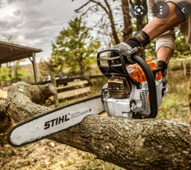
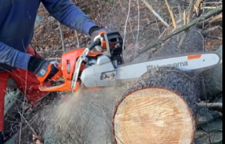
Chain Saw
Main two brands:
Husqvarna (preferred by professionals)
Stihl (dealer only, a bit chaper, less maintenance)
bar length: 16", 18", 20", ... , 28", ...
bar weight, steel, titanium, plastic inserts to reduce weight
chains:
chain pitch = distance between any 3 riverts – and divide by 2
chain gauge = width of the drivelink – same as bar
chain length (in drive lengths)
full-chisel vs semi-chisel (how teeth are bent)
Types of engines: gas, battery, corded
gas engines (cc = cubic centimeters)
Get two (50,70) or three (30,50,70):
30 cc =
50 cc = 3.9 HP
70 cc = 5HP
90 cc is too big
Cutting trees
Limbing – cutting off branches
Bucking – cutting delimbed tree into logs
log
Stihl
30cc: MS 170, 180 – limbing
50cc: MS 261 – great all around (Pro) (lighter, ...) $670, 18", 20"
50cc: MS 271 Farm Boss (cheap plastic) $470, 18", 20"
72cc: MS 462 – light (13 lbs), 16"-28", $1,100
Even bigger: 500i, 661
Husqvarna
30cc: 235 – small, similar to Stihl 180
50cc: 450 Rancher (or 455, 460)
50cc: 550 Mark ii. 16"-20" $670
70cc: 572 - new auto-tune type, 24", $1,100
390, 395 – for big trees
MS 261
550 Mark ii
bought July 10, 2022

