Slide 1
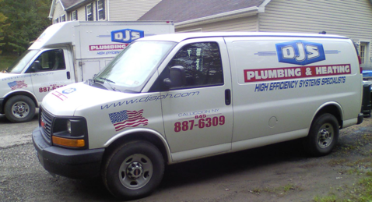
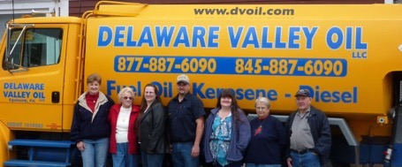
Oil - 550 Gallon Tank
Service?
Cleaning?
Delaware Valley Oil
http://dvoil.com
Phone (845)-887-6090
Office: M-F 8am-4pm
3 Bridge Street, Callicoon, NY 12723
P.O. Box 838 Callicoon NY 12723
Email delawarevalleyoilllc@yahoo.com
Email: LeanaStanton@aol.com
Owner: Casey Milk
Truck driver: Larry, Kevin
Brian
845-645-9403 cell
Plumber
(Boiler/Filter mainenance)
2022-07-06: 150 gal ($5.79/gal) 2022-11-22: 150 gal ($5.59/gal)
DJS Plumbing and Heating
Doug Santoro
(845) 887-6309 office
(845) ... mobile
email: djsph@hvc.rr.com
.. https://www.djsph.com
.. https://www.facebook.com/DJSPlumbingHeating/
.. 9 Del Vue Rd, Callicoon, NY 12723
.. 4-6 weeks waiting for scheduled service

Slide 2
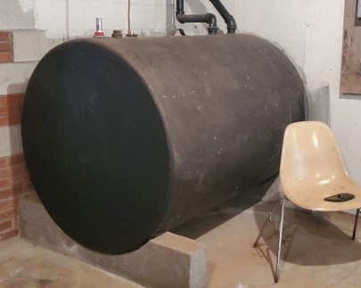
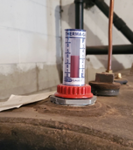
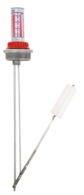
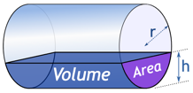

Oil Tank 48" diameter, 550 gal
inch | part | part | gals | inch | part | part | gals
1 | 0.02 |  | 3 | 25 | 0.52 |  | 290
2 | 0.04 |  | 8 | 26 | 0.54 |  | 304
3 | 0.06 |  | 14 | 27 | 0.56 |  | 319
4 | 0.08 |  | 22 | 28 | 0.58 |  | 333
5 | 0.10 |  | 30 | 29 | 0.60 |  | 347
6 | 0.13 | 1/8 | 40 | 30 | 0.63 | 5/8 | 362
7 | 0.15 |  | 50 | 31 | 0.65 |  | 376
8 | 0.17 |  | 60 | 32 | 0.67 |  | 390
9 | 0.19 |  | 71 | 33 | 0.69 |  | 403
10 | 0.21 |  | 83 | 34 | 0.71 |  | 417
11 | 0.23 |  | 95 | 35 | 0.73 |  | 430
12 | 0.25 | 1/4 | 108 | 36 | 0.75 | 3/4 | 442
13 | 0.27 |  | 120 | 37 | 0.77 |  | 455
14 | 0.29 |  | 133 | 38 | 0.79 |  | 467
15 | 0.31 |  | 147 | 39 | 0.81 |  | 479
16 | 0.33 |  | 160 | 40 | 0.83 |  | 490
17 | 0.35 |  | 174 | 41 | 0.85 |  | 500
18 | 0.38 | 3/8 | 188 | 42 | 0.88 | 7/8 | 510
19 | 0.40 |  | 203 | 43 | 0.90 |  | 520
20 | 0.42 |  | 217 | 44 | 0.92 |  | 528
21 | 0.44 |  | 231 | 45 | 0.94 |  | 536
22 | 0.46 |  | 246 | 46 | 0.96 |  | 542
23 | 0.48 |  | 260 | 47 | 0.98 |  | 547
24 | 0.50 | 1/2 | 275 | 48 | 1.00 | "1" | 550
Calculator:
https://www.mathsisfun.com/geometry/cylinder-horizontal-volume.html
Krueger Sentry Therma Tank Gauge
https://www.jmesales.com/krueger-sentry-type-h-2-in-galvanized-therma-tank-gauge/

Slide 3
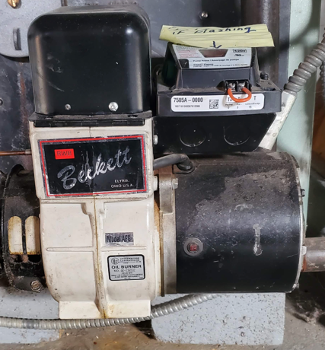

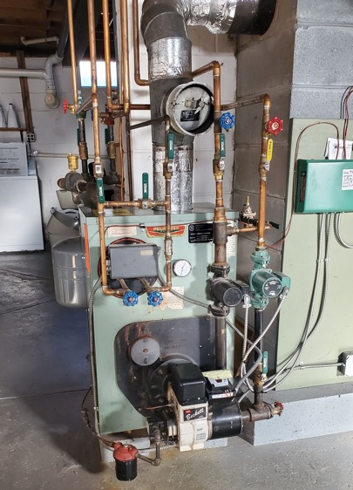
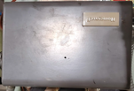
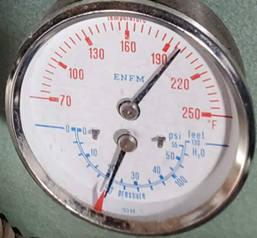
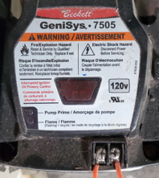
Peerless Boiler
https://www.peerlessboilers.com
https://www.youtube.com/watch?v=5GbXgEYw5TE
xxx
Honeywell boiler aquastat (thermostat)
sends "more heat" signal
to 7505 burner control unit
Specific model 7505A
Beckett GeniSys™ 7505 oil burner control https://www.beckettcorp.com/product/genisys-7505-oil-burner-control/
used with a suitable cad cell flame sensor to control the oil burner motor, igniter, and optional solenoid valve
has 24 VAC thermostat terminals
can provide interrupted or intermittent duty ignition, and it has a 15 second lockout time

Slide 4
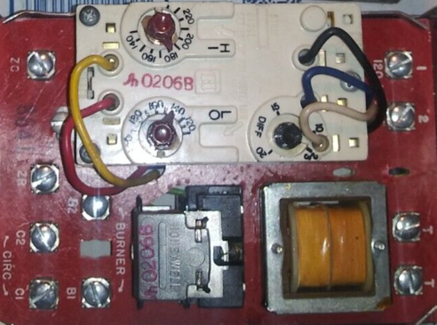
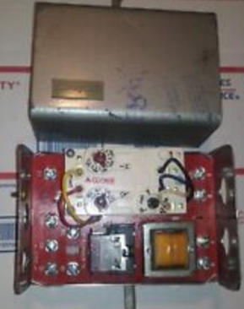
Honeywell Aquastat
Pictures from internet
Maybe different model
$120

Slide 5
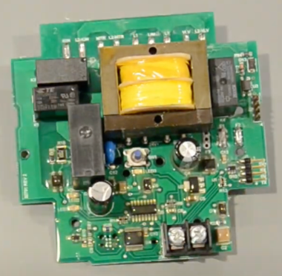
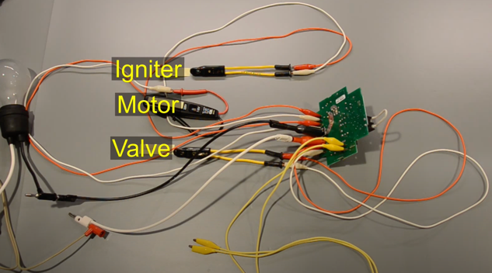
Troubleshooting Genisys 7505
Google for:
Genisys 7505 won't start after power outage
Video troubleshooting the 7505
.. https://www.youtube.com/watch?v=Wd7vrkUDaz4
Checks for flame presence
Ignites – and checks that it is ignited
reacts to signal "more heat" to start/stop blower (and shut off the valve)

Slide 6
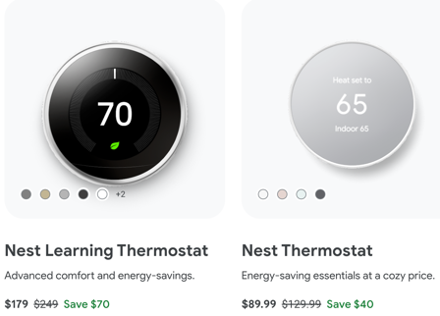

Google Nest
Google Nest Thermostat:
.. https://store.google.com/us/product/nest_thermostat
Nest Wifi requires a Nest Wifi router (or Google WiFi)
Latest - Nest Wifi Pro router ($200)
The devices are controlled using Google Home App
https://www.cnet.com/home/internet/nest-wifi-vs-nest-wifi-pro-wi-fi-6e-mesh-routers/

