Slide 1
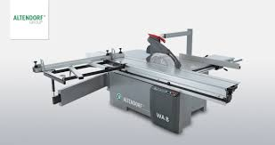

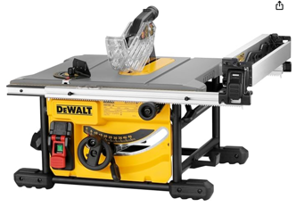
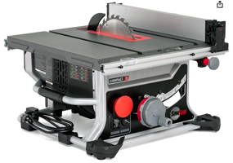
Table Saw
Sliding Table Saw (European)
DEWALT Table Saw for Jobsites, 8-1/4 Inch, 15 Amp (DWE7485)
SawStop CTS-120A60 Compact Table Saw - 15A,120V,60Hz

