Slide 1
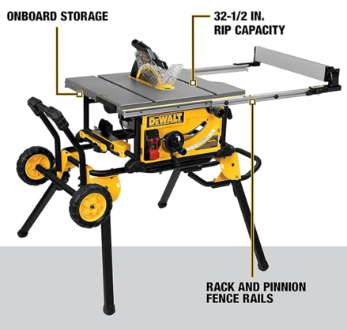
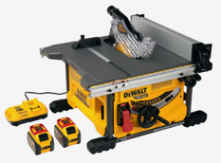
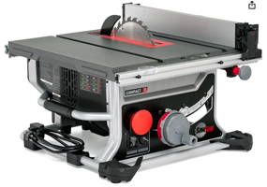

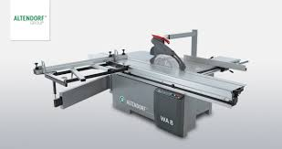
Table Saw
DEWALT DWE7491RS
10-Inch Table Saw, 32-1/2-Inch Rip Capacity
$550 on amazon
DEWALT 60V MAX Table Saw DCS7485T1-EB
8-1/4-Inch blade
$420 on amazon (batteries and charger sold separately)
Sliding Table Saw (European)
SawStop CTS-120A60 Compact Table Saw - 15A,120V,60Hz
$900 on amazon

