Slide 1
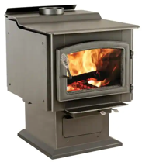
Wood Burning Stove
Our property ~3K sqft (2K livable+1K basement). Suitable model at Home Depot: Ashley Hearth 3200 (number "3200" means "area 32000 sqft")
It is very good, has window to look at fire, big (accepts 22" logs)
In Canada they like another brand - "DROLET": .. https://www.drolet.ca/en/products/stoves/
Other examples: .. https://www.popularmechanics.com/home/g37791189/best-wood-stoves/
Many stores, for example: .. https://myfireplaceproducts.com/us_en/ht-3000-wood-stove-db07300
==============================
Installation cost typically $1,000 - $3000 (depends on how much ventilation work is needed) .. https://homeguide.com/costs/wood-stove-installation-cost .. https://www.houzz.com/cost/70-wood-stove-installation-cost
Ashley Hearth 3200
Model: AW3200E-P
$2,255 AT HOME DEPOT
(plus 200 tax, 100 delivery, 2,000 install) Total - $4,600
Heating Area: 3,200 sq. ft.
BTU: 152,000
Weight: 400 pounds
Max Log Length: 22 inches Non-catalytic
https://www.homedepot.com/p/Ashley-Hearth-Products-3-200-sq-ft-EPA-Certified-Pedestal-Wood-Burning-Stove-with-Blower-AW3200E-P/313742319

Slide 2
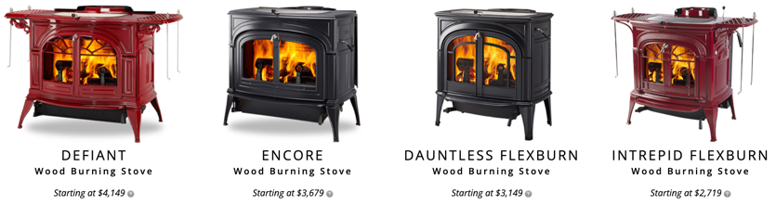
Learn more about Wood Burning Stoves
Five Best Wood Burning Stoves - https://www.youtube.com/watch?v=Df-sVM-hxrE
Cast Iron Vs Steel Wood Burning stoves - https://www.youtube.com/watch?v=yPtVhpHXg0E
Catalytic vs Non Catalytic Wood Stove - https://www.youtube.com/watch?v=_DajfQQN7qM A catalytic combustor = metal grid with special catalytic coating that helps to re-burn the gasses and particulates. It increases efficiency, fewer emissions, longer burn times (30+ hrs)
How to Run an Overnight Burn - https://www.youtube.com/watch?v=5oledpf2ocU
Stove Fans - https://www.youtube.com/watch?v=Zd-93HLnkb4
Woodstove DIY - https://www.youtube.com/watch?v=6uuhrdmfnqo
3 ways I improved efficiency - https://www.youtube.com/watch?v=iGZWx0gwRCo
Vermont Castings wood stoves - https://www.youtube.com/watch?v=IqJehn5mb9k

